Slide 1
Posterior Cruciate Ligament Injuries
Ian S Rice MD

Slide 2
Outline
Epidemiology
Anatomy
Biomechanics
Mechanism of Injury
Evaluation/Imaging
Injury Classification
Treatment

Slide 3
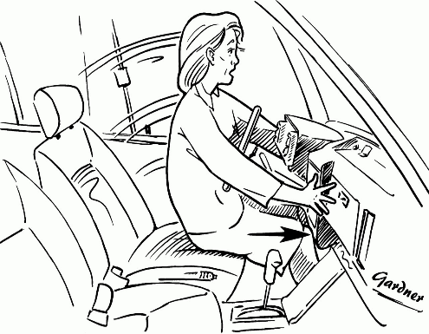
Epidemiology of PCL injuries
Relatively uncommon, 5-10% of all knee ligament injuries
Under-reported as mostly asymptomatic
Usually with associated injuries (60%)
  PCL + PLC (most common)
  PCL + ACL
  PCL + MCL
  can have meniscus tears (16-28%) in acute and up to 36% in chronic PCL.

Slide 4
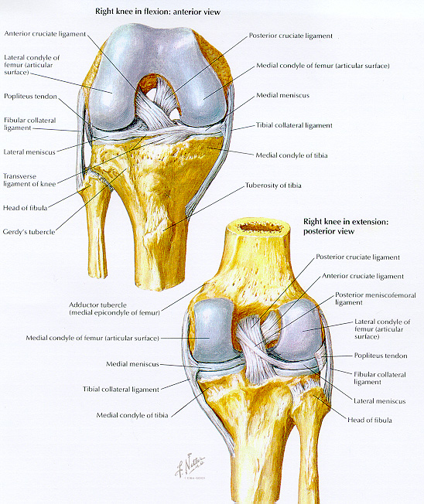
PCL Anatomy
originates from the inner surface of the medial femoral condyle and runs inferior and posterior to insert on the posterior intercondylar fossa of the tibial plateau
intra-articular but extrasynovial
2 parts: larger anterolateral (AL) bundle and a posteromedial (PM) bundle
The AL bundle of the PCL has a greater linear stiffness and elastic modulus than the PM bundle.
The cross-sectional area of the PCL increases as it extends from its tibial to its femoral insertions.
The insertion site of the PCL is 3.5 times greater than the diameter of the ligament's midsubstance.
The PCL has larger collagen fibrils proximally, making it capable of withstanding more stress
The PCL complex consists of the lateral meniscus and the ligaments of Humphrey and Wrisberg.
intimately linked to the PLC
Notes:
originates from the inner surface of the medial femoral epicondyle and runs downward and backward to insert on the posterior intercondylar fossa of the tibial plateau.
intra-articular but extrasynovial, blending in with the posterior capsule.
2 parts: anterolateral (AL) bundle and a posteromedial (PM) bundle
The AL bundle of the PCL has a greater linear stiffness and elastic modulus than the PM bundle.
The cross-sectional area of the PCL increases as it extends from its tibial to its femoral insertions.
The insertion site of the PCL is 3.5 times greater than the diameter of the ligament's midsubstance.
The PCL has larger collagen fibrils proximally, making it capable of withstanding more stress
The PCL complex consists of the lateral meniscus and the ligaments of Humphrey and Wrisberg.
The PCL is intimately linked to the posterolateral corner of the knee
• The PCL is intra-articular but extra-synovial and
averages 38 mm in length and 13 mm in width.
• Fan-shaped structure, narrowest at its midportion and
widest at its origin on the MFC (32mm in AP diameter).
• Compact insertion on the posterior tibial shelf, which is
just posterior and 1 cm distal to the tibial plateau.
• Located near the longitudinal axis of rotation, just
medial to the center of the knee.

Slide 5
Femoral Insertion
Fun Facts
AL bundle larger
Broad relatively verticle footprint
Average footprint 209 mm²
AL bundle 118 mm²
PM 90 mm²
Medial bifurcate ridge b/w 2 bundles (50% specimens.)
Meniscofemoral ligaments consist of 17.2% of the area of PCL complex and are variably present in 90% of specimens.
Lopes, et. Al. 20 human cadaver knees.

Slide 6
Tibial Insertion
Fun Facts
More consistent insertion than femoral side.
Matava, recommends the center of tibial tunnel be 7 mm anterior to the posterior tibial cortex.
Placement too posterior or inferior fails to reproduce normal PCL anatomy and risks NV bundle. Creates KILLER TURN.
Notes:
On the tibial insertion site, the 2 bundles insert without anatomic separation in a centrally located facet on the posterior tibia approx 1-1.5 cm distal to the joint line

Slide 7
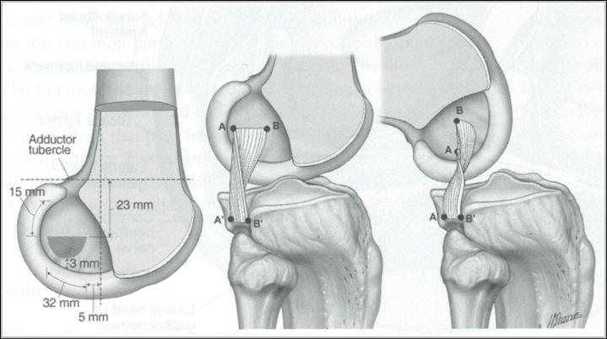
Biomechanics
Restraint to posterior tibial translation (95% at 90 degrees); contribution increases as knee flexion increases
AL bundle: tight in flexion and helps prevent posterior tibial translation when the knee is flexed.
PM bundle: tight in extension and helps prevent posterior translation when the knee is near full extension.
In conjunction with the PLC, the PCL acts to resist posterior translation, external rotation, and varus rotation.
The PCL and PLC together help to lessen patellofemoral and medial compartment joint contact pressures.

Slide 8
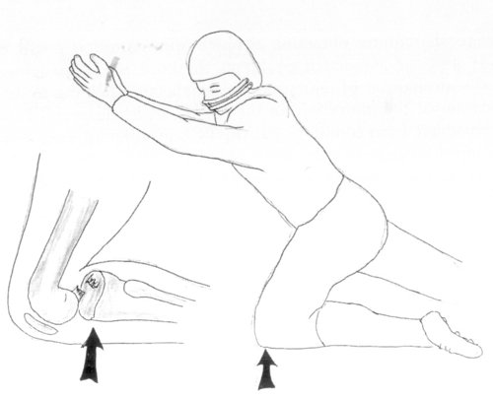
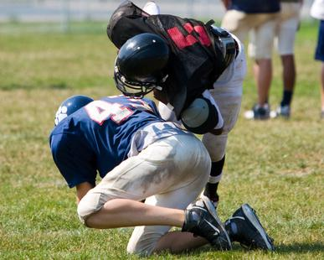
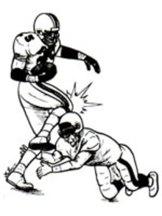
Mechanism of Injury
posteriorly directed force on the proximal tibia with flexed knee
  MVA (50%)
  Sports (40%)
  Other (10%)
in the athlete: fall on a hyperflexed knee with the foot in plantar flexion – most common mech for isolated PCL injuries
PCL and posterior capsule can also be torn by a hyperextension mechanism
Notes:
most common: high-velocity, posteriorly directed force on the proximal tibia when the knee is flexed (MVA, flexed knee on dashboard) – with associated ligament injuries
in the athlete: fall on a hyperflexed knee with the foot in plantar flexion – most common mech for isolated PCL injuries
PCL and posterior capsule can also be torn by a hyperextension mechanism

Slide 9
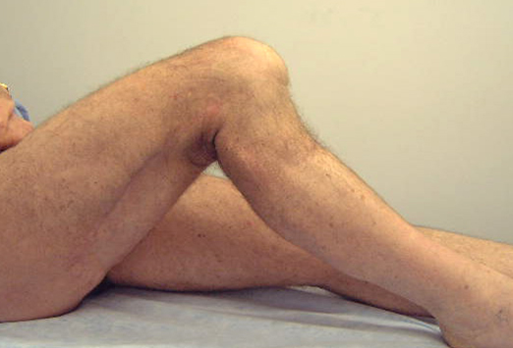
Clinical Evaluation
History, mechanism
Limp, difficulty walking down inclines
disability>instability
Knee exam
  Swelling, effusion
  Ecchymosis
  Posterior TTP
  10-20 deg flexion lag
  Knee aspiration may yield hemarthrosis
Check neurovascular status
  Varus stress, and conomitant PLC injury can place neuropraxia on Peroneal Nerve.

Slide 10
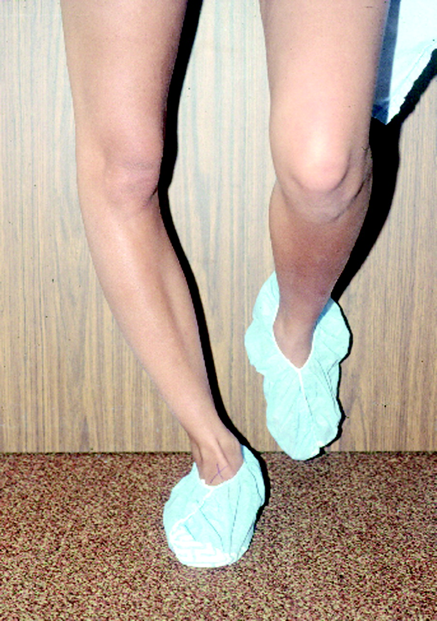
Gait Examination
Watch them walk
Hyperextension varus thrust gait
Medial compartment narrows, lateral compartment enlarges
Indicates posterolateral instability
Patellofemoral and medial compartment see highest joint stress

Slide 11
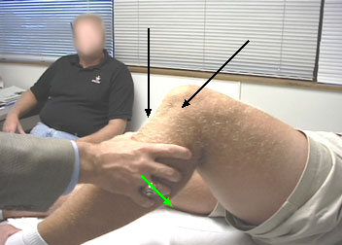
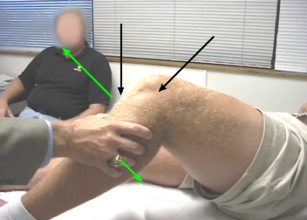
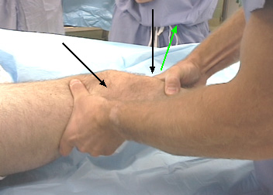
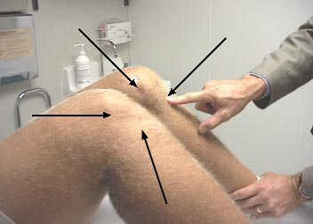
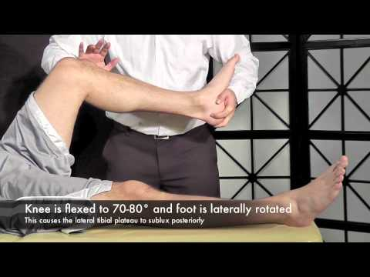
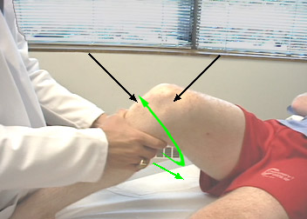
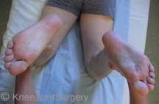
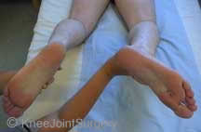
H & P
Physical Exam
  Dial Test →
    PLC and PCL
  Posterolateral external rotation test →
    PLC
  Posterior Drawer Test →
    PCL
  Varus stress Test →
    LCL +/- PLC (at 30 deg)
  Quadriceps Active Test & posterior sag →
    PCL
  Reverse pivot shift→
    PCL
  Gait exam →
    PCL and PLC
  Ext Rotation Recurvatum →
    PCL
  ROM, NV exam, effusion (acute vs. chronic), lachmans, anterior drawer, meniscal exams, patellar grind.

Slide 12
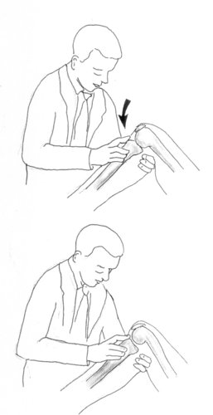
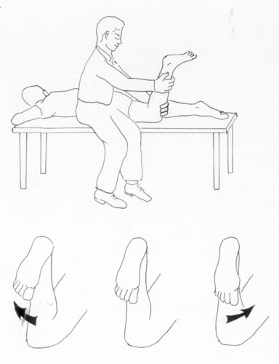
Evaluation/Diagnosis
Posterior Drawer Test
most sensitive and specific
knee flexed to 90° and the hip flexed to 45°. A posteriorly directed force is exerted on the proximal tibia.
  Grade I: 0 to 5 mm posterior displacement of the tibia on the femur
  Grade II: 5 to 10 mm; tibial condyles are at same level as femoral condyles
  Grade III: >10 mm; usually combined ligamentous injury
Notes:
Prone posterior drawer test. With the patient prone and the knee flexed to 90°, a posteriorly directed force is applied on the tibia. With a PCL deficiency, this will result in posterior subluxation of the tibia and deviation of the foot toward the side of the capsular injury.

Slide 13
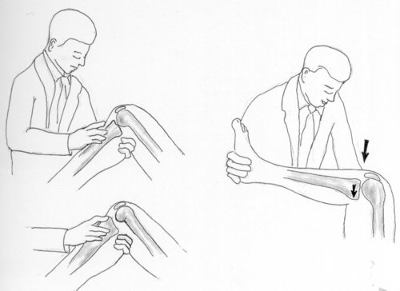
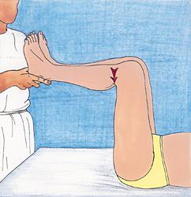
Evaluation/Diagnosis
Posterior Sag Test (Godfrey’s test)
patient supine, knee and hip flexed to 90°
the anterior contour of the patella tendon and tibia are observed
normal knee: the anterior tibial surface is approximately 1 cm anterior to the femoral surface
79% sensitivity, 100% specificity (Rubistein et al).
Notes:
Posterior sag test (Godfrey's test). With a PCL injury, gravity causes posterior subluxation of the tibia relative to the femur, giving the patella tendon a concave appearance compared with the contralateral side.
With posterior subluxation of the tibia, the patella tendon will appear concave and the prominence of the tibial tubercle will be decreased. The posterior sag should be checked in both internal and external rotation and compared with the contralateral leg.

Slide 14
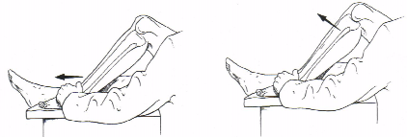
Evaluation/Diagnosis
Quadriceps Active Test
supine position with knee flexed, foot flat
quadriceps neutral angle between 60° and 90° of knee flexion, no anterior or posterior shift of the tibia with isometric quadriceps contraction
If (+)PCL tear -> visible and palpable anterior shift of the tibia (>2mm) with active contraction of the quadriceps muscle.
54% sensitivity and 97% sensitivity (Rubistein et al).
Notes:
Quadriceps active test. In a PCL-deficient knee, contraction of the quadriceps tendon causes reduction of the posterior tibial sag.

Slide 15
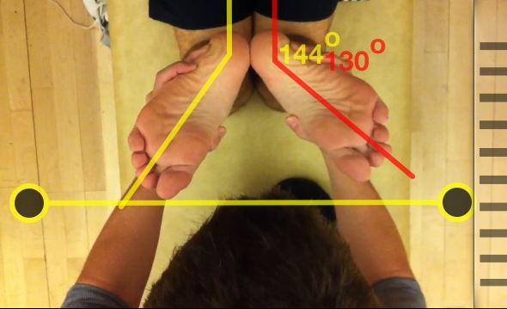
Evaluation/Diagnosis
Concomitant evaluation:
Dial Test
  Prone or supine position, prone no assistant.
  ER lower legs at 30 degrees → PLC
    If tibial tuberosity > 10-15 degrees over contralateral.
  ER lower legs at 90 degrees → PCL
    If “further” increase in ER then PCL associated.

Slide 16
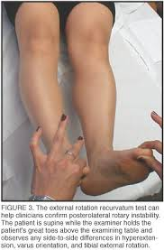
Concomitant exams for PLC (found in 60% cases)
Posterolateral Drawer Test
Posterior drawer in 15 deg ER
Popliteus or politeofibular ligament inj
External rotation recurvatum test
Hyperextension and into varus if postitve
Reverse Pivot Shift Test
Supine knee at 70-80 deg with foot ER
PLC inj → posterior subluxation, spontaneously reduces as extend to 20 deg flexion. (cooper er al, + in 35% of normal knees)

Slide 17
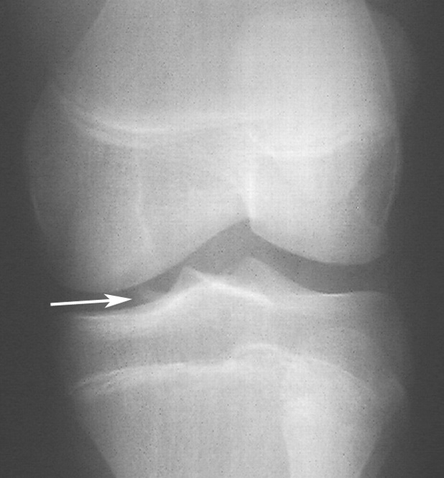
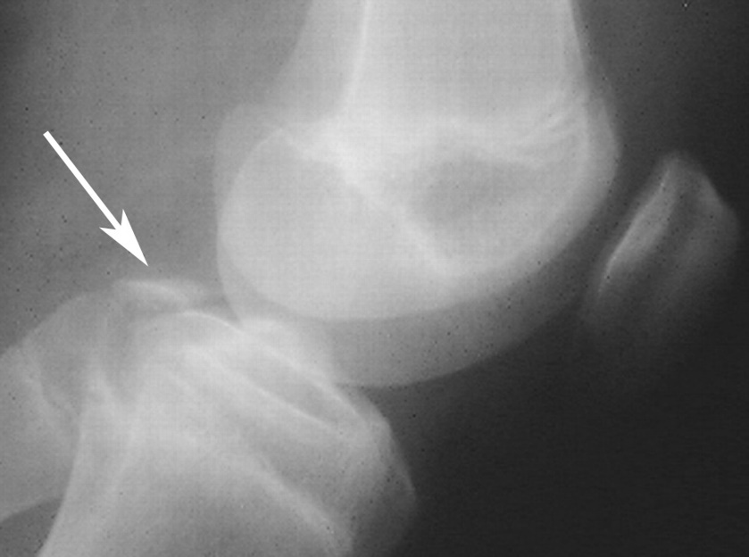
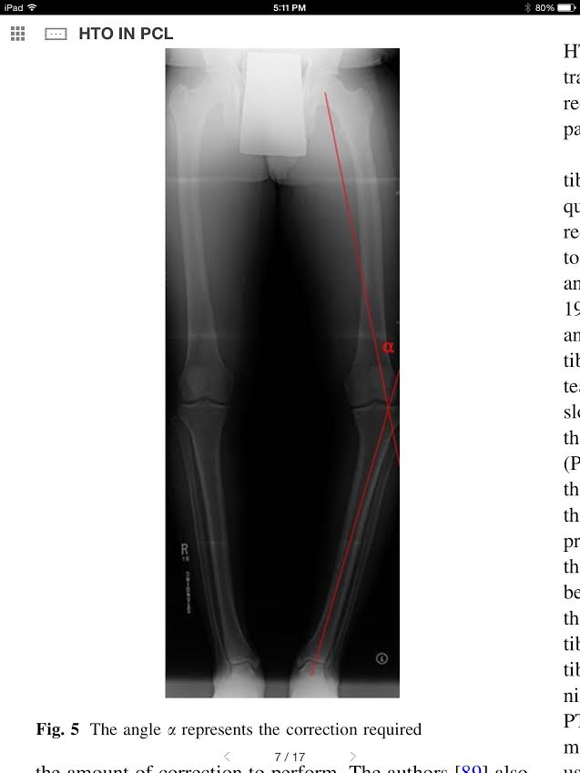
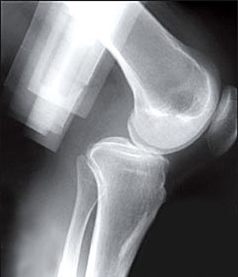
Imaging - xray
Posterior stress xray in drawer position or kneeling onto tibial tubercle, or at 90 degrees with 10 sec of hamstring contraction.
Notes:
PCL avulsion fracture. (a) Anteroposterior oblique radiograph of the left knee shows a bone fragment (arrow) within the knee joint. The exact origin of the fragment is difficult to discern on this view. (b) Lateral radiograph shows that the avulsed fragment (arrow) arises from the posterior tibial plateau.

Slide 18
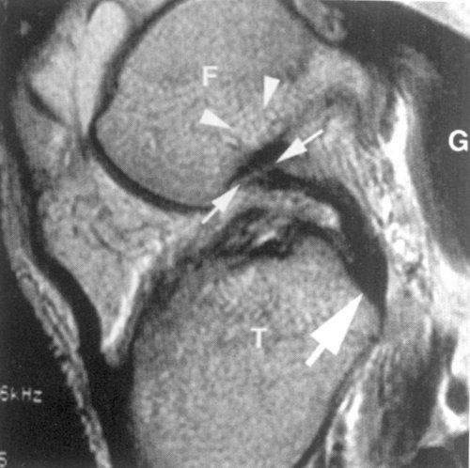
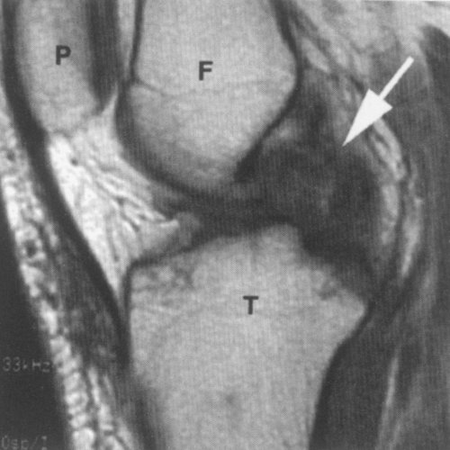
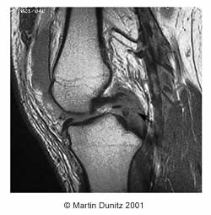
Imaging - MRI
MRI

Slide 19
Classification
  Grade I: 1 to 5 mm posterior displacement of the tibia on the femur
  Grade II: 6 to 10 mm; tibial condyles are at same level as femoral condyles
  Grade III: >10 mm; usually combined ligamentous injury
  Shelbourne et al. Natural Hx of acute, isolated nonop treated PCL injuries. 1992.

Slide 20
Treatment
Non-Operative
  Grade I and II tears
    Anti-inflammatories
    +/- Bracing
    ROM
    Emphasize Quad strengthening
  Gradual return to activity within 3-6 weeks
Shelbourne et al (AJSM 1992)
  “The natural history of acute, isolated, nonoperatively treated posterior cruciate ligament injuries: A prospective study.”
  133 athletic, active patients, 5.4 yr ave f/u
  No change in physical exam from initial injury to follow-up
  No correlation between subjective knee scores and degree of laxity or time from injury
  Half returned to same or higher level sports, 1/3 at lower level and 1/6th did not return to sport

Slide 21
Operative Treatment
Indications
  Tibial avulsion fractures
  Symptomatic Grade III PCL tears
  Combined PCL/PLC deficient knee with >10 mm posterior translation and >15 deg ext rot on dial test.
repair of PLC required if concomitant PCL injury, otherwise poor outcome
Presence of degenerative changes may require arthroplasty
If arthroplasty not indicated, may consider tibial osteotomy to increase tibial slope
  Closing wedge thought to decrease slope (use for chronic ACL deficiency), opening wedge increase slope (use for PCL chronic deficiency)

Slide 22
PCL Reconstruction
  Method of tibial fixation
    Tibial tunnel
    All inside technique
    Tibial Inlay
  Femoral tunnel placement
  Number of graft bundles
    Single vs double
  Degree of graft tensioning

Slide 23
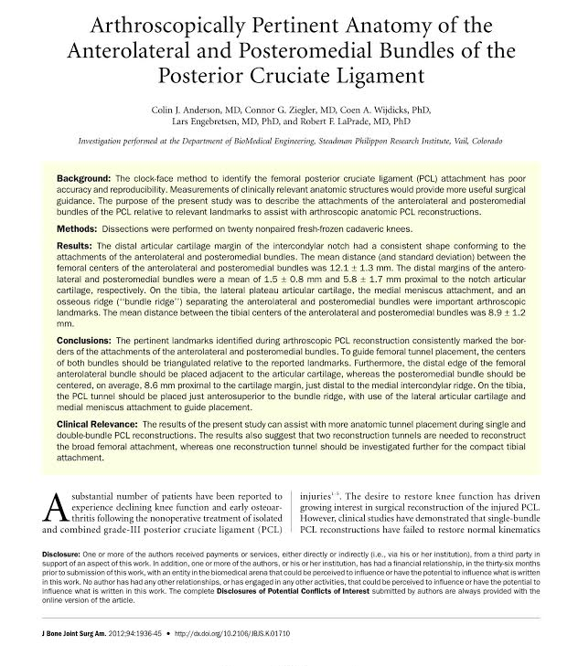
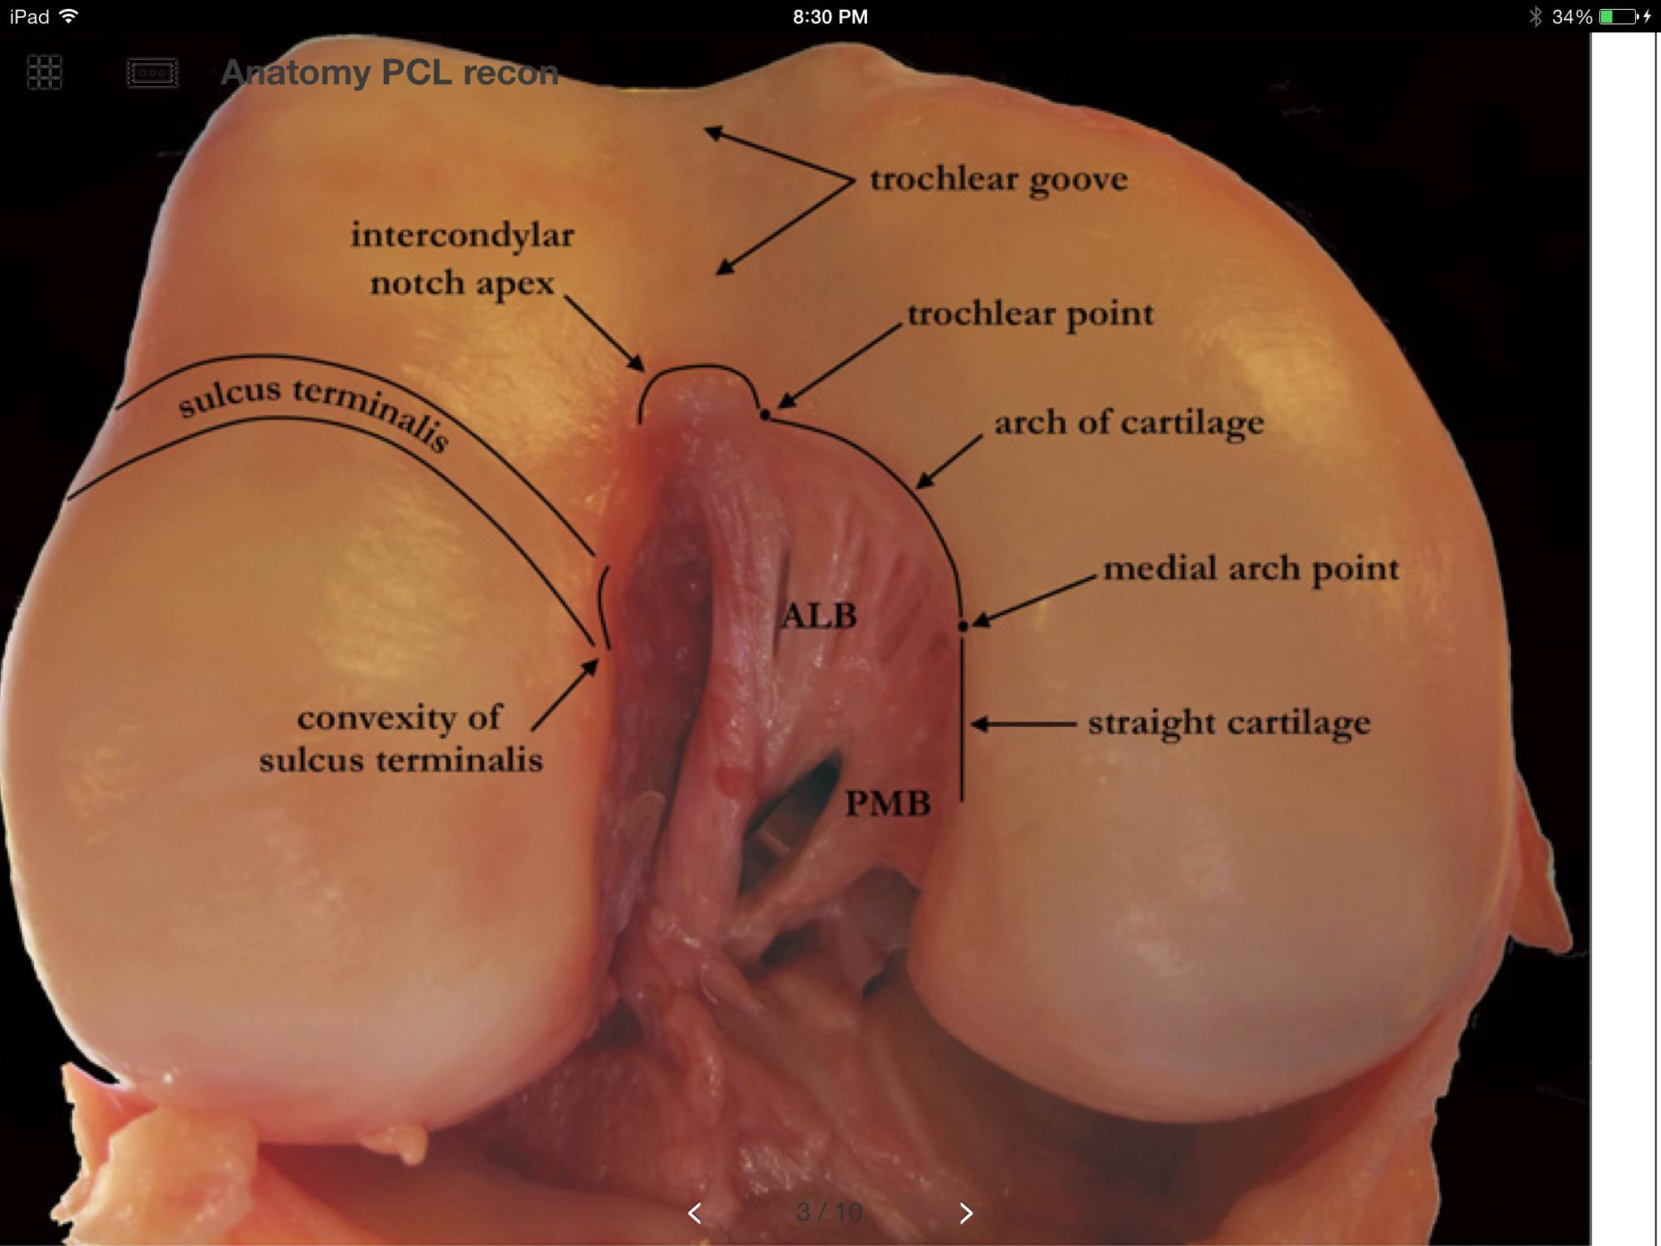
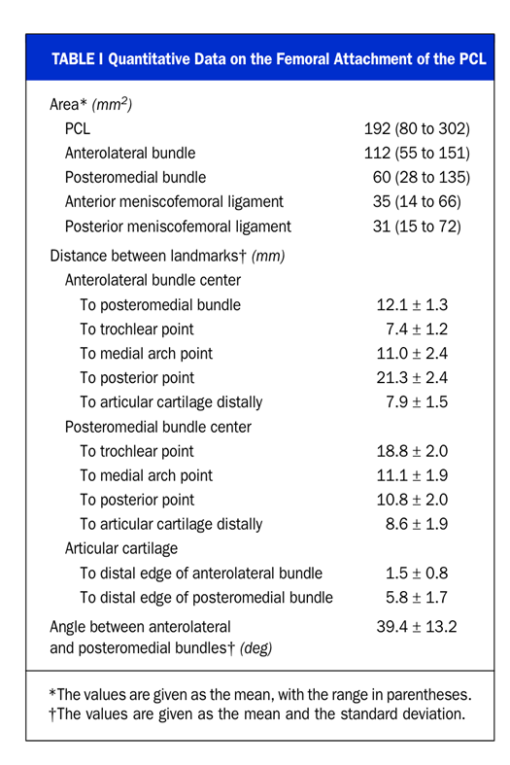
The Numbers Game

Slide 24
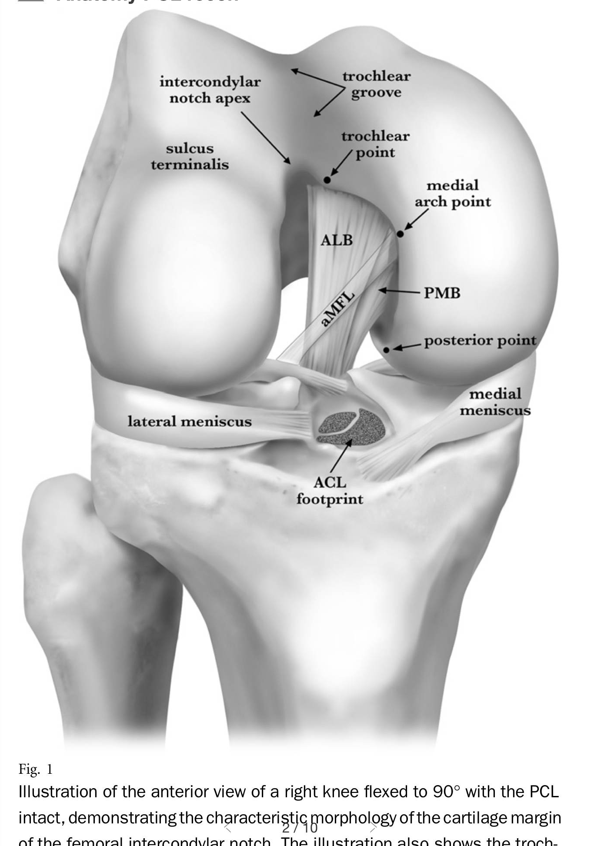
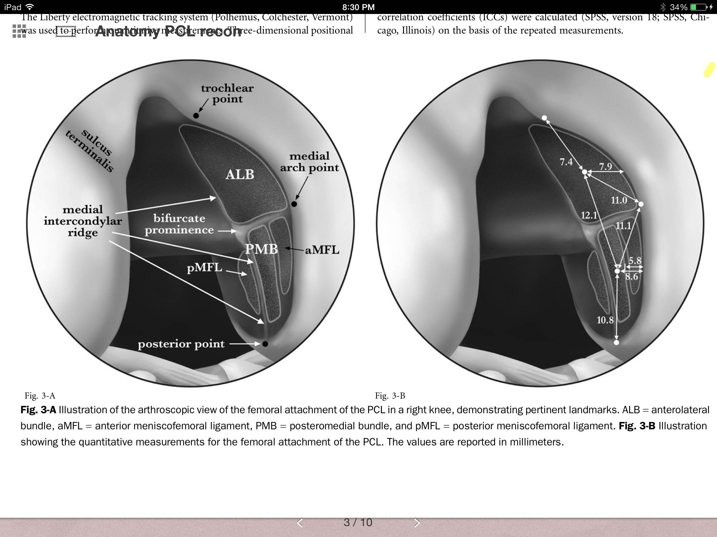

Slide 25
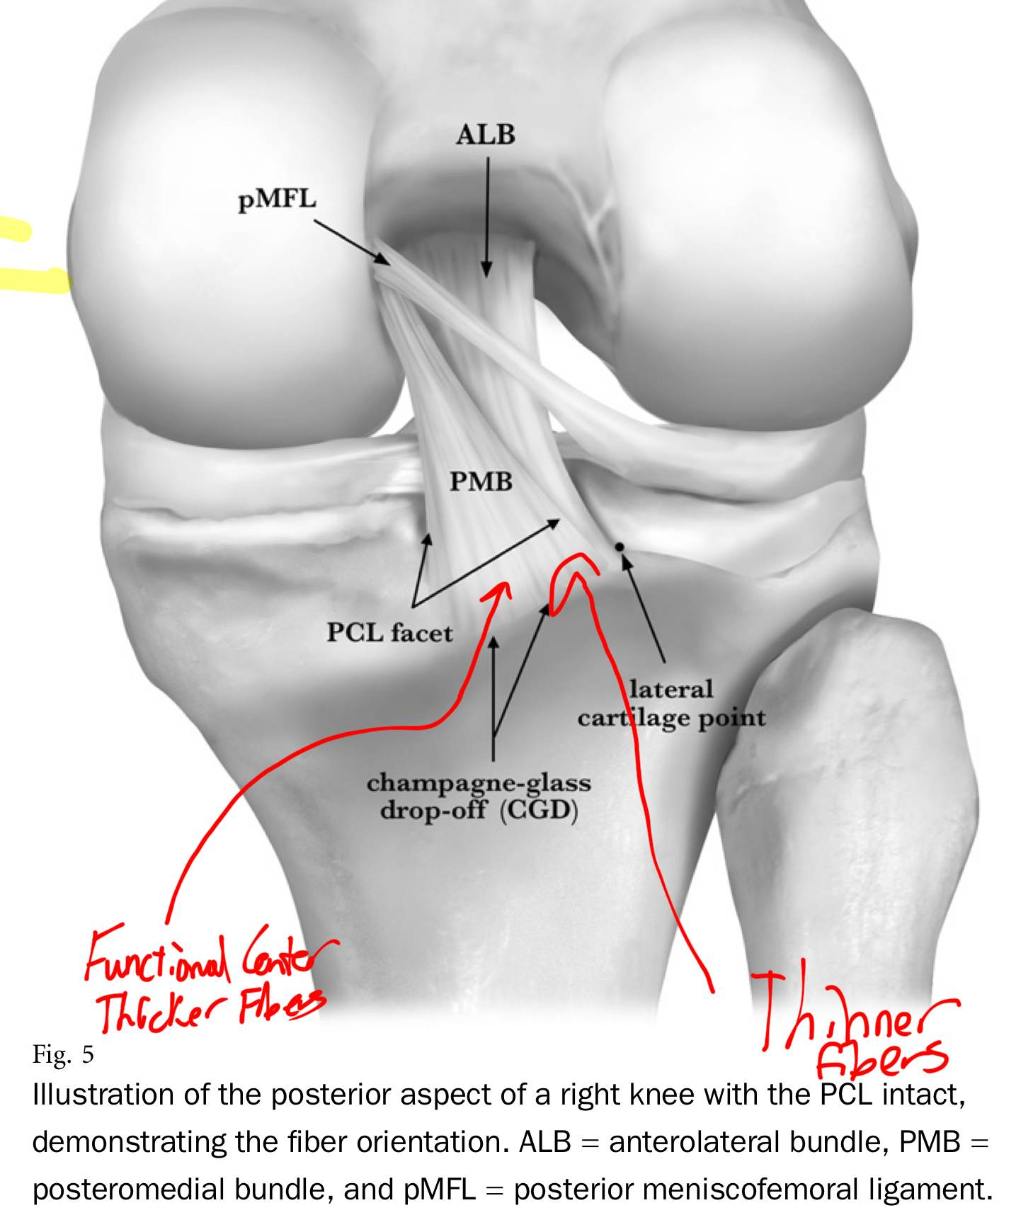
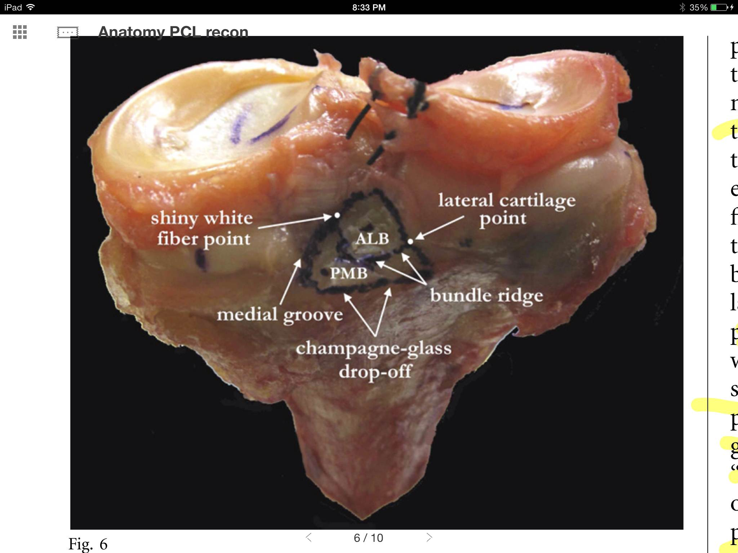
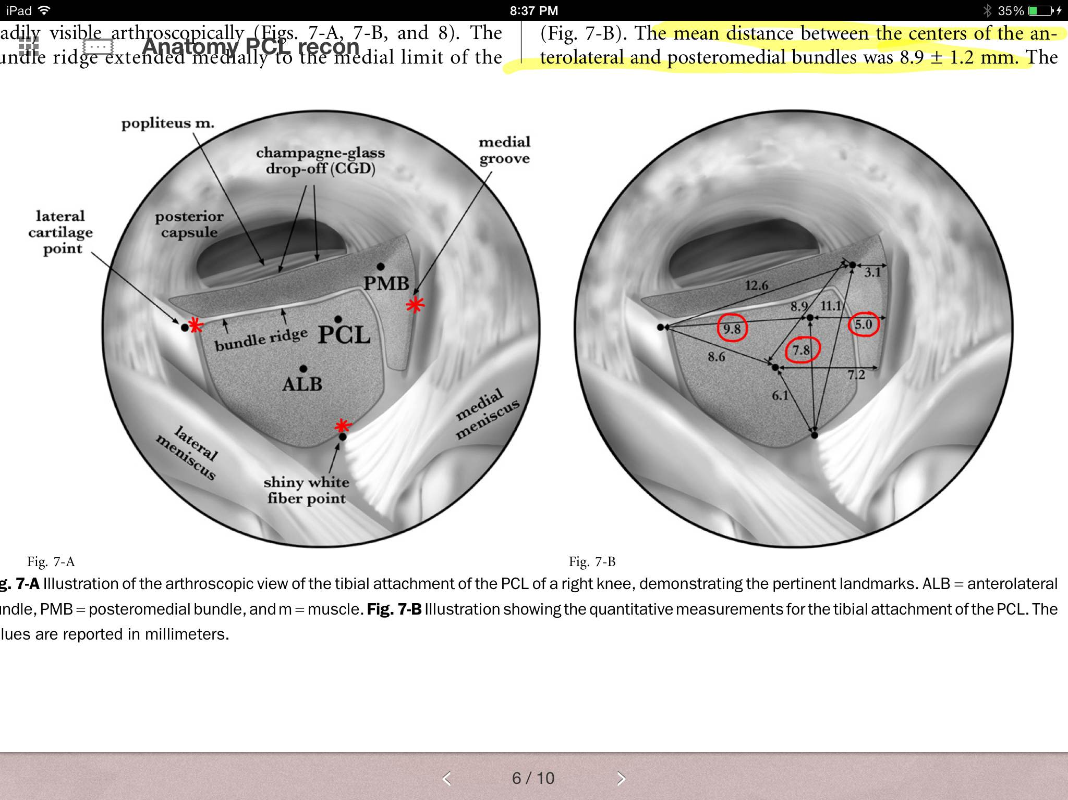

Slide 26
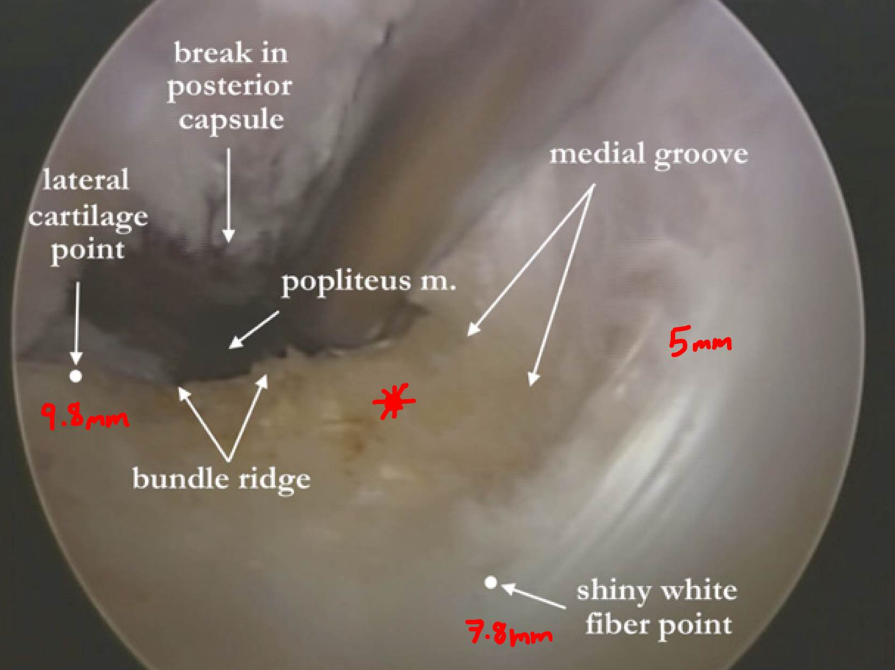
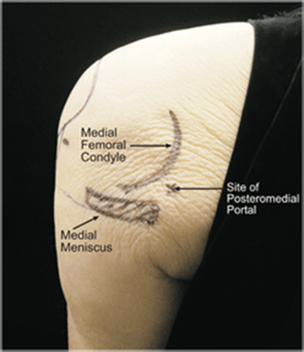
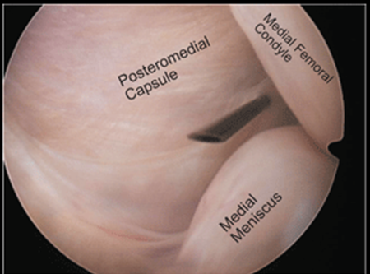
Create Posteromedial Portal
Use 70 degree scope to visualize behind the post horn medial meniscus

Slide 27
Tibial Tunnel
Use arthroscopic guide set to approx. 55 degrees, placed just distal and lateral to articular edge of posterior plateau along the PCL Facet.
Either medial or lateral to tibial tubercle, usually medial
Exit point is at the distal-most aspect of PCL footprint. Matava notes 7mm anterior to the posterior tibial cortex.
Neurovascular structures at risk, thought to have upwards of 20 mm of wiggle room, protect all posterior directed drilling.

Slide 28
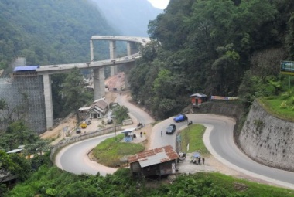
The Killer Turn
graft makes a 90 degree turn around the superior edge of the posterior aperture of the tibial tunnel
Graft attenuation
15% failure at 2,000 loading cycles (Markolf AJSM 2003)

Slide 29
Tibial Inlay
Graft secured to anatomic tibial attachment
Avoids killer curve
Less A-P laxity compared to transtibial grafts (Bergfeld AJSM 2001)

Slide 30
Femoral tunnel
Wiesel technique uses Angled awl via anterolateral portal can be used to create starting hole at 1:00 (R) or a 11:00 (L)
  A-P position is so the tunnel ede located at junction of articular cartilage.
  Tunnel aprox 30 mm.
single bundle graft (Markolf AJSM 2006)
  Anterolateral
    Reproduced normal PCL forces
    Increased laxity from 0-45 deg
  Central
    Best reproduced normal knee laxity
    High graft forces from 0-45 deg
  Posteromedial
    Overconstrained knee
    Highest graft forces in same range
double-bundle graft – approximate AL and PM insertions
“critical corner” (Handy et al Arthroscopy 2005)
  Angle at which graft enters femoral tunnel
  More acute with inside-out technique

Slide 31
Video of pcl reconstruction no disclosures to arthrex
http://www.arthrex.com/resources/presentation/OvAVZJdirUCk2wFEc7oUQQ/pcl-all-inside-reconstruction
  Joel Boyd, Arthrex Graftlink PCL all inside reconstruction. ~7 mins.
http://www.arthrex.com/resources/presentation/koyMZMaGlUiZNgE-OIheyg/arthroscopic-inlay-pcl-surgical-technique
  Jim Bradley, Arthroscopic Inlay PCL ST. ~ 7 mins.

Slide 32
Single vs Double Bundle
Single bundle
  most common; recreate anterolateral limb
  technically easier than the double-bundle option
  makes the knee more stable to posterior translation in flexion compared with isometric reconstruction.
  decreased ability to resist posterior tibial translation near full extension of the knee
Double bundle
  major theoretical advantage is that it more accurately recreates the biomechanics of the two bundles of the PCL.
    Thought to be better for rotational stability in subtle PLC injury, but no different if no PLC injury.
  more technically demanding than a single-bundle reconstruction, especially if concomitant ACL reconstruction is to be performed as well.
Notes:
most common reconstruction option
technically easier than the double-bundle option
makes the knee more stable to posterior translation in flexion compared with isometric reconstruction.
Opponents of AL bundle reconstruction cite the decreased ability of the graft to resist posterior tibial translation near full extension of the knee
major theoretical advantage of the double-bundle graft is that it more accurately recreates the biomechanics of the two bundles of the PCL. A double-bundle reconstruction is more technically demanding than a single-bundle reconstruction, especially if concomitant ACL reconstruction is to be performed as well.
Opponents of double-bundle PCL reconstruction cite the technical challenges as well as the limited clinical benefits of the procedure.

Slide 33
Graft Tensioning
single-bundle grafts
  should be tensioned at 70° to 90° of flexion, with simultaneous application of an anterior tibial force.
  Tensioning the graft in extension can result in an overconstrained knee
  Tensioning without an anterior tibial force can result in a relatively loose graft.
Double bundle
  Differential tensioning, AL at 90 deg, PM at 0 deg, results in reciprocal in situ forces similar to native PCL in cadaveric studies (Carson Arthroscopy 2007)
  Others angles (90/90 deg and 45/45 deg) produced excessive forces in the PM bundle
Notes:
single-bundle grafts
should be tensioned at 70° to 90° of flexion, with simultaneous application of an anterior tibial force.
Tensioning the graft in extension can result in an overconstrained knee
Tensioning without an anterior tibial force can result in a relatively loose graft.
Double bundle
Differential tensioning, AL at 90 deg, PM at 0 deg, results in reciprocal in situ forces similar to native PCL in cadaveric studies (Carson Arthroscopy 2007)
Others angles (90/90 deg and 45/45 deg) produced excessive forces in the PM bundle

Slide 34
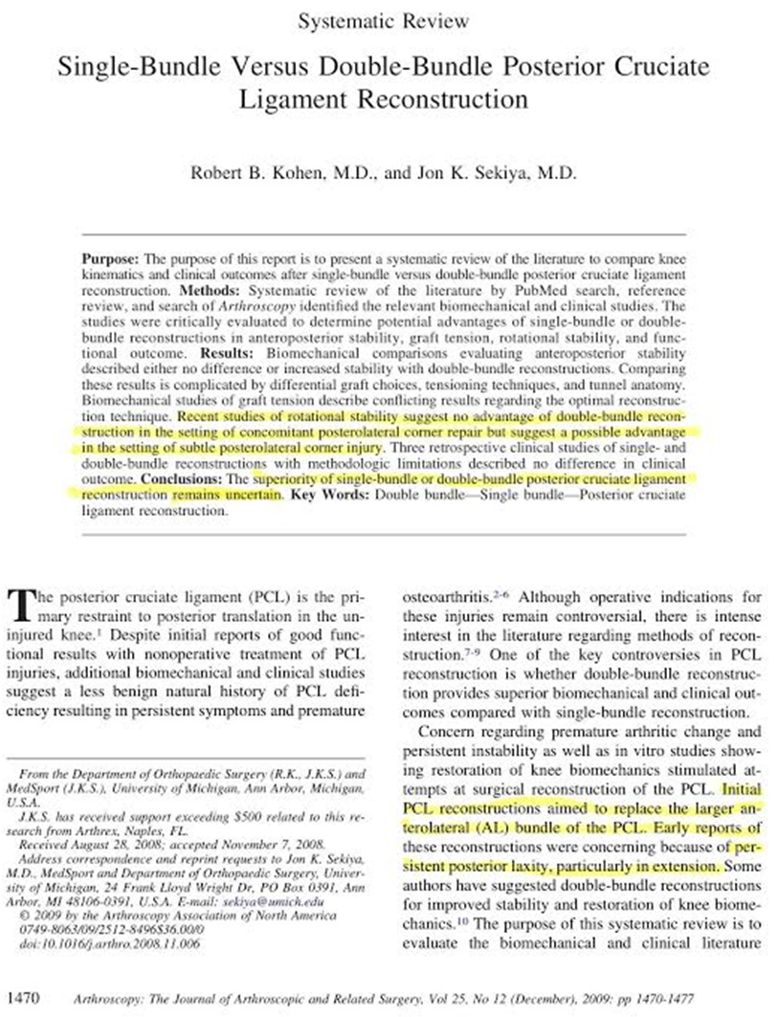
Systematic review of literature
Look for advantages of Double vs. Single bundle.
Complicated findings due to different graft choice, tensions, tunnel anatomy.
Found no difference or increased stability with Double Bundle.
Conflicting biomechanical results with differing tensions
Rotational stability “suggest” no advantage in PLC repair, but “suggest possible” advantage with subtle PLC injury.
3 retrospective studies showed no difference single vs. double.

Slide 35
Postop Rehab
Designed to restore range of motion without stressing the graft
  Open chain avoided, stick to closed chain (foot planted) exercises
  Quad exercises started first day (active knee ext, no weights); passive knee flexion to inc ROM over 6 weeks.
  Running begins at 5 months, sport specific drills at 6-7 months.

Slide 36
Posterolateral Corner
Background Data:
  Epidemiology: uncommon, <2% of all acute lig injuries.
    High incidence of concomitant inj → PCL>ACL>collateral.
    Most commonly d/t sports inj, MVAs, and falls
      MOI: 1)hyperextension of knee with varus moment (football helmet to knee), 2)hyperextension alone, 3) hyperextension with ER force 4) severe varus force alone 5) severe ER stress alone. KEY: hyperextension, varus or ER
  Significance of PLC:
    Can be debilitating d/t chronic instability.
    Higher rate of failure of cruciate repair if PLC unstable.
    PLC resists varus and ER forces
      Varus thrust gait and sensation of instability → esp when toe off of gait.
      Clinically manifested with stair climbing and cutting activity → lateral knee pain.
      Causes increased patellofemoral contact pressure and medial compartment joint pressure → leads to eventual tricompartmental DJD.

Slide 37
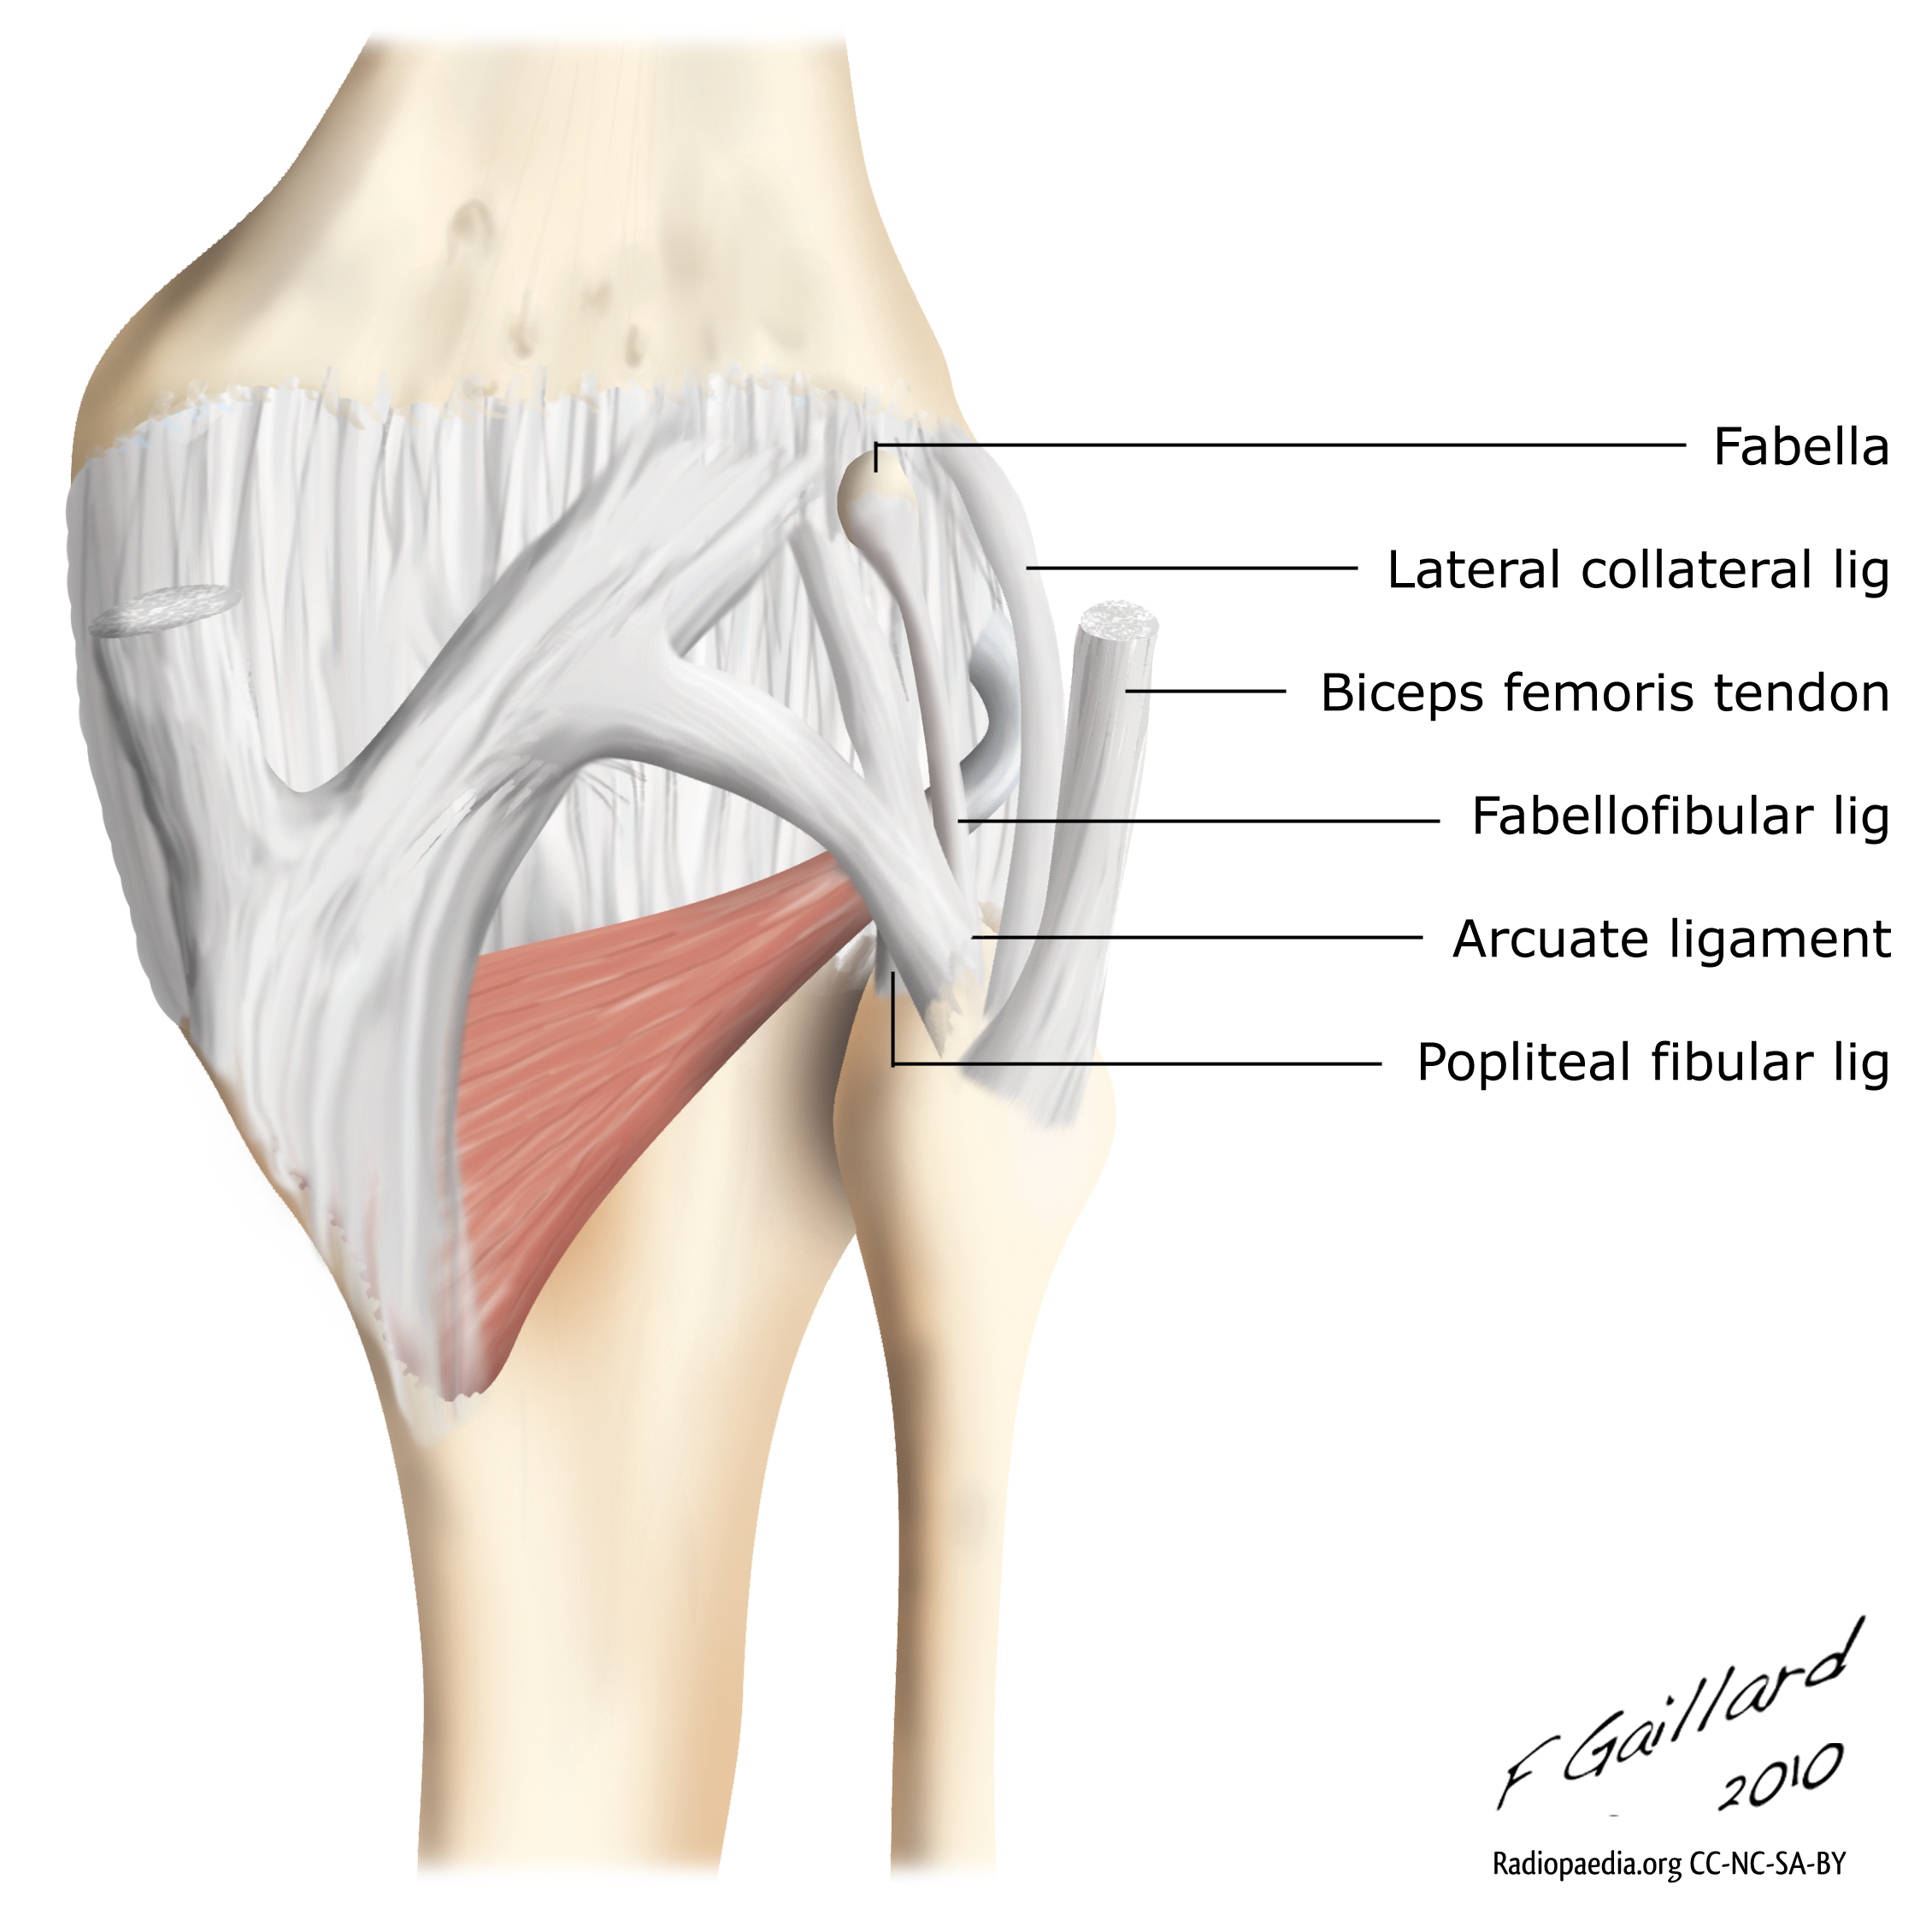
Anatomy of plc Complex
Seebacher et al set up into layers.
  Superficial
    IT band anterior and biceps femoris posteriorly.
  Middle
    Quadriceps retinaculum ant.
    Patellofemoral lig posteriorly
    Patellomeniscal ligament
  Deep
    Lateral joint capsule/coronary ligament
    Popliteus tendon
    Popliteofibular ligament
    Arcuate ligament
    LCL
    Fabellofibular ligament

Slide 38
H & P
History
  Rarely occur on own, look for associated injuries (cruciates, collaterals, meniscus)
  Aching pain posterolateral knee (chronic PLC), and sensation of instability in extension
Physical Exam
  Dial Test → PLC and PCL
  Posterolateral external rotation test → PLC
  Posterior Drawer Test → PCL
  Varus stress Test → LCL +/- PLC (at 30 deg)
  Quadriceps Active Test & posterior sag → PCL
  Reverse pivot shift→ PCL
  Gait exam → PCL and PLC
  Ext Rotation Recurvatum → PCL
  ROM, NV exam, effusion (acute vs. chronic), lachmans, anterior drawer, meniscal exams, patellar grind.

Slide 39
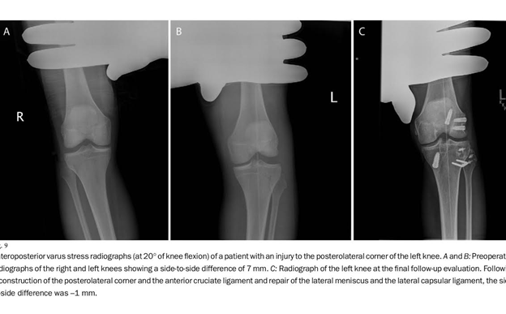
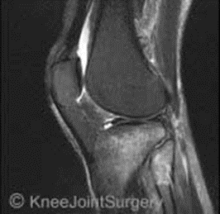
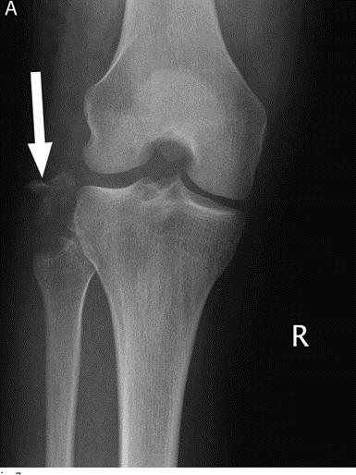
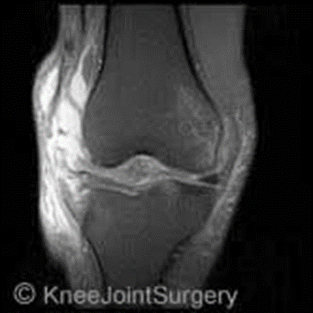
Imaging/diagnostics
Xrays
  AP and lateral
    Full length standing to evaluate for varus malalignment
    Look for increased lateral joint space and knee dislocation (acute).
    Associated fractures – avulsion (arcuate, segond, Gerdy’s)
    Tricompartmental arthritic changes
      Varus → medial joint line
      ER → patellofemoral joint changes
MRI
  Standard coronal, sagittal, axial images
    Laprade et al, recommended getting a coronal oblique 2mm thin cuts including entire fibular head and styloid → pop tendon and LCL.
    Useful to evaluate for concomitant pathology

Slide 40
Classification and non op treatment
Classification, grades 1-3, covey, JBJS 2001.
  Grade 1 → minimal tearing of ligaments, no abnormal joint motion
  Grade 2 → partial tearing of ligs but NO abnormal joint motion
  Grade 3 → complete lig tearing, and abnormal joint motion (PE tests +).
Non op Treatment
  Grade 1, 2 injuries →
    Usually successful, some higher grade 2 injuries may fail.
    Immobilize 2-4 weeks (immobilizer, cast)
    Quadriceps sets and SLR allowed immediately in immobilizer only
    Restrict WB during 1st 2-4 wks.
    After 3-4 wks → allow WBAT (send to therapy) and protected ROM in hinged brace, and closed chain quad strengthening
    AVOID hamstring strengthening for 6-10 wks after injury.
Operative Treatment
  Indications: 5-10 mm of opening to varus stress at 30 degrees
  Positive dial test or posterolateral external rotation test
  These are consistent with a grade III PLC injury.

Slide 41
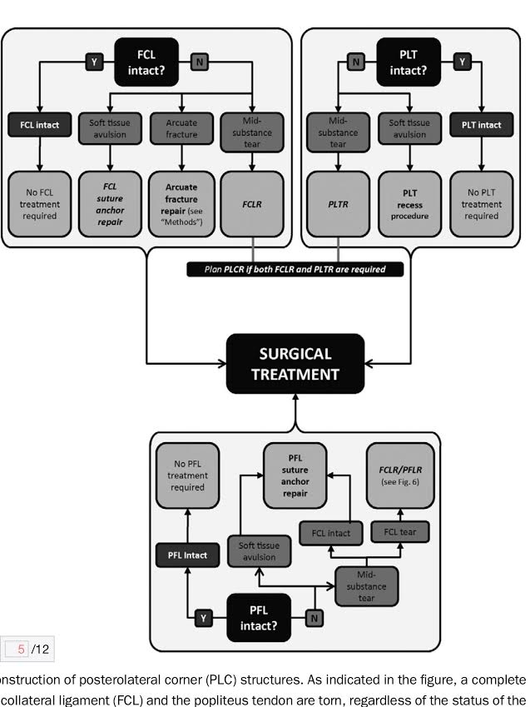
Algorithm For Treatment, acc to LaPrade et al.

Slide 42
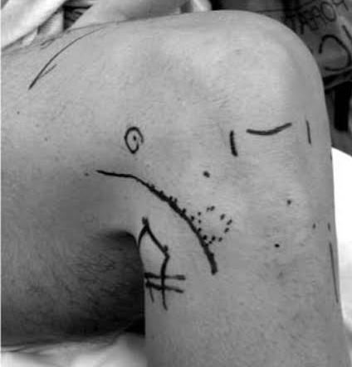




Operative treatment
Ranawat, PLC review 2008
Operative timing
  Ideally between 10 days and 3 weeks after injury.
  Encourage ROM and quad strengthening before surgery.
  >3 weeks increased scarring and difficulty in reparing PLCs primarily (for avulsions.)
  Multiple ligament injuries
    Femoral Tunnel PCL and graft, femoral tunnel ACL and graft, then open PLC recon, then tibial tunnels and graft tensioning lastly. Sgaglione N. Management of the multiple ligament knee injury. Presented at: Orthopedics Today Hawaii; Jan. 13-16, 2013; Kohala Coast, Hawaii.
Techniques
  Primary repair of avulsion (only if reaches in full ext)
    Popliteus tendon, biceps femoris, arcuate fracture, LCL
  Reconstruction of midsubstance or chronic tear
Dissection (Wiesel, 2011)
  Positioning: lazy lateral position, allows for arthroscopic work and IR of leg for open PLC approach.
  Incision 12-18 cm start just superior to lateral epicondyle along posterior border or center of IT band.
    Lateral hockey stick
    Straight
    Curvilinear
  Isolate the peroneal nerve and protect it, found behind the biceps femoris.. Trace it around the fibular head.

Slide 43






Avulsion INjuries
Fix with Suture Anchor to fibula

Slide 44


More Avulsions

Slide 45


PLC Reconstructions
Geeslin, LaPrade, 2011.
LaPrade, 2008.
Laprade Reconstruction → recreates the Popliteus T, Popliteofibular Lig and LCL throught a A-P tibial tunnel, M-L fibular tunnel and is anchored into the anatomic insertions of each structure.

Slide 46
PLC Reconstruction video
https://www.vumedi.com/video/the-anatomic-posterolateral-corner-reconstruction-technique/?list=c86622f8-13b8-41a8-b29b-ba910ec51f3c
By LaPrade.
https://www.vumedi.com/video/chronic-posterolateral-reconstruction-live-demo/
Live demo by LaPrade.

Slide 47
(OBQ11.204) Which of the following should be avoided in early rehabilitation following posterior cruciate ligament (PCL) reconstruction? Topic Review Topic
1. Quadcriceps muscle activation
2. Closed chain active terminal extension exercises
3. Prone passive flexion with active terminal extension
4. Prone hamstring curls
5. Active maximal ankle dosiflexion

Slide 48
PREFERRED RESPONSE ▼ 4
CORRECT
DISCUSSION: Resisted hamstring strengthening exercises (ex. hamstring curls) are generally avoided in the early phase of rehabilitation following PCL reconstruction - this is because the hamstrings create a posterior pull on the tibia which increases stress on the graft.
Kaufman et al studied the joint reactive forces during isokinetic exercises. They found that posterior shear forces exist during the flexion portion of isokinetic exercise and during extension exercises at knee joint angles greater than 40 degrees. The maximum posterior shear force was 1.7 body weight.
Incorrect Responses:
1. & 2. Progressively obtaining a full range of motion is an initial goal of rehabilitation. Quadriceps muscles help to obtain extension and near terminal extension actually decrease force on the graft. Non-weight-bearing resisted knee extension (60° to 0°) is an acceptable exercise in the initial stages following PCL reconstruction.
3. Prone positioning allows the weight of the leg to help maintain an anterior force on the tibia, while passive flexion minimizes hamstring pull.
5. Active ankle exercises such as ankle pumps are encouraged.
REFERENCES:
1. Paine R. Section A: Language of exercise and rehabilitation. In: DeLee JC, Drez D, Miller MD, eds. Rehabilitation and Therapeutic Modalities: Orthopaedic Sports Medicine. Vol 2. 3rd ed. Philadelphia, PA: Saunders-Elsevier; 2010:221-237.
2. Kaufman KR, An KN, Litchy WJ, Morrey BF, Chao EY. Dynamic joint forces during knee isokinetic exercise. Am J Sports Med. 1991 May-Jun;19(3):305-16. PMID:1867339 (Link to Abstract)

Slide 49
(OBQ06-55) A football player sustains an isolated posterior cruciate ligament (PCL) tear. Which of the following mechanisms is most likely to have caused this injury?
1. Fall on the flexed knee with the foot in plantarflexion
2. Fall on the flexed knee with the foot in dorsiflexion
3. Non-contact twist causing knee external rotation and valgus
4. Non-contact twist causing knee internal rotation and varus
5. Direct contact blow to the posterior knee

Slide 50
(OBQ06-55) A football player sustains an isolated posterior cruciate ligament (PCL) tear. Which of the following mechanisms is most likely to have caused this injury?
1. Fall on the flexed knee with the foot in plantarflexion
2. Fall on the flexed knee with the foot in dorsiflexion
3. Non-contact twist causing knee external rotation and valgus
4. Non-contact twist causing knee internal rotation and varus
5. Direct contact blow to the posterior knee
PREFERRED RESPONSE > 1
CORRECT
DISCUSSION: Schulz et al retrospectively analyzed 494 patient with PCL injuries. Traffic accidents (45%) and athletic injuries (40%) were the most common causes. The most common injury mechanisms were dashboard injuries (35%) and falls on the flexed knee with the foot in plantarflexion (24%). Multiligament injuries involving the PCL occurred in 64% of patients injured in traffic accidents vs. 48% of those with athletic injuries (p<0.0001). Janousek found similar results showing that MVA was more likelt to result in multi-ligament injuries, while a fall on the knee with the foot plantarflexed is most likely to result in an isolated PCL injury.
REFERENCES:
1. OITE06 #55
2. Janousek AT, Jones DG, Clatworthy M, Higgins LD, Fu FH. Posterior cruciate ligament injuries of the knee joint. Sports Med 1999;28:429-441. PMID:10623985 (Link to Abstract)
3. Schulz MS, Russe K, Weiler A, Eichhorn HJ, Strobel MJ. Epidemiology of posterior cruciate ligament injuires. Arch Orthop Trauma Surg 2003;123:186-191. PMID:12734718 (Link to Abstract)

Slide 51
(OBQ04-161) A 35-year-old male has sustained an isolated PCL injury. The surgeon should explain that without surgical reconstruction, he is at increased risk of degenerative joint disease in which knee compartments?
1. medial and patellofemoral
2. medial only
3. lateral
4. lateral and patellofemoral
5. patellofemoral only

Slide 52
(OBQ04-161) A 35-year-old male has sustained an isolated PCL injury. The surgeon should explain that without surgical reconstruction, he is at increased risk of degenerative joint disease in which knee compartments?
1. medial and patellofemoral
2. medial only
3. lateral
4. lateral and patellofemoral
5. patellofemoral only
PREFERRED RESPONSE > 1
CORRECT
DISCUSSION: Strobel et al conducted a retrospective arthroscopic review of 181 PCL-deficient knees that were treated nonoperatively initially but later underwent knee arthroscopy. They found that PCL insuffiency significantly increased the risk of developing medial femoral condyle and patellar cartilage degeneration over time. Of the patients whose PCL-deficiency was present for more than 5 years, 77.8% showed degenerative cartilage lesions of the medial femoral condyle and 46.7% showed cartilage degeneration of the patella. After 1 year of PCL insufficiency, the number of medial femoral cartilage lesions increased threefold (13.6% v 39.1%).
REFERENCES:
1. OITE04 #161
2. Strobel MJ, Weiler A, Schulz MS, Russe K, Eichhorn HJ. Arthroscopic evaluation of articular cartilage lesions in posterior-cruciate-ligament-deficient knees. Arthroscopy. 2003 Mar;19(3):262-8. PMID:12627150 (Link to Abstract)

Slide 53
(OBQ07-15) Strengthening of what muscle group most effectively counteracts the deficit seen with an incompetent PCL?
1. Hip flexors
2. Hip abductors
3. Gastroc-soleus
4. Quadriceps
5. Hamstrings

Slide 54
(OBQ07-15) Strengthening of what muscle group most effectively counteracts the deficit seen with an incompetent PCL?
1. Hip flexors
2. Hip abductors
3. Gastroc-soleus
4. Quadriceps
5. Hamstrings
PREFERRED RESPONSE ▼ 4
CORRECT
DISCUSSION: The primary function of the PCL complex is to restrict posterior tibial translation. After acute PCL rupture or PCL reconstruction, resisted hamstring strengthening is avoided as it pulls the tibia posteriorly. Therefore, therapy should focus on quadriceps strengthening which pulls the tibia anteriorly. The Irrgang paper describes rehabilitation principles for multi-ligament knee injuries. The Wind Article is a review which includes rehabilitation priciples for both non-op and operative PCL treatment. The Harner paper is a similar but earlier review.
REFERENCES:
1. OITE07 #15
2. Wind WM, Bergfeld JA, Parker RD. Evaluation and treatment of posterior cruciate ligament injuries: Revisited. Am J Sports Med 2004;32:1765-75. PMID:15494347 (Link to Abstract)
3. Harner CD, Hoher J. Evaluation and treatment of posterior cruciate ligament injuries. Am J Sports Med 1998;26:471-82. PMID:9617416 (Link to Abstract)
4. Irrgang JJ, Fitzgerald GK. Rehabilitation of the multiple-ligament-injured knee. Clin Sports Med. 2000 Jul;19(3):545-71. PMID:10918965 (Link to Abstract)

Slide 55
(OBQ09-82) Which of the following rehabilitation principles is true regarding non-operative treatment of a high-grade partial PCL tear?
1. Quadriceps strengthening and prone range of motion should begin as tolerated
2. Hamstring strengthening and supine range of motion should begin as tolerated
3. Resisted quadriceps and hamstring strengthening, no early range of motion
4. No strengthening for 6 weeks
5. No range of motion for 6 weeks

Slide 56
(OBQ09-82) Which of the following rehabilitation principles is true regarding non-operative treatment of a high-grade partial PCL tear?
1. Quadriceps strengthening and prone range of motion should begin as tolerated
2. Hamstring strengthening and supine range of motion should begin as tolerated
3. Resisted quadriceps and hamstring strengthening, no early range of motion
4. No strengthening for 6 weeks
5. No range of motion for 6 weeks
PREFERRED RESPONSE > 1
CORRECT
DISCUSSION: Initial treatment for PCL tears is non-operative. Range of motion is typically initiated early. Flexion may be done in a prone position to limit posterior sag. While quadriceps strengthening is essential, resisted hamstring exercises are generally avoided initially because they pull the tibia in a relatively posterior position. The references include two recent review articles on the evaluation and treatment of PCL tears. The wind article reviews the evaluation and treatment of PCL tears and the Margheritini paper is a general review article on the PCL anatomy and injuries.
REFERENCES:
1. OITE09 #82
2. Garrick JG (ed): Orthopaedic Knowledge Update: Sports Medicine 3. Rosemont, IL, American Academy of Orthopaedic Surgeons, 2004, pp 155-168
3. Margheritini F, Rihn J, Musahl V, Mariani PP, Harner C. Posterior cruciate ligament injuries in the athlete: An anatomical, biomechanical and clinical review. Sports Med 2002;32:393-408 PMID:11980502
4. Wind WM Jr, Bergfeld JA, Parker RD. Evaluation and treatment of posterior cruciate ligament injuries: revisited. Am J Sports Med. 2004 Oct-Nov;32(7):1765-75. PMID:15494347

Slide 57
(OBQ06-99) A 35-year-old construction worker presents with medial-sided knee pain. He has no instability complaints but at age 18, he sustained a complete PCL injury that was treated non-operatively. A radiograph is shown in Figure A. What surgical treatment is the best option given his age and occupation?
1. PCL reconstruction
2. Unicompartmental knee replacement
3. Total knee replacement
4. Lateral closing wedge osteotomy of the proximal tibia
5. Medial opening wedge osteotomy of the proximal tibia

Slide 58


Slide 59
(OBQ06-99) A 35-year-old construction worker presents with medial-sided knee pain. He has no instability complaints but at age 18, he sustained a complete PCL injury that was treated non-operatively. A radiograph is shown in Figure A. What surgical treatment is the best option given his age and occupation?
1. PCL reconstruction
2. Unicompartmental knee replacement
3. Total knee replacement
4. Lateral closing wedge osteotomy of the proximal tibia
5. Medial opening wedge osteotomy of the proximal tibia
PREFERRED RESPONSE > 5
DISCUSSION: The radiographs show a knee with significant medial compartment narrowing. A frequently tested fact is that wear associated with chronic PCL instability occurs most commonly in the patellofemoral joint and the medial compartment of the knee. A young laborer is not an ideal candidate for arthroplasty because of early wear and loosening concerns. In addition, cruciate ligaments are required for the insertion of a unicompartmental knee replacement. Isolated PCL reconstruction would not be recommended as he already has arthritis and cruciate reconstruction in a mal-algined knee is at increased risk of failure. Either valgus producing osteotomy is reasonable, but the opening wedge tends to increase posterior tibial slope which is helpful in PCL-deficient knees. The article by Giffin et al described that by performing an opening medial wedge osteotomy, the slope of the knee is effectively increased by about 3 degrees and this reduces posterior subluxation or sag of the tibia on the femur. This helps to accommodate for the deficient ligamentous restraint posteriorly, whereas decreasing slope may be protective in an ACL-deficient knee.
REFERENCES:
1. OITE06 #99
2. Giffin JR, Vogrin TM, Zantop T, Woo SL, Harner CD. Effects of increasing tibial slope on the biomechanics of the knee. Am J Sports Med 2004;32:376-382 PMID:14977661 (Link to Abstract)

Slide 60
(OBQ09-35) A 23-year-old collegiate soccer player sustained a right knee injury 6 months ago. He has been treated with rest and rehabilitation but is unable to play at his previous level due to his knee "giving way." Physical exam reveals 10° varus alignment when standing and a varus thrust with walking. Strength is full compared to the other side. Ligamentous exam reveals a stable ACL and MCL, but opens to a varus stress and a 3+ posterior drawer and positive dial test at both 30° and 90° degrees of flexion. What is the best treatment option to allow this patient to return to competitive athletic activity?
1. Functional bracing
2. Reconstruction of the PCL
3. Reconstruction of the ACL and PCL
4. High tibial osteotomy to decrease tibial slope and correct varus malalignment; reconstruction of the PCL & PLC
5. High tibial osteotomy to increase tibial slope and correct varus malalignment; reconstruction of the PCL & PLC

Slide 61
(OBQ09-35) A 23-year-old collegiate soccer player sustained a right knee injury 6 months ago. He has been treated with rest and rehabilitation but is unable to play at his previous level due to his knee "giving way." Physical exam reveals 10° varus alignment when standing and a varus thrust with walking. Strength is full compared to the other side. Ligamentous exam reveals a stable ACL and MCL, but opens to a varus stress and a 3+ posterior drawer and positive dial test at both 30° and 90° degrees of flexion. What is the best treatment option to allow this patient to return to competitive athletic activity?
1. Functional bracing
2. Reconstruction of the PCL
3. Reconstruction of the ACL and PCL
4. High tibial osteotomy to decrease tibial slope and correct varus malalignment; reconstruction of the PCL & PLC
5. High tibial osteotomy to increase tibial slope and correct varus malalignment; reconstruction of the PCL & PLC
PREFERRED RESPONSE ▼ 5
DISCUSSION: This patient sustained a combined posterior cruciate ligament (PCL) and posterolateral corner (PLC) injury. The 3+ posterior drawer indicates the PCL injury while the opening to varus stress indicates injury to the lateral collateral ligament (a component of the PLC). In addition, this patient has a positive dial test at both 30° (PLC tear) and 90° (PLC and PCL tear) degrees of flexion. Repair of the PCL alone and ignoring the PLC injury and/or varus malalignment will result in increased risk of failure of the reconstruction. Giffin et al in a recent cadaveric study showed that increasing the tibial slope in PCL deficient knees reduces the posterior tibial sag.
REFERENCES:
1. OITE09 #35
2. Garrick JG (ed): Orthopaedic Knowledge Update: Sports Medicine 3. Rosemont, IL, American Academy of Orthopaedic Surgeons, 2004, pp 183-197
3. Giffin JR, Stabile KJ, Zantop T, Vogrin TM, Woo SL, Harner CD. Importance of tibial slope for stability of the posterior cruciate ligament deficient knee. Am J Sports Med. 2007 Sep;35(9):1443-9. Epub 2007 Jul 19. PMID:17641101 (Link to Abstract)

Slide 62
(OBQ07-4) At what angle of knee flexion should the graft be tensioned at during posterior cruciate ligament (PCL) reconstruction with a single bundle graft?
1. 5 degrees hyperextension
2. 0 degrees flexion
3. 15 degrees flexion
4. 30 degrees flexion
5. 90 degrees flexion

Slide 63
(OBQ07-4) At what angle of knee flexion should the graft be tensioned at during posterior cruciate ligament (PCL) reconstruction with a single bundle graft?
1. 5 degrees hyperextension
2. 0 degrees flexion
3. 15 degrees flexion
4. 30 degrees flexion
5. 90 degrees flexion
PREFERRED RESPONSE > 5
DISCUSSION: For single bundle reconstructions, the PCL is usually tensioned in flexion and the ACL is tensioned in more extension. While not truly isometric, these positions are closest to the isometric points which means that the graft will not have excess strain or laxity as it is taken through a full range of motion. The Margheritini et al. paper describes 2 different methods of tibial fixation, but were performed at 90 degs of flexion. The Sekiya paper describes the technique and results of single bundle PCL reconstructions.
REFERENCES:
1. OITE07 #4
2. OKU: Sports Medicine 3, 2004 pg 155-168.
3. Margheritini F, Rihn JA, Mauro CS, et al. Biomechanics of initial tibial fixation in posterior cruciate ligament reconstruction. Arthroscopy. 2005 Oct;21(10):1164-71. PMID:16226642 (Link to Abstract)
4. Sekiya JK, West RV, Ong BC, et al. Clinical outcomes after isolated arthroscopic single-bundle posterior cruciate ligament reconstruction. Arthroscopy. 2005 Sep;21(9):1042-50. PMID:16171628 (Link to Abstract)

