Slide 1
Medial and Lateral Collateral Ligament Injuries
Ian RiCe MD

Slide 2
Medial Collateral Ligament

Slide 3
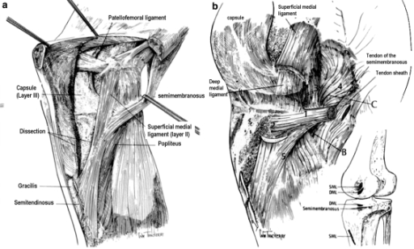
MCL: Anatomy
Tibial collateral ligament
2 layers: superficial and deep

Slide 4
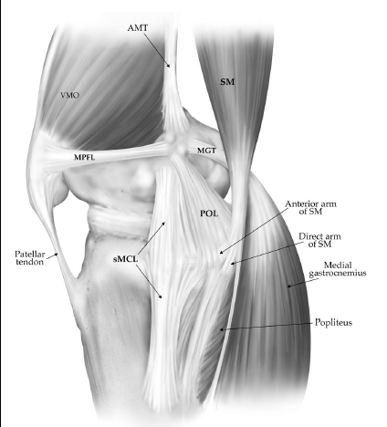
MCL: Anatomy
Superficial MCL
  Fibers
    Anterior – parallel, distinct vertical margin
    Posterior – become oblique
  Femoral attachment
    Circular, femoral epicondyle
    1 cm anterior and distal to adductor tubercle
  Tibial attachment
    4.5 cm distal to joint line on tibial metaphysis
    Blends with tibial periosteum
    Posterior and deep to pes anserinus
  Bursa (of Voshell)
  Primary valgus stabilizer

Slide 5
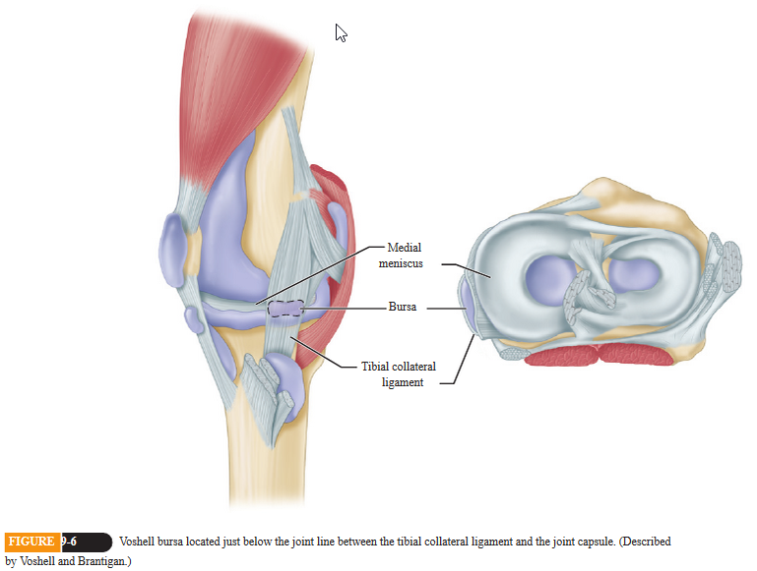
MCL: Anatomy

Slide 6
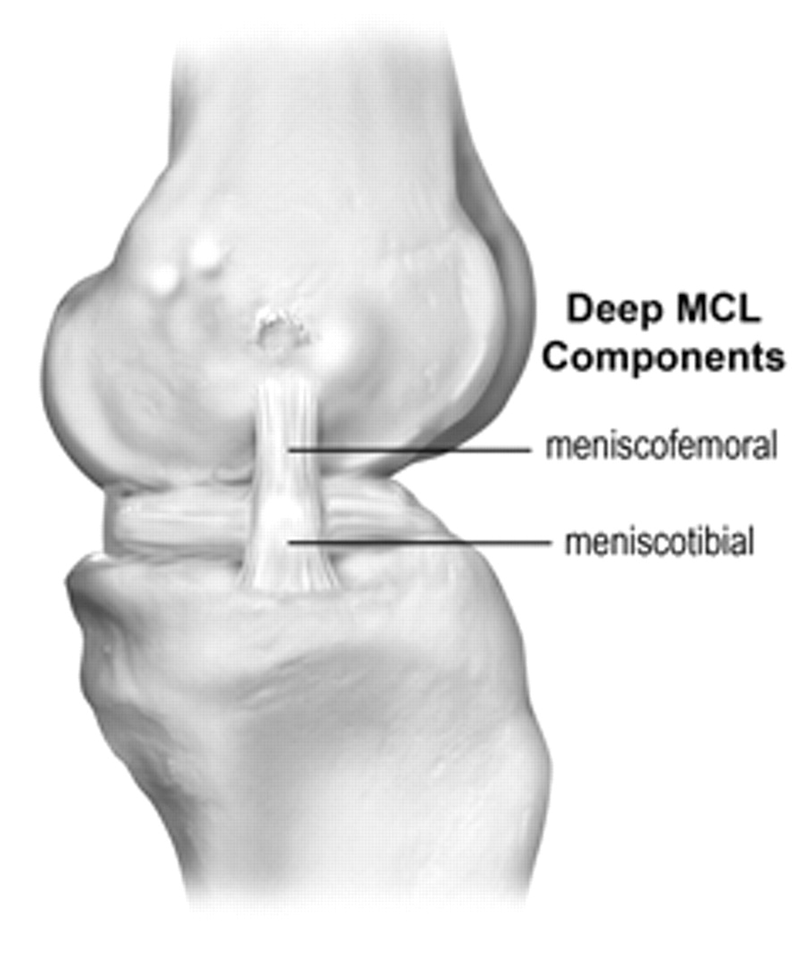
MCL: Anatomy
Deep MCL
  AKA medial capsular ligament
  Originates from distal femur, blends with superficial fibers
  Divided into:
    Meniscofemoral
    Meniscotibial
  Attached to medial meniscus by coronary ligaments
  Secondary restraint to valgus stress (4-8% restraint)

Slide 7
Posterior Oblique Ligament: Anatomy
Origin: medial femur distal to the adductor tubercle and posterior to the superficial MCL origin
Insertion: Posteromedial corner of tibia
Action:
  Stabilize medial meniscus in conjunction with coronary ligaments
  Posteromedial rotatory stability

Slide 8
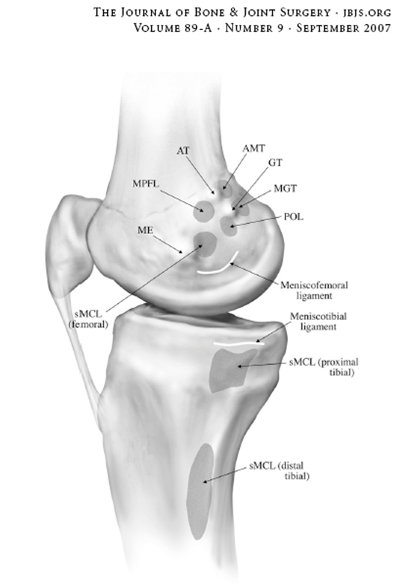
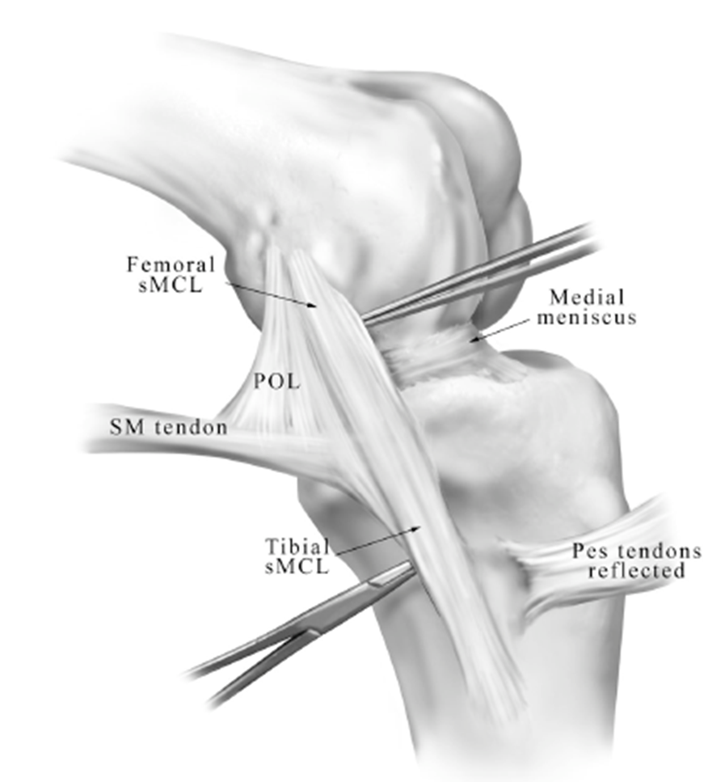

Slide 9
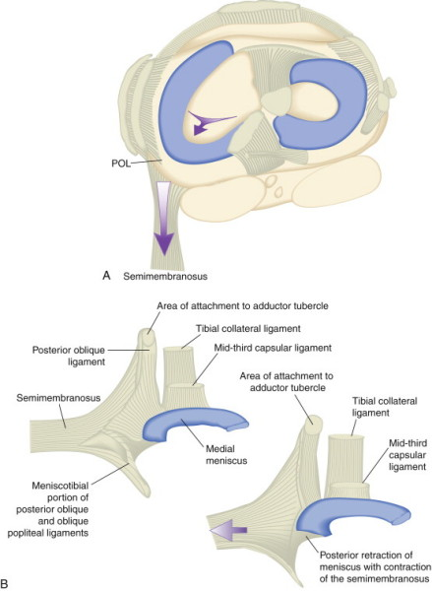
Semimembranosus
Tension on POL during knee flexion thought to retract posterior horn of medial meniscus, preventing impingement.

Slide 10
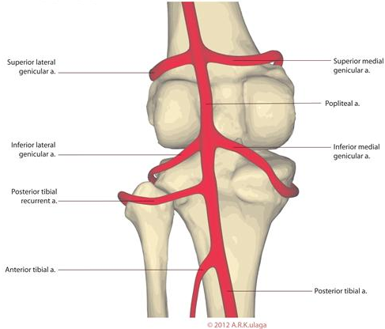
MCL: Anatomy

Slide 11
Medial Knee Stability
Can be organized into static/dynamic forces
Static
  Superficial MCL
  Deep MCL
  Posterior oblique ligament (POL)
Dynamic
  Medial head of gastroc
  Pes anserine tendons (Sartorius, Gracilis, semiT)
  Semimembranosus
  Vastus medialis

Slide 12
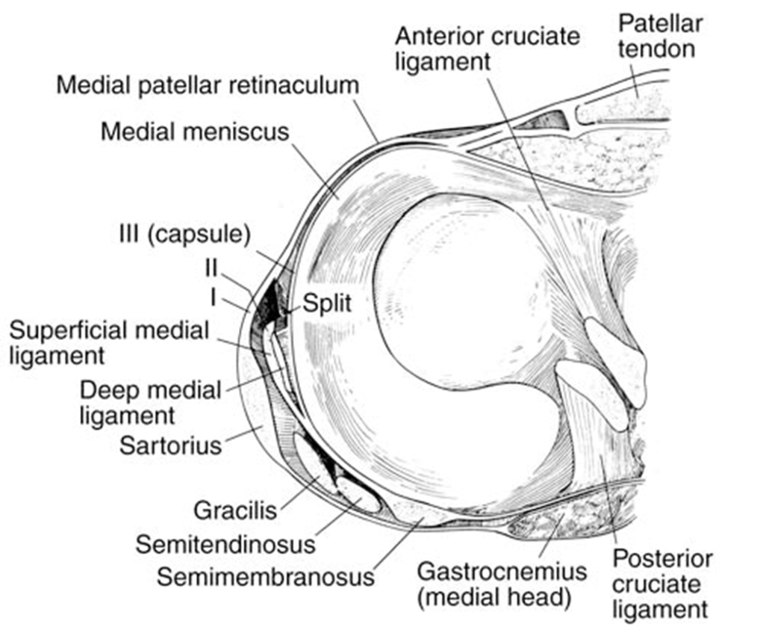
MCL: Anatomy
Medial knee capsuloligamentous structures can be divided into 3 layers

Slide 13
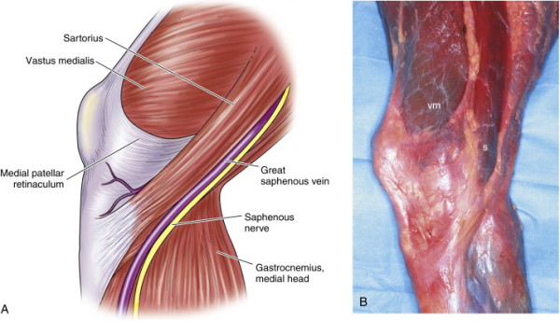
MCL: Layer 1
Sartorius and crural fascia
  Covers both heads of gastroc and neurovascular structures
  Blends with layer II anteriorly
  Joins tibial periosteum near insertion of pes anserinus tendons

Slide 14
MCL: Between Layers 1 and 2
Semitendinosis
Gracicilis

Slide 15
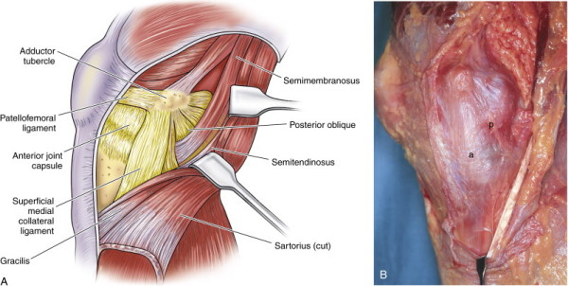
MCL: Layer 2
Superficial MCL
Posterior oblique ligament

Slide 16
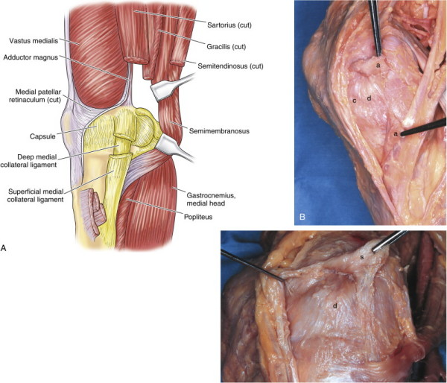
MCL: Layer 3
Capsule
Deep MCL
Coronary ligaments

Slide 17
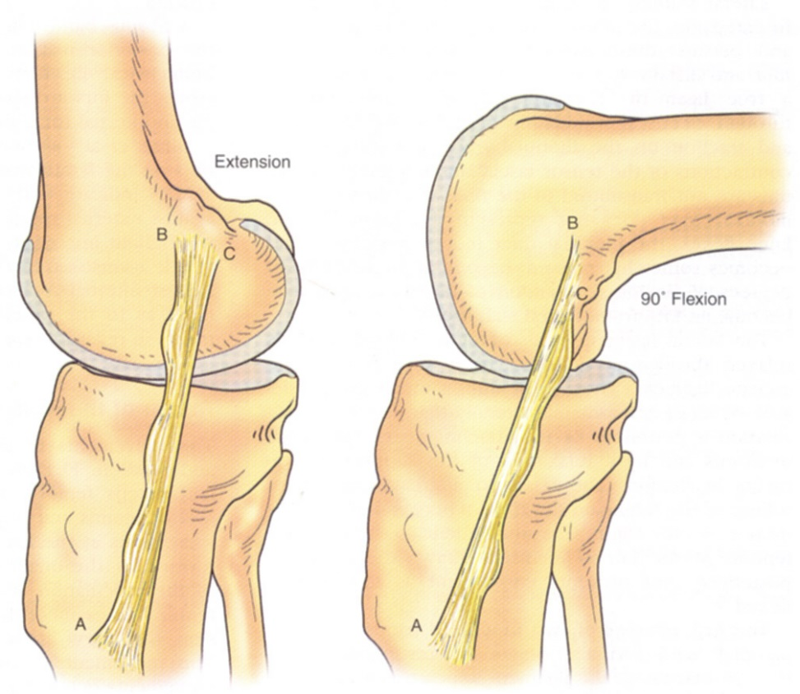
MCL: Biomechanics
Fan shaped, near instant center of rotation
  Anterior fibers tense in flexion
  Posterior fibers tense in extension
1-2 cm excursion during flexion
Tight in external rotation

Slide 18
MCL: Research
At 25 degrees of flexion, the superficial MCL provided 78% of the restraint to valgus stress, and at 5 degrees, the contribution was 57%. As the knee extends, the posterior capsule and POL tighten, providing increasing restraint to valgus stress. At 5 degrees, the POL provides 18% medial stability and at 25 degrees only 4%. Similarly, the deep ligament accounted for 8% at 5 degrees and 4% at 25 degrees. The cruciate ligaments provided the remaining stabilizing force with increasing amounts as the knee was extended.
“This study shows the increased awareness the physician should exhibit with increased laxity in extension owing to the possible rupture of the cruciates and posteromedial complex.”
Grood E.S., Noyes F.R., Butler D.L., et al: Ligamentous and capsular restraints preventing straight medial and lateral laxity in an intact human cadaver knees. J Bone Joint Surg Am 1981; 63:1257-1269

Slide 19
MCL: Research
Sequentially sectioned the deep ligament, POL, and superficial ligament and found that the superficial ligament was the primary stabilizer against valgus and external rotation stresses. After the deep ligament and POL had been cut, sectioning the superficial MCL increased the medial joint opening 5 to 7 mm and increased external rotation 200% to 300%.
Warren L.F., Marshall J.L., Girgis F.: The prime static stabilizer of the medial side of the knee. J Bone Joint Surg Am 1974; 56:665-674.

Slide 20
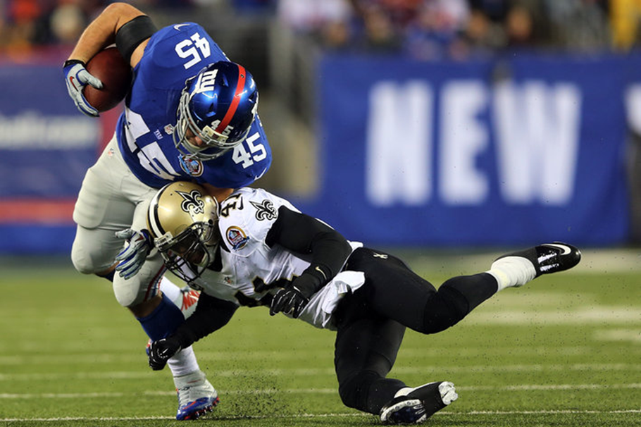
MCL: INJURY MEcHANISM
Typical mechanism is force to the lateral aspect of the leg or lower thigh, ie. clipping injury in football
noncontact injury is from external rotation stress (cutting, pivoting, or twisting)
Knee dislocation
Skiers are more prone to medial-side injuries with 60% of all skiing knee injuries affecting the MCL

Slide 21
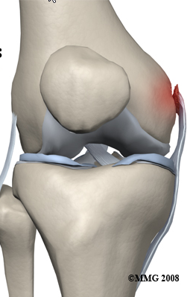
MCL: Injury Mechanism
Rupture typically occurs at femoral insertion
Tibial sided avulsions are rare

Slide 22
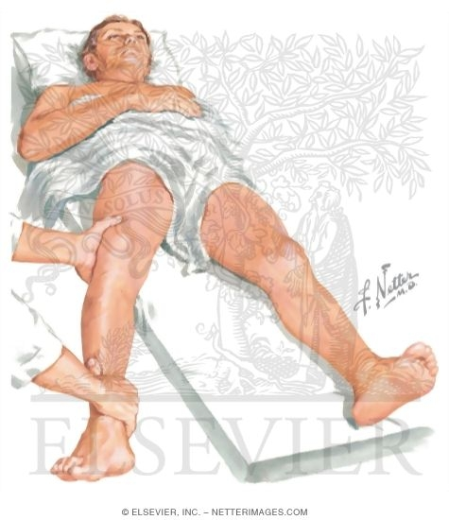
MCL: Physical Examination
Compare both sides
Point tenderness may identify location of injury 78% of time (Hughston, et al.)
  Localized swelling can identify tear in medial knee structures 64% of time
Valgus stress at 30 degrees is gold standard
Dropping leg over edge of exam table may make assessment easier

Slide 23
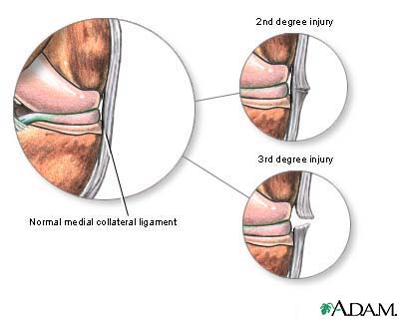
MCL: Severity
Grade
  I - <5 mm (Physiologic 2)
  II - 5-9 mm
  III -10+ mm
Degree
  I – tenderness, no instability
  II – valgus laxity with firm end point
  III – Mushy or absent end point

Slide 24
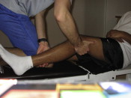
MCL: Slocum’s Test
Rationale: disruption of the deep MCL allows the meniscus to move freely and allows the medial tibial plateau to rotate anteriorly
Modified anterior drawer
Valgus stress in 15 degrees external rotation and 80 degrees flexion
Prominence of medial tibial condyle is positive test

Slide 25
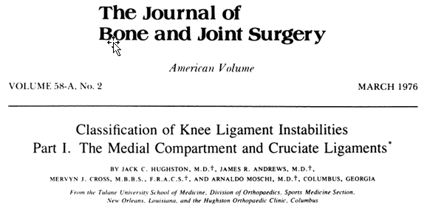
MCL: Gait
Many patients (50%) with Grade III injuries can walk unaided and have minimal pain
Incomplete tears found to be more painful than complete tears
Vaulting type gait – Quad activation for medial stabilization
  knee is hyperextended and locked at the end of the stance phase and the patient vaults over the extremity
  Contrast with bent knee gait in ACL tear

Slide 26
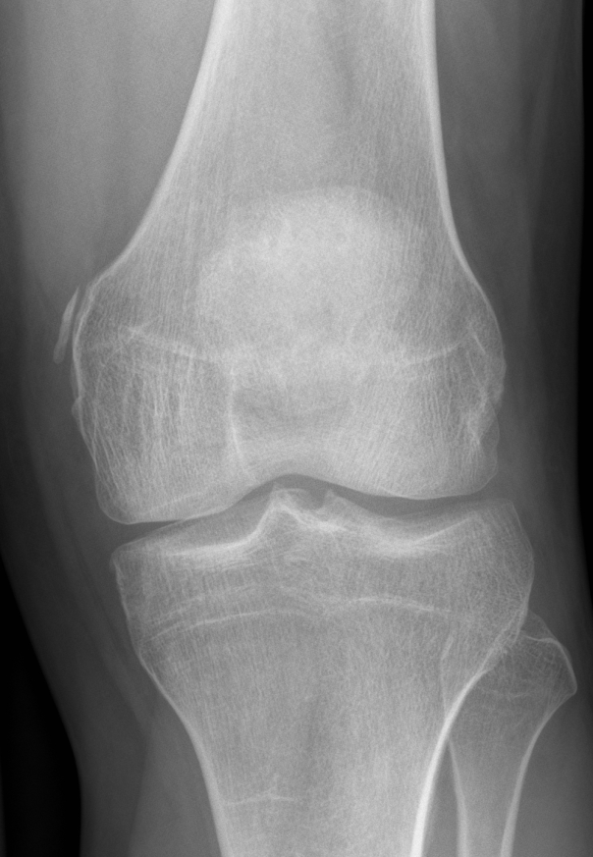
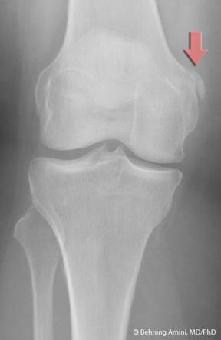
MCL: Imaging
Pellegrini – Stieda Lesion
Evidence of old, chronic MCL injury
Intra-substance calcification
Usually near proximal origin
Follows severe injuries
Can be treated with excision if symptomatic

Slide 27
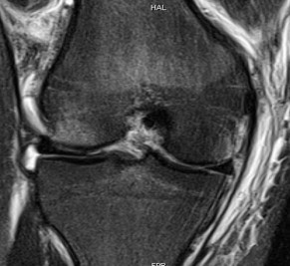
MCL: Imaging
MRI helpful for delineating of disruption of the collateral complex
Determine whether injury is proximal, mid substance, or distal
Determine whether the deep and/or superficial ligament is disrupted
Collateral ligament is best visualized on T2 weight images:
  high signal of edema and hemorrhage in the substance of the low signal ligament
Look for concomitant meniscal tear

Slide 28
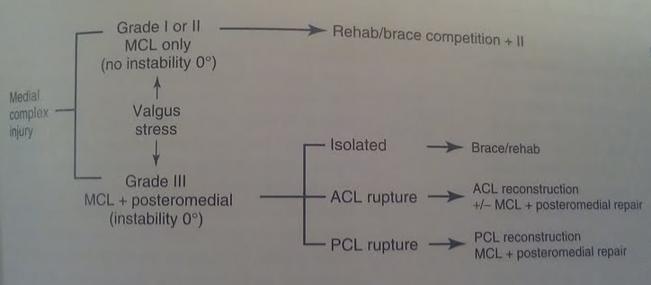
MCL: Miller’s Treatment Algorithm

Slide 29
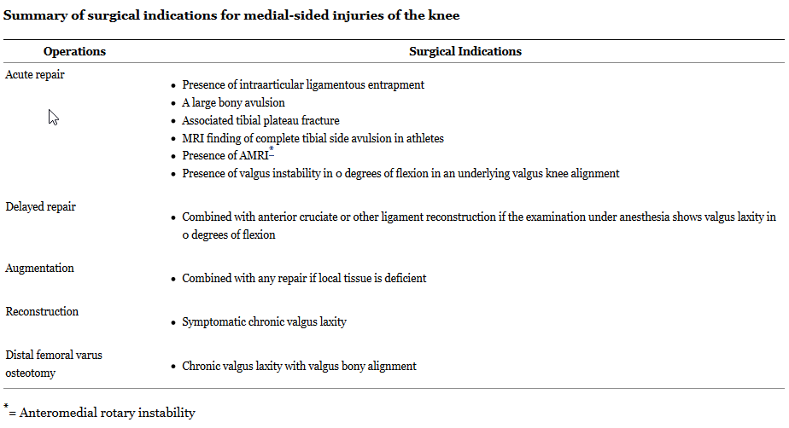
Phisitkul P et al. “MCL Injuries of the Knee: Current Concepts Review.” Iowa Orthop J. 2006; 26: 77–90.

Slide 30
Grade I (isolated)
NSAIDs, rest, therapy
Therapy
  Early weight-bearing
  Emphasize early ROM
  Strengthening
    quad sets, SLRs, and hip adduction above the knee to begin immediately
    cycling and progressive resistance exercises as tolerated
  Functional ROM bracing to protect against further valgus insult
Return to play
  Grade I returned to play at an average of 10.6 days
  Increased laxity and higher risk of reinjury, but not statistically significant

Slide 31
Grade II
Treatment same as Grade I
Nonoperative
  Emphasize early ROM, progressing to strengthening
  Early weight-bearing
  Functional ROM bracing to protect against further valgus insult
players with grade II injury returned to play at an average of 19.5 days.
Again, higher incidence of reinjury than control knees, but not statistically significant

Slide 32
Grade III (isolated)
More controversial
Trend toward nonop
  Splint in full extension (2 weeks)
  Then ROM, WBAT
  Return to play in 9.2 weeks
  Healing may continue for years
  Strenghtening -> 80% then agility program
  Brace for remainder of season to protect against valgus insult

Slide 33
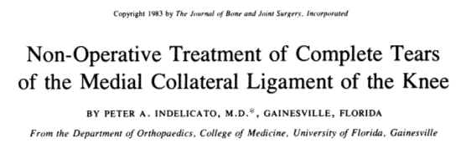
First to prospectively compare operative to nonoperative treatment of isolated third-degree ruptures. All patients underwent examination under anesthesia and arthroscopy to rule out other pathology
Objectively stable knees in 15 of 16 patients treated operatively and in 17 of 20 patients treated nonoperatively
Subjective scores were higher in the nonsurgical group
  good to excellent results of 90% in the nonsurgical group
  88% in the surgically repaired group
No benefit to surgical intervention.
J Bone Joint Surg Am. 1983 Mar;65(3):323-9.

Slide 34
MCL Repair
Medial approach to the knee
Indicated for acute injuries
ligament avulsions: should be reattached with suture anchors in 30 degrees of flexion
interstitial disruption: anterior advancement of the MCL to femoral and tibial origins

Slide 35
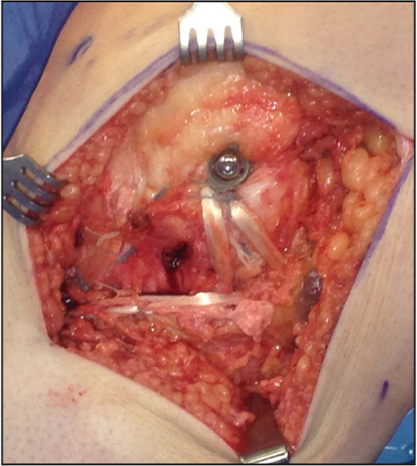
MCL reconstruction
Medial approach to the knee
Indications
  chronic instability
  insufficient tissue for repair
Graft type
  Choice of semitendinosus autograft or hamstring, tibialis anterior or achilles tendon allograft

Slide 36
MCL: Rehabilitation Protocol
Immobilization shown to have detrimental effects on the mechanical properties of the MCL, such as disorganization of collagen fibrils, decrease in the structural properties of the bone-ligament- bone complex, and resorption of bone at ligament insertion sites
Early controlled motion has become a part of standard nonoperative treatment protocols in most current series.

Slide 37
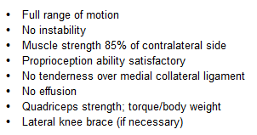
MCL: Return to play

Slide 38

MCL: Associated Injuries
Additional injury to surrounding structures increases with increasing force (Fetto and Marshall)
  20% of Grade I
  52% Grade II
  78% Grade III
88% of surgically treated medial sided knee injuries had injury to more than one medial or posteromedial structure, most commonly the posterior oblique ligament (POL).

Slide 39
MCL: Associated ACL Injury
“The literature supports nonoperative treatment of the MCL tear with surgical reconstruction of the ACL. This is the trend that most surgeons are currently using.”
Early versus late reconstruction continues to be a subject of debate, with studies supporting both sides

Slide 40
Lateral Collateral Ligament

Slide 41
INTRODUCTION
Incidence of PLC injuries is not accurately known →often undetected
Isolated injuries to PLC are rare
  DeLee & Rockwood–
    2 % of all ligamentous knee injuries
  Usually combined with cruciate ligament injury (PCL > ACL)
MRI study of tibial plateau fxs showed PLC injuries in 68% of cases
Commonly being recognized when residual instability exists s/p ACL or PCL reconstruction.
  Poor outcomes after ACL reconstruction? → PLC injury?

Slide 42
LCL Anatomy
Femur: proximal and posterior to lateral epicondyle
Fibula: 8.2 mm posterior to anterior surface
Primary static restraint to varus opening

Slide 43
PLC Anatomy
Popliteus
  Originates posteromedial tibia
  Intra-articular course through knee
    Popliteal hiatus of coronary ligament
  Inserts at popliteal saddle of lateral femoral condyle
  Internally rotates
Popliteus Tendon Complex
  Popliteus muscle/tendon unit
  Connections from tendon to surrounding structures
    Popliteofibular ligament
    Popliteotibial ligament
    Popliteomeniscal ligament
  Restrict posterior tibial translation, ER of tibia, varus stress
Notes:
Popliteus always inserts anterior and distal to LCL femoral attachment
PFL: from fibular styloid process to musculotendinous junction of popliteus; anterior and posterior division
PML: fascicles extend from tendon to lateral meniscus to provide dynamic stability

Slide 44
PLC Anatomy
Popliteofibular Ligament (PFL)
  Arises from myotendinous jxn of popliteus
  Inserts on fibular styloid
  Present in 94-100% of knees.

Slide 45
PLC Anatomy-
Other supports and restraints
Iliotibial Band
Biceps femoris
Oblique Popliteal Ligament
Ligament of Wrisberg
Fabellofibular ligament
  Thickening of distal capsular edge of short head of biceps
Lateral capsular ligament (middle third)
Lateral meniscus
Posterior cruciate ligament
Notes:
IT Band: Multiple layers that blend with short head of biceps to form an anterolateral sling for knee
FFL: thickening of distal capsular edge of short head of biceps
Lateral capsular ligament: thickening of lateral capsule
Lateral meniscus increases conformity of of knee joint and provides stability-especially to convex joint surfaces laterally.
Popliteus tendon attaches to meniscofemoral ligament intra-articularly

Slide 46
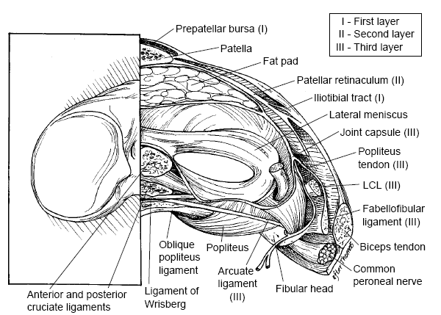
Anatomy: Lateral Layers
Anatomy
Layers run from superficial to deep

Slide 47
ANATOMY – Layer 1
Iliotibial Band and Biceps Femoris
  Dynamic external rotators of the tibia.
  Secondary restraint to varus stress.
Common peroneal nerve lies between layers 1 & 2

Slide 48
ANATOMY – Layer 2
Quadriceps Retinaculum
Lateral Patellofemoral Ligament

Slide 49
ANATOMY – Layer 3
Superficial
  LCL
  Fabellofibular ligament
Deep
  Arcuate ligament
  Coronary ligament
  Popliteus tendon
  Popliteofibular ligament
  Capsule

Slide 50
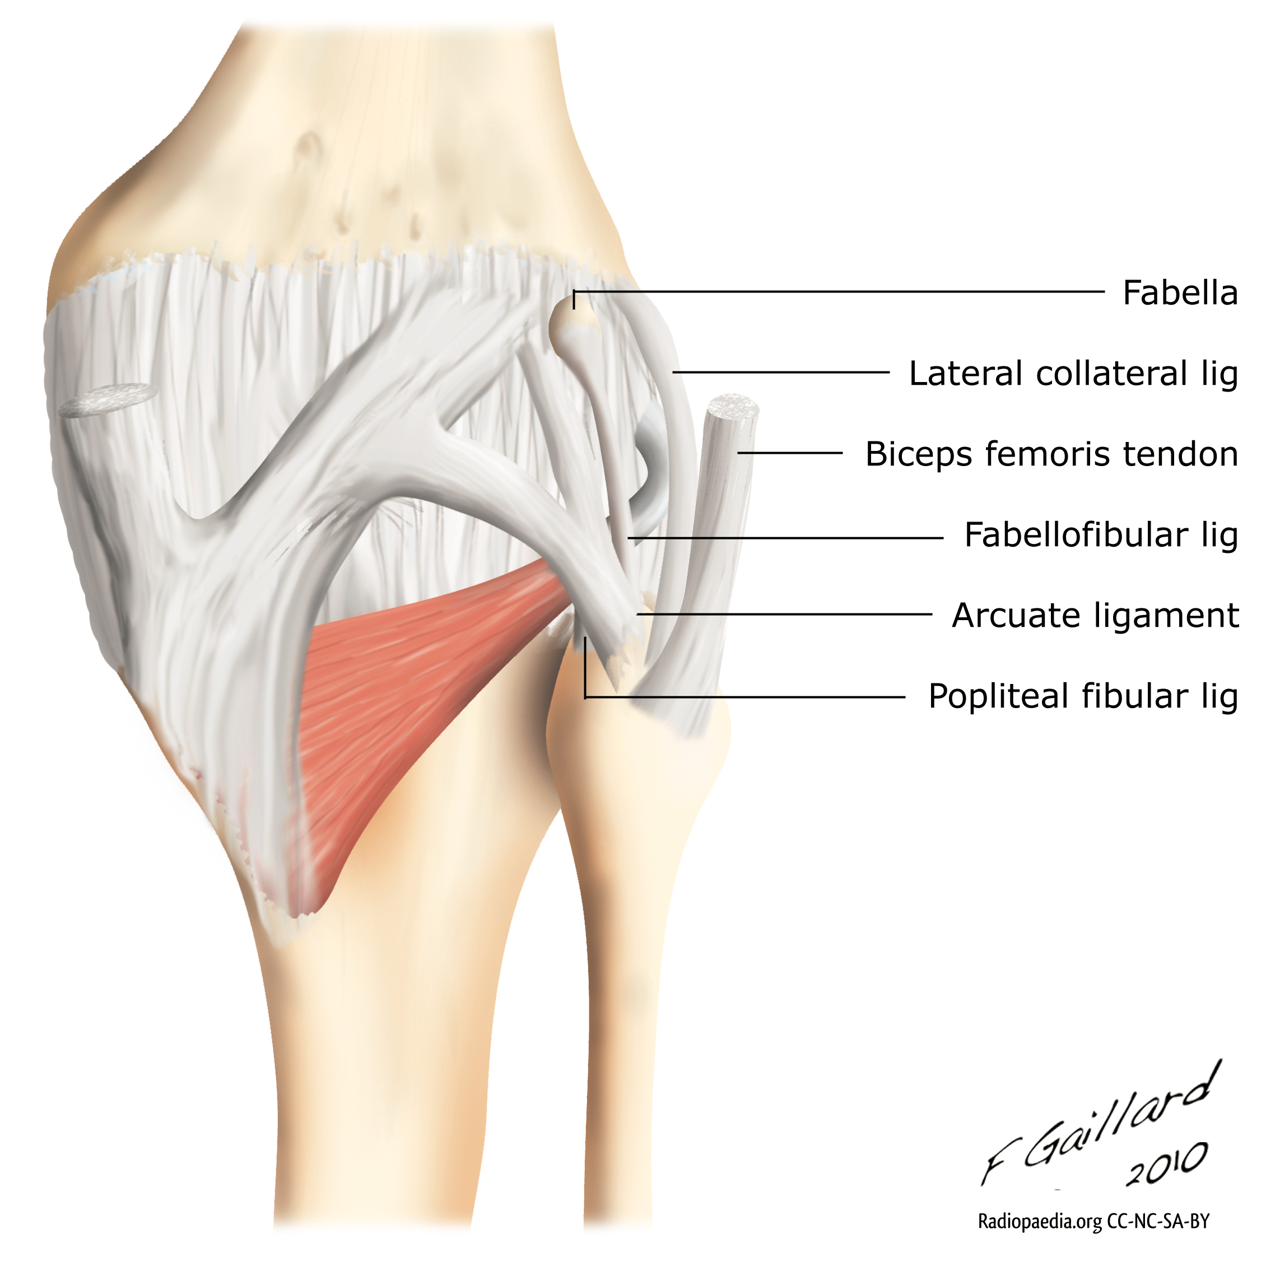
ANATOMY – Layer 3
Arcuate ligament
  Variable
  Reinforces the posterolateral capsule and covers the popliteus
  Y shaped with medial and lateral limbs
  Fibular styloid to lateral femoral condyle

Slide 51
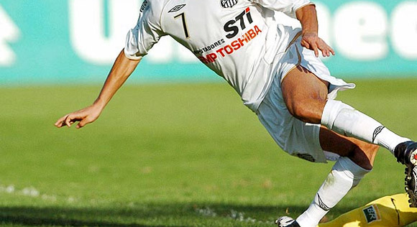
Biomechanics
Structures of the PLC (including LCL) function to resist:
  Varus opening
  External tibial rotation
  Posterior tibial translation
  Act in combination with PCL for overall stability to lateral knee
PLC (excluding the LCL)
  Primary stabilizer of ER at all flexion angles
    Larger role at ~ 30° compared to 90 ° flexion
  Resist posterior tibial translation
    Isolated sectioning produced increased translation at all angles, greatest at early flexion
  Primary restraint to posterior tibial translation at full knee extension

Slide 52
Biomechanics
LCL
  Tight in extension, lax in flexion
  Greater ER resistance at full extension vs flexion
PCL
  Resists posterior translation of tibia
    Primary in greater knee flexion
  Isloated sectioning had no effect on ER

Slide 53
Biomechanics
Three most important structures to control varus and ER
  LCL
  Popliteus tendon
  Popliteofibular ligament

Slide 54
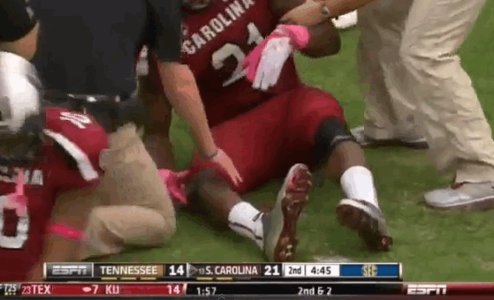
Clinical Evaluation
History
  Common Mechanisms
    Blow to anteromedial tibia
    Hyperextension w/ ER (+/- contact)
    Direct varus blow to flexed knee
    Knee dislocation
  Combined with ACL or PCL injury
    More common than isolated PLC injury
  Timing
    Acute: 3-4 weeks
    Chronic: >6 weeks

Slide 55
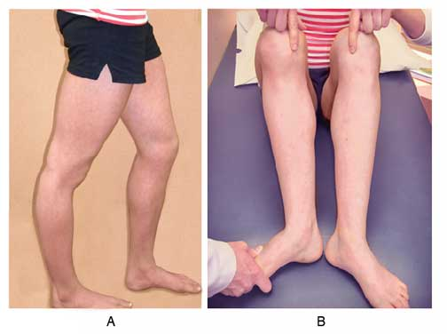
Physical Examination
Complete knee examination
  Remember association with other injuries
  TTP & echymosis at posterolateral knee
Neurovascular exam
  12 – 29% with peroneal nerve palsy
Gait assessment
  Varus or hyperextension/varus thrust can be seen
Numerous specific tests

Slide 56
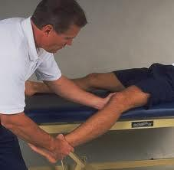
Physical Examination
Adduction-Abduction stress test
  Normal varus laxity 7°
  Performed at 0° and 30° flexion.
    Can get laxity at full extension with cruciate injury.

Slide 57
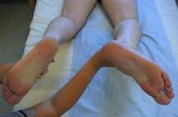
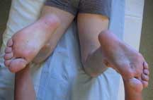
Physical Examination: Dial Test
May be done prone or supine
  10° difference in rotation
    @ 30° = PLC
      Reduced rotation at 90° = Isolated PLC
    @ 90° = PLC and PCL
        Veltri and Warren

Slide 58
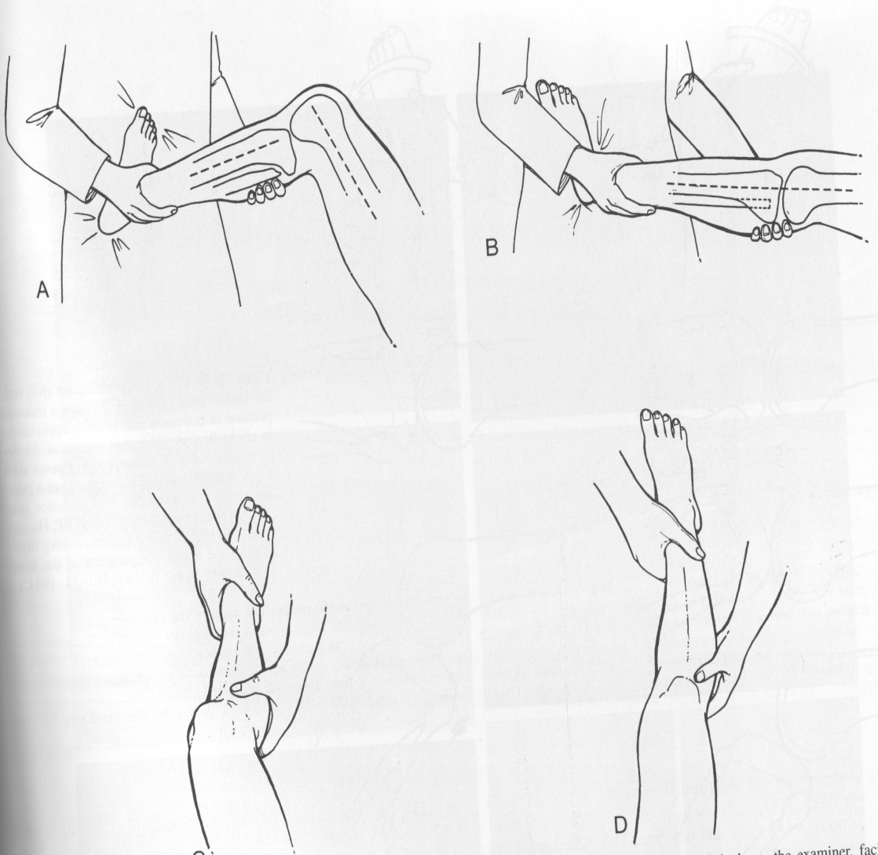
Physical Examination
Reverse Pivot Shift –
  Start – knee flexed 90°
  Slowly extend knee with axial load and valgus stress. Foot in ER.
  Tibia is subluxed > will “jump” or reduce at 20-30° of flexion
    IT band changes from flexor to extensor at this angle
  LaPrade & Terry (1997)
    + RPS associated with:
        LCL injury
        Mid-third lateral capsular ligment injury
        Popliteal complex injury

Slide 59
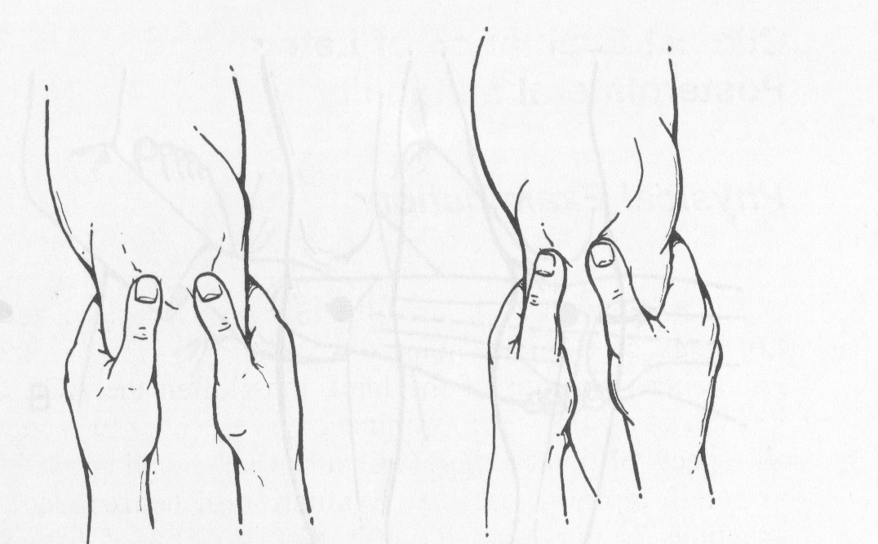
Physical Examination
Posterolateral Drawer Test
  Performed with the hip flexed 45°, knee flexed 80°, and foot is ER 15°.
  A combined posterior drawer and external rotation force is then applied to the knee to assess for an increase in posterolateral translation (lateral tibia externally rotates relative to lateral femoral condyle)
    Graded 1-3 in 5 mm increments
    70-75% sensitivity
      Hughston & Norwood

Slide 60
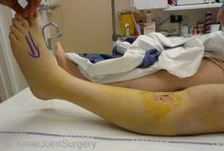
Physical Examination
External Rotation Recurvatum
  Positive when lower leg falls into external rotation and recurvatum when leg suspended by toes in supine patient

Slide 61
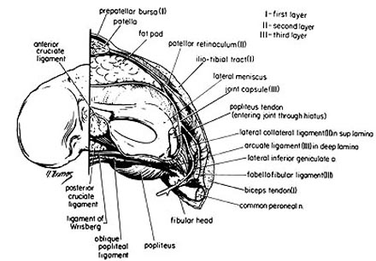
Classification
No universal classification system has been adoptied
Modification of Hughston system
  Grade I = 0-5mm varus or 0-5° rotation
  Grade II = 6-10mm varus or 6-10° rotation
  Grade III = >10mm varus and >10° rotation

Slide 62
Imaging
X-Rays →
  AP/Lat weight-bearing, Patellofemoral views
  Typically normal
  BUT, fibular head fractures, avulsion of Gerdy’s, tibial plateau fractures, tibiofemoral dislocation, PCL avulsion fractures, Segond’s fracture, tibial spine fractures
Chronic injuries
  May show arthrosis of lateral compartment
  Full-extremity films to evaluate alignment
Stress views for laxity

Slide 63
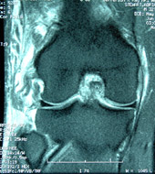
Imaging
MRI
  Diagnostic study of choice
  Standard sequences
    Coronal oblique slices may improve accuracy & sensitivity of PLC specific injuries
  May be especially useful in acute injuries
    Difficult/Limited exam due to pain

Slide 64
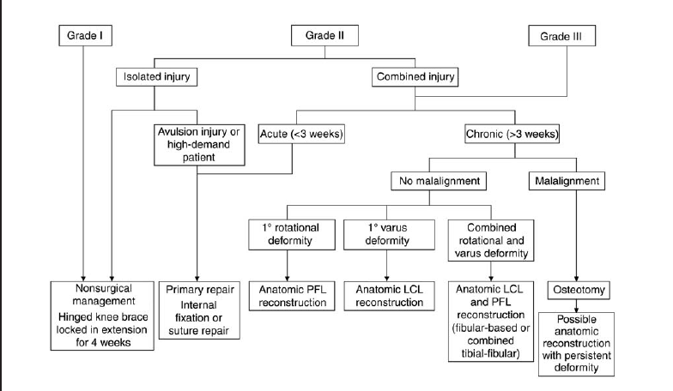
Treatment Options
Ranawat et al. (2008) JAAOS

Slide 65
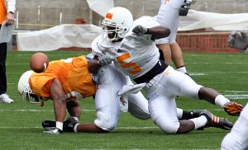
TREATMENT
Nonoperative –
  Isolated PLC injuries typically report little functional impairment initially
  Brief period of protective weight-bearing followed by functional rehab can lead to good results.
    Initial 2-4 weeks immobilization (protected WB initial 2 weeks)
      Hinged knee brace locked in extension
    Increased ROM, WB, and strengthening
      Return to full activity around 3-4 months

Slide 66
TREATMENT
Nonoperative –
  Baker et al (JBJS 1983)
    13 patients isolated PLC injury
      All returned to full pre-injury activity.
  Kannus (Am J Sports Med 1989)
    Grade I & II injuries do well with nonoperative treatment (despite persistent laxity)
      Grade III do poorly with non-op tx

Slide 67
Surgical Treatment
Indications
  Grade III injuries
  Persisent pain, instability, and/or functional limitations despite non-op management
Options
  Direct repair +/- augmentation, or reconstruction
  Acute disruptions
    Primary repair with or without augmentation.
  Chronic Injury
    Occasionally possible to tighten existing structures
    More commonly ligamentous reconstruction required

Slide 68
Surgical Treatment
PLC repair/reconstruction, ACL and/or PCL reconstruction, +/- HTO
  Indications
    In acute and chronic combined ligament injuries
Technique
  PLC reconstruction should be performed at same time or prior to (as staged procedure) ACL or PCL to prevent early cruciate failure
  Combined ACL and posterolateral corner reconstruction allows less anterior translation than isolated ACL reconstruction, but could not identify significant differences between the two groups in terms of functional outcomes (Kim et al JBJS 2012).
  High Tibial Osteotomy
    Indicated in patients with varus mechanical alignment
    Failure to correct bony alignment jeopardizes ACL and PLC reconstruction success

Slide 69
Surgical Treatment
Early surgery is better!
  Within 3 weeks
  Better function and stability
    More likely to restore native anatomy & biomechanics
Stannard (2005)– Early surgery
  37% failure with repair vs. 9% failure with reconstruction
    Cruciate repairs were not done at initial surgery
Pearls:
  1: Diagnose and address all concomitant injuries
  2: Treat avulsions w/ direct internal fixation or sutures
  3: LCL should have midsubstance repair and graft reconstruction
  4: Possible release of peroneal nerve
  5: Fix all combined injuries at once if possible
Notes:
Chronic injuries must have reconstruction
Chronic injuries with malalignment must address both the malalignment and the reconstruction. Malalignment usually treated with high tibial osteotomy
Varus malalignment = 3° of varus discrepency

Slide 70
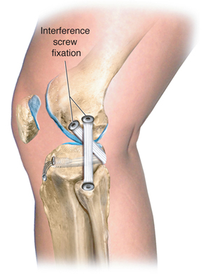
LCL Reconstruction
  There is no benchmark technique/procedure
  Non-anatomic vs. Anatomic
    Non-anatomic: more historical
      Biceps tenodesis, arcuate copmlex/proximal bone block advancments, IT band sling, augments
    Anatomic (nearly anatomic): more common recently
      Fibular-based vs. tibial-fibular-based

Slide 71
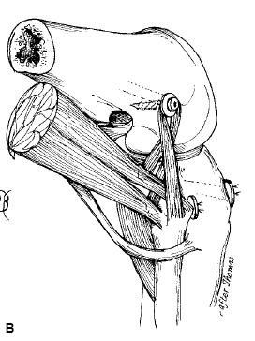
BICEPS TENODESIS
Replaces LCL & PFL
Band of distal biceps femoris tendon is attached to lateral femoral epicondyle.
Attachment to fibular head kept
Variations on this theme → whole tendon moved anterior, different modes of fixation, tendon can be looped.
Fixation on femur
  1 cm anterior to LCL attachment.

Slide 72
LCL Reconstruction
Fibular-based
  Larson
    Reconstruct both LCL and PFL
    Two-tailed, figure of 8

Slide 73
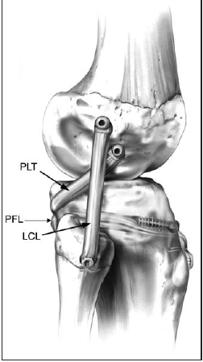
LCL REconstruction
Tib-fib-based
  More closely resembles anatomy
  No evidence of improved outcomes yet
  More technically demanding
  LaPrade technique
    Reconstructs LCL, PFL, and popliteus tendon
    2 tendon grafts

Slide 74
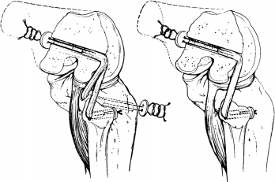
LCL REconstruction
Tib-Fib Based
  Tendon graft is fixed to isometric point of the femoral epicondyle.
  One branch is fixed to the fibular head with a bone tunnel and tranosseous sutures to reconstruct the LCL.
  Second limb is brought through the posterior tibia to reconstuct the popliteofibular ligament

Slide 75
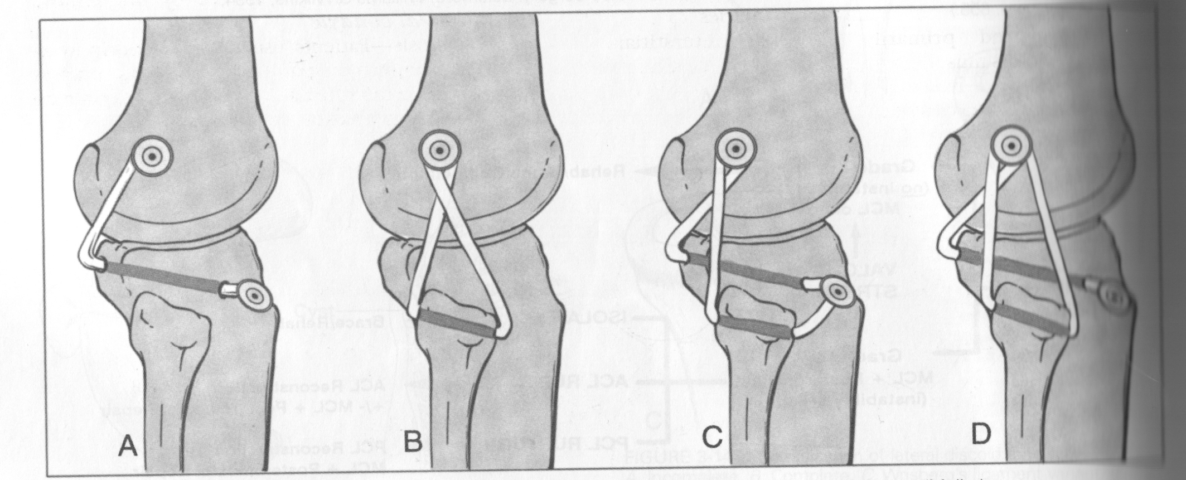
LCL REconstruction

Slide 76
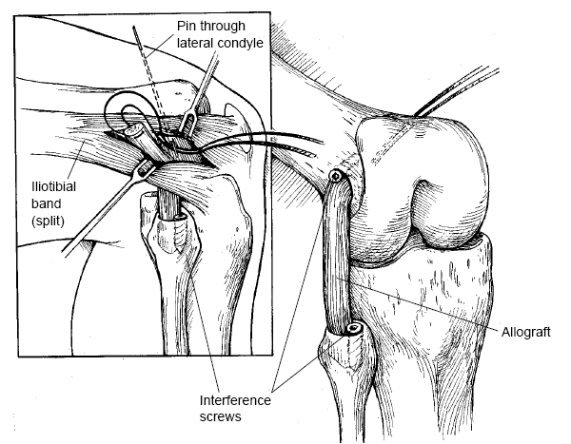
LCL REconstruction
Bone –PT-Bone Allograft. Achilles can be used as well.

Slide 77
Treatment Options
Ranawat et al. (2008) JAAOS

Slide 78
Rehabilitation
Partial WB w/ Knee brace locked in extension for 6 weeks
Brace unlocked for ROM exercise early ➔ closed chain quad strengthening
  Avoid active flexion exercises early
Quad sets
Return to full function at 10-12 months

Slide 79
OITE Questions

Slide 80
A soccer player sustains a knee injury. He is noted to have a significant increase in tibial passive external rotation both at 30 and 90 degrees. His MRI would most likely show which of the following?
1. A fibular collateral ligament tear
2. A popliteus tendon tear
3. A posterior cruciate ligament tear
4. Answers 1 & 2
5. Answers 1, 2 & 3

Slide 81
Preferred Response: 5
DISCUSSION: The fibular collateral ligament (also known as lateral collateral) and the popliteus tendon are both components of the postero-lateral corner (PLC). A positive dial test at 30 degrees indicates an isolated PLC injury, while a positive dial test at 30 and 90 degrees indicates PLC and concurrent posterior cruciate ligament (PCL) injury. The Fanelli article describes the evaluation and treatment of multi-ligament knee injuries including PCL and posterior-lateral corner tears.
REFERENCES:
1. OITE07 #123
2. Fanelli GC, Orcutt DR, Edson CJ: The multiple-ligament injured knee: Evaluation, treatment, and results. Arthroscopy. 2005:21:471-486. PMID:15800529 (Link to Abstract)

Slide 82
A 25-year-old man injured his knee in a motor vehicle collision. Abnormal examination findings include 10° increased external tibial rotation at 30° and 90° knee flexion. What additional examination finding is expected?
1- Increased opening to valgus stress at 30° of knee flexion
2- Increased varus opening at 0° of knee flexion
3- Positive apprehension sign with lateral patellar translation
4- Positive pivot shift test
5- Medial tibial plateau rests 10 mm anterior to the medial femoral condyle

Slide 83
Preferred Response: 2
Recommended Reading(s):
LaPrade RF, Terry GC: Injuries to the posterolateral aspect of the knee: Association of
anatomic injury patterns with clinical instability. Am J Sports Med 1997;25:433-438.
Gollehon DL, Torzilli PA, Warren RF: The role of posterolateral and cruciate ligaments in
the stability of the human knee: A biomechanical study. J Bone Joint Surg Am
1987;69:233-242.

Slide 84
A 25-year-old competitive soccer player has chronic anterior knee pain and reports “sloppiness” since injuring it in a collision with another player 2 months ago. He missed several weeks of practice but has since attempted a return to play. Examination reveals no quadriceps atrophy, standing varus alignment of 8°, a posterior sag sign, 3+ posterior drawer, 2+ varus instability in extension, 3+ varus instability at 30°, and 20° increased prone external rotation at 30° and 90°. He walks with a varus thrust. What is the best treatment option?
1- High tibial osteotomy
2- Reconstruction of the posterior cruciate ligament (PCL) and repair of the posterolateral
corner (PLC)
3- Reconstruction of the PCL
4- Reconstruction of the PCL and PLC
5- High tibial osteotomy and PCL/PLC reconstruction

Slide 85
Preferred Response: 5
Recommended Reading(s):
Garrick JG (ed): Orthopaedic Knowledge Update: Sports Medicine 3. Rosemont, IL,
American Academy of Orthopaedic Surgeons, 2004, pp 183-197.
Giffin JR, Vogrin TM, Zantop T, et al: Effects of increasing tibial slope on the biomechanics
of the knee. Am J Sports Med 2004;32:376-382.

Slide 86
What anatomic structure inserts most anteriorly on the proximal fibula?
1- Sartorius
2- Iliotibial band
3- Biceps femoris
4- Popliteofibular ligament
5- Lateral collateral ligament

Slide 87
Preferred Response: 5
Recommended Reading(s):
LaPrade RF, Ly TV, Wentorf FA, et al: The posterolateral attachments of the knee: A
qualitative and quantitative morphologic analysis of the fibular collateral ligament, popliteus
tendon, popliteofibular ligament, and lateral gastrocnemius tendon. Am J Sports Med
2003;31:854-860.
Stannard JP, Brown SL, Farris RC, et al: The posterolateral corner of the knee: Repair
versus reconstruction. Am J Sports Med 2005;33:881-888.

Slide 88
All of the following are true regarding grade III medial collateral ligament (MCL) tears of the knee EXCEPT: Review Topic
1. Proximal ruptures have decreased residual valgus laxity following nonoperative treatment than distal ruptures
2. They result in greater than 10 mm of valgus opening
3. They can result in a Stener-type lesion
4. They require operative repair when there is a concomitant anterior cruciate ligament tear
5. Proximal ruptures have better healing potential with nonoperative treatment than distal ruptures

Slide 89
PREFERRED RESPONSE ▶ 4
Grade III indicates a complete rupture of the MCL with greater than 10mm of opening on valgus stress. Careful evaluation is needed to evaluate for concomitant injuries such as medial meniscus and ACL tears. However, the presence of an ACL tear does not preclude nonoperative treatment. Timing of ACL reconstruction with a concomitant MCL sprain should be delayed proportional to the extent of MCL damage. (Grade I injuries, 3-4 weeks; grade II injuries, 4-6 weeks; grade III injuries, 6-8 weeks.)
According to Shelbourne et al, many surgeons recommend nonoperative management of acute grade III MCL injuries occurring at the femoral origin or mid-substance, and primary repair of injuries at the tibial origin. Perhaps because of better vascularity, proximal tears tend to heal better than distal ones. In contrast, distal ruptures may heal with excessive valgus instability and occasionally result in a Stener-type lesion with the torn MCL flipped over the insertion of the pes anserinus where it is unable to heal normally. Illustration A is an MRI image showing a distal grade III rupture.
The reference by Azar provides a review of the anatomy, clinical exam and treatment options for MCL tears.

Slide 90
References
Ranawat A, Baker CL, Henry S, Harner CD: Posterolateral Corner Injury of the Knee: Evaluation and Management. JAAOS 2008; 16: 506-518.
Gollehon DL, Torzilli PA, Warren RF: The role of the posterolateral and cruciate ligaments in the stability of the human knee: A biomechanical study. J Bone Joint Surg Am 1987; 69:233-242.
Grood ES, Stowers SF, Noyes FR: Limits of movement in the human knee: Effect of sectioning of the posterior cruciate ligament and posterolateral structures. J Bone Joint Surg Am 1988; 70:88-97.
Watanabe Y, Moriya H, Takahashi K, et al: Functional Anatomy of the posterolateral structures of the knee. Am J Sports Med 1996; 24: 311-316.
Orthobullets.com
LaPrade RF, Terry GC. Injuries to the posterolateral aspect of the knee. Association of anatomic injury patterns with clinical instability. Am J Sports Med. 1997 Jul-Aug;25(4):433-8.
Fanelli GC, Orcutt DR, Edson CJ: The multiple-ligament injured knee: Evaluation, treatment, and results. Arthroscopy. 2005:21:471-486.
Sung-Jae Kim, MD, PhD; Duck-Hyun Choi, MD; Byoung-Yoon Hwang, MD: The Influence of Posterolateral Rotatory Instability on ACL Reconstruction: Comparison Between Isolated ACL Reconstruction and ACL Reconstruction Combined with Posterolateral Corner Reconstruction.J Bone Joint Surg Am. 2012;94(3):253-259 .

