Slide 1
Femoroacetabular Impingement and Hip Arthroscopy
Ian Rice, M.D.

Slide 2
Overview
Newer (last 15-20 years) concept to explain hip pain and development of osteoarthritis in patients without history and radiographic evidence of hip dysplasia
  Stulberg in 1975 developed the term “pistol grip” deformity
  Ganz first described FAI in 1995
Conditions leading to FAI
  Posttraumatic deformities, coxa profunda (deep socket), protrusio acetabuli, acetabular retroversion
Three Types of FAI
  CAM
  Pincer
  Combined CAM/Pincer
Unclear role of genetics
  Siblings with a cam-type deformity have a relative risk of 2.8
  Pincer-type has a relative risk of 2.0
  Prevalence is low in the Eastern world
Parvizi et al JAAOS 2007

Slide 3
Pathophysiology of FAI
90% of patients with labral pathology have underlying structural abnormalities
Insufficient congruency between femoral head and socket leads to asymmetric wear of the chondral surfaces with or without instability of the hip
Reactive hip pain with movement of hip in flexed position results in abnormal engagement between the femoral head and acetabulum
  Affects musculature as well: adductor longus, proximal hamstrings, hip abductors, iliopsoas, hip flexor muscles
Retroversion of femur itself can increase external rotation and decrease internal rotation, without elements of FAI

Slide 4
Hip Anatomy
Arteries of the hip joint
  Branches of medial and lateral circumflex arteries
  Deep branch of superior gluteal artery
  Inferior gluteal artery
Nerves to the acetabular labrum
  Branch of the nerve to the quadratus femoris
  Obturator nerve

Slide 5
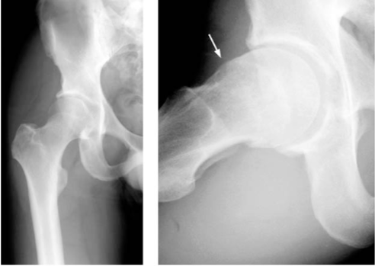
CAM Lesion
Abnormally shaped (nonspherical) femoral head
Results in repeated abutment of the femoral neck into the acetabular rim causing tearing of the labrum and or avulsion from the rim
  Shear injury to the transition zone and adjacent articular cartilage —> good healing rates
Labral and chondral lesion is often observed in the anterosuperior area of the acetabulum
Typcially young, active male patients
Chondrolabral delamination
Sequelae of SCFE

Slide 6
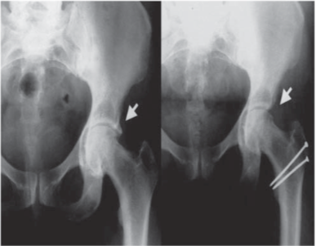
Pincer Lesion
Overcoverage of the acetabular rim
  Associated with conditions like coxa profunda, acetabular retroversion
Abutment between acetabulum and femoral head causes the labrum to fail usually via degenerative changes
  Primary intrasubstance labral injury - often less reparable
Labral damage anterosuperior
  Posteroinferior contrecoup pattern of cartilage loss of the femoral head and acetabulum
Typically middle-aged women who engage in athletic activities

Slide 7
Mixed (Impingement) Patterns
Both femoral and acetabular deformity (most common)
Allen et al JBJS 2009 showed bilateral cam-type deformity was present in 78% of hips with only 26% symptomatic
Cam Types present with pistol grip deformities, focal femoral neck prominence, flattening of lateral femoral head
Pincer Types present with posterior wall sign, excessive acetabular coverage, crossover sign

Slide 8
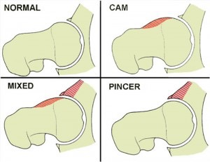

Slide 9
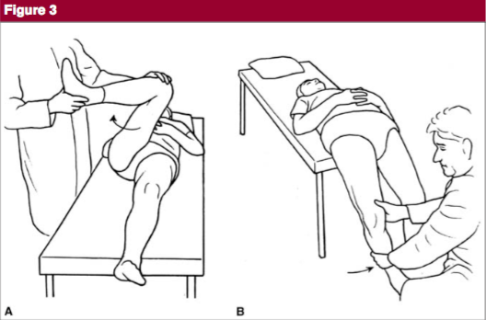
History and Physical
Slow onset of groin pain with or without minor trauma (C-sign)
Exacerbated by activity
  Athletics, prolonged walking or sitting
Exam shows hip limitation of motion
Impingement Test
  Knee & hip flexed to 90, then internally rotate the leg
    Positive test recreates the pain
Posteroinferior impingement - external rotation with hip in extension

Slide 10
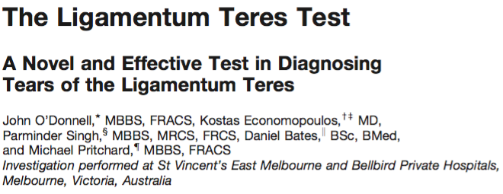
75 patients
Hip is flexed to 70 deg and 30 deg short of full abduction
Hip is then internally and externally rotated to it’s limits of motion
  Pain is considered a positive test
Patients were then hip scoped
Sensitivity 90% and Specificity 85%

Slide 11
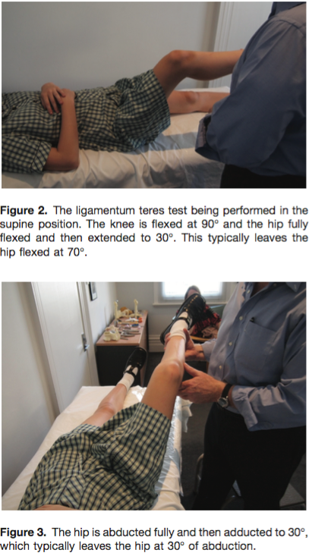
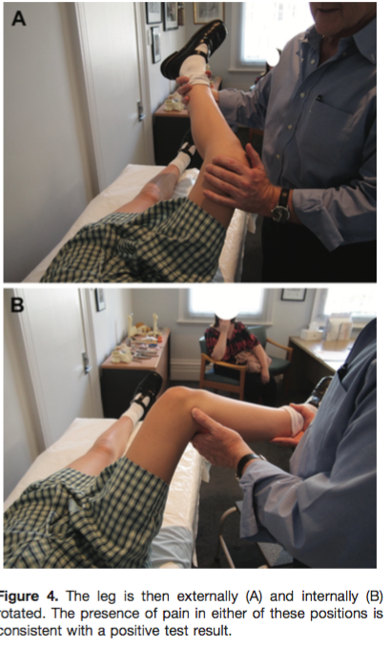

Slide 12
Ligamentum Teres Tears
Treatment: Debridement
Internal and External Rotation of the Hip at 30 and 60 deg of abduction places the bundles of the ligaments in tension
LT is max tight at 90 deg of hip flexion and 90 deg of external rotation
  Capsular ligaments are lax in this position
Want to avoid soft tissue or bony impingement
  However, labral tears and pincer lesions are a confounding variable

Slide 13
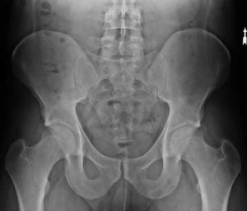
Imaging
X-rays
  Standing true AP and lateral radiographs
  True AP: coccyx points towards the symphysis pubis with a distance of 1-2 cm between
    Critical to assess version
MRI Arthrograms
  Sensitive (>90%) and specific (50-90%) for detecting labral and chondral lesions
    Limited in detecting undetached chondral separations

Slide 14
X-ray buzzwords
Increased Alpha Angle
Head Neck offset
Cross over or posterior wall sign
Increased lateral center-edge angle
Ischial spine sign
Retroversion
Acetabular overcoverage

Slide 15
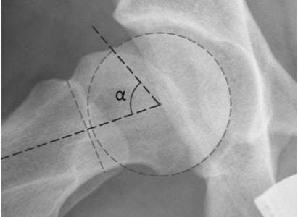
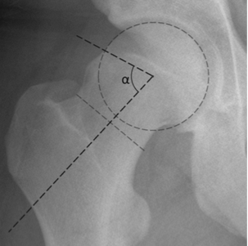
Alpha Angle
Longitudinal axis of femoral neck is defined through the narrowest point and through the head center
Alpha point: radius of curvature of the femoral head first exits the circle of best fit corresponding to the circular head
Laborie et al BJJ 2014 found avg alpha angle in frog leg view was for men was 47 deg and 42 for women (AP view was 62 and 52 deg)
  Showed original thresholds of 50 deg to be too low, need to increase to 55 or even 60 deg to reduce false positive results

Slide 16
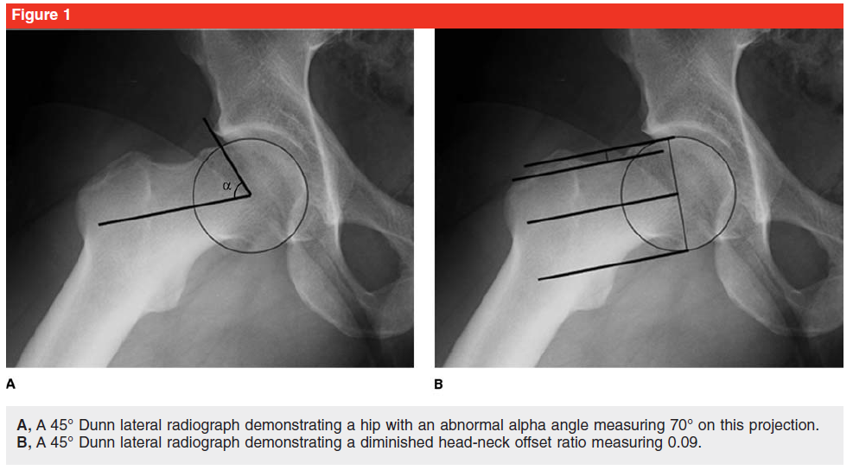
Head Neck Offset Ratio
Line at center of neck to head, two parallel lines at top of neck and top of femoral head gives the neck-head length.
  Ratio is neck to head length to diameter of head
Eijer used MRI and found 7.2mm and ratio of 0.13 in symptomatic vs 11.6mm and 0.21 in asymptomatic controls
  Proposed 8mm and 0.17 ratio for abnormal measurements

Slide 17
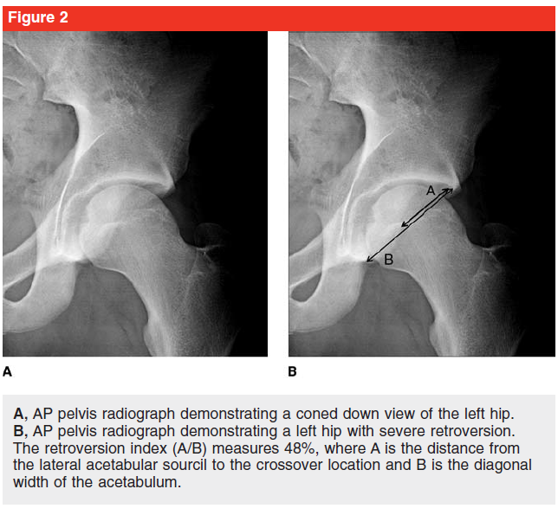
Ischial Spine Sign
If ischial spine is present inside the pelvis, indicating of retroversion of acetabulum

Slide 18
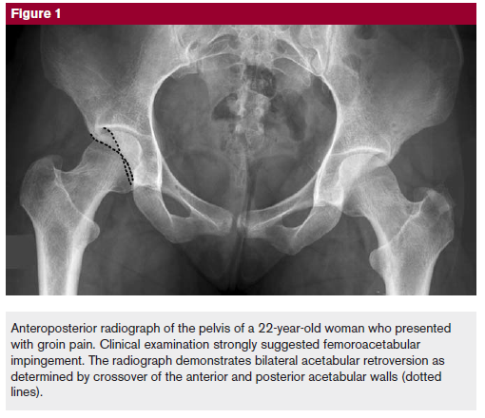
Crossover Sign
Anterior wall projects lateral to medial wall before coverage at lateral acetabular sourcil

Slide 19
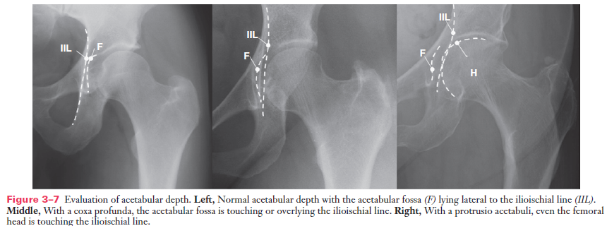
Global Overcoverage

Slide 20
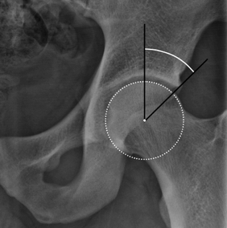
Center Edge Angle
Center Edge Angle (Normal 25-39, <15 is dysplasia)

Slide 21
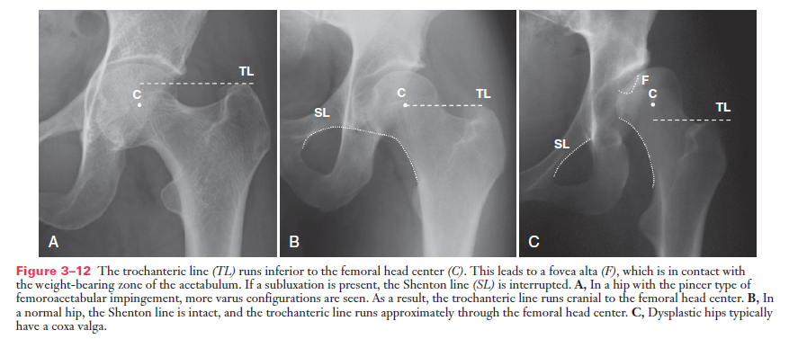
Global Overcoverage

Slide 22
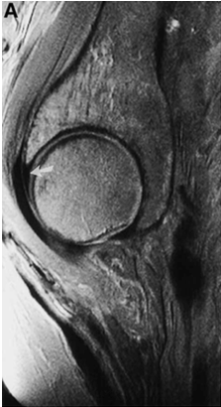
MRI - Normal Hip Labrum
Kelly et al Arthroscopy 2005

Slide 23
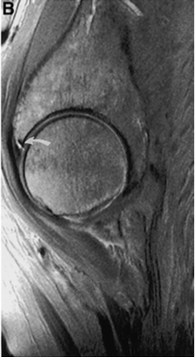
MRI - Labral Tear

Slide 24
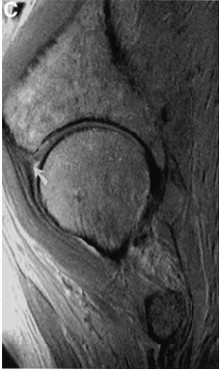
MRI - Degenerative Hip Labral Tear

Slide 25
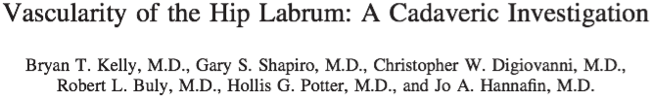
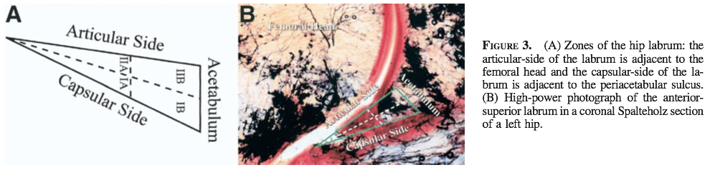
6 cadavers (12 hips) underwent an MRI, then injected with India Ink, then frozen and labrum was sliced into 3mm sections
Zone 1 (capsular) had more vascularity than Zone II (articular)
Zone 1a had most consistent source of vessels, Zone 1b had greatest overall mean vascularity score
Overall, no intrinsic blood supply

Slide 26
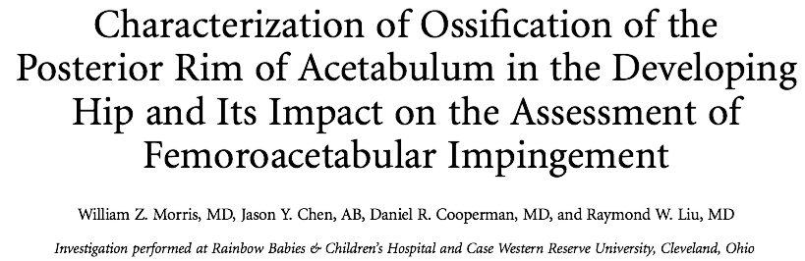
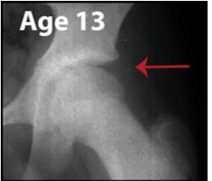
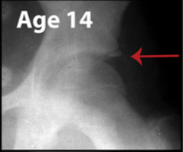
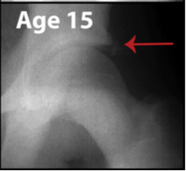
612 x-rays of the Left hip
Showed a posterior rim sign (secondary ossification center of the posterior rim) which occurred around time of triradiate closure and is present for 10 months
Need to be aware of this finding to ensure proper diagnosis of adolescents with acetabular undercoverage

Slide 27
Non-operative Treatment
Activity Modification
  Restriction of athletics
NSAIDs
PT - ROM or stretching is counterproductive
  Strengthening is helpful

Slide 28

15 patients randomized to home exercise versus formal PT for symptomatic FAI
VAS and Hip Outcome Scores measured
Both groups had statistically significant improvement in their scores
Conclusion: Home exercises can help as much as formal PT

Slide 29
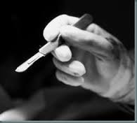
Surgical Treatment
Open Femoroacetabuloplasty
  Surgical Dislocation
  Acetabular Osteotomy
Hip Arthroscopy

Slide 30
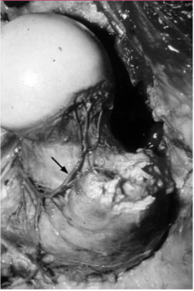
Surgical Dislocation
Preservation of blood supply is critical
  Deep branch of the medial femoral circumflex artery crosses the obturator externus posteriorly, then runs anteriorly toward the short rotators and crosses the femoral neck anteriorly to become the retinacular vessels
    Preserve the short external rotators of the hip

Slide 31
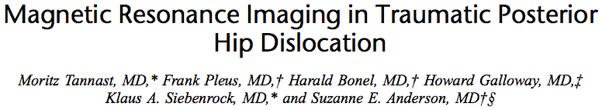
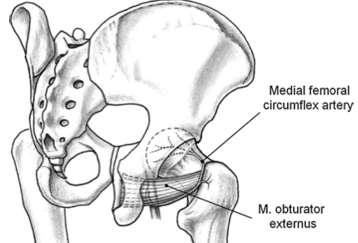
Retrospective look at 19 patients
Found the MFCA is intact when the obturator externis tendon is not damaged
  Deep branch of MFCA runs anterior to the tendon of the obturator interns and gemelli
  Travels posterior and extracapsularly toward the intertrochanteric crest between the iliopsoas laterally and the pectinous medially along the base of the femoral neck

Slide 32
Trochanteric Flip Osteotomy
Initially described by Ganz et al BJJ 2001
Perfomed at the site of the lateral border of the piriformis fossa proximally and at the vastus ridge distally
Trochanter segment will have a small attachment of the abductor muscles which can be retracted anteriorly
  MFCA is protected by obturator externus
S shaped capsulotomy to expose hip joint and hip can then be dislocated
Osteotomy is fixed with two 4.5mm cortical screws
Risks: trochanteric osteotomy nonunion, femoral head osteonecrosis, heterotopic ossification, hip abductor weakness
Ganz et al BJJ 2001

Slide 33
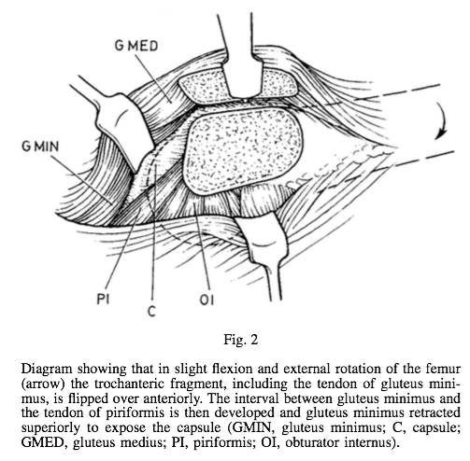
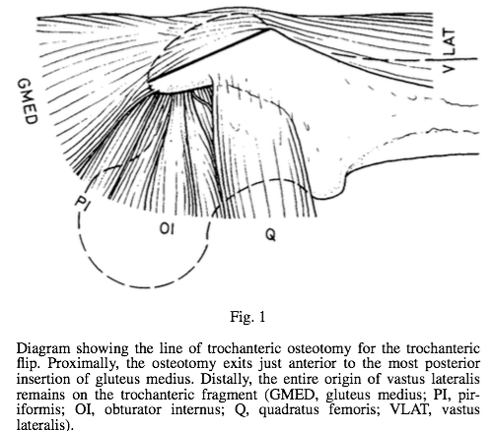
Trochanteric Flip Osteotomy
Ganz et al BJJ 2001

Slide 34
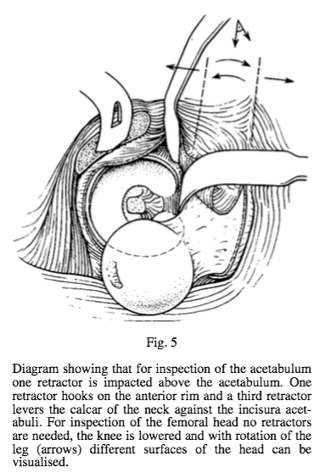
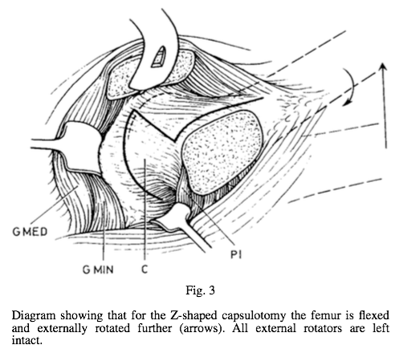
Trochanteric Flip Osteotomy
Ganz et al BJJ 2001

Slide 35
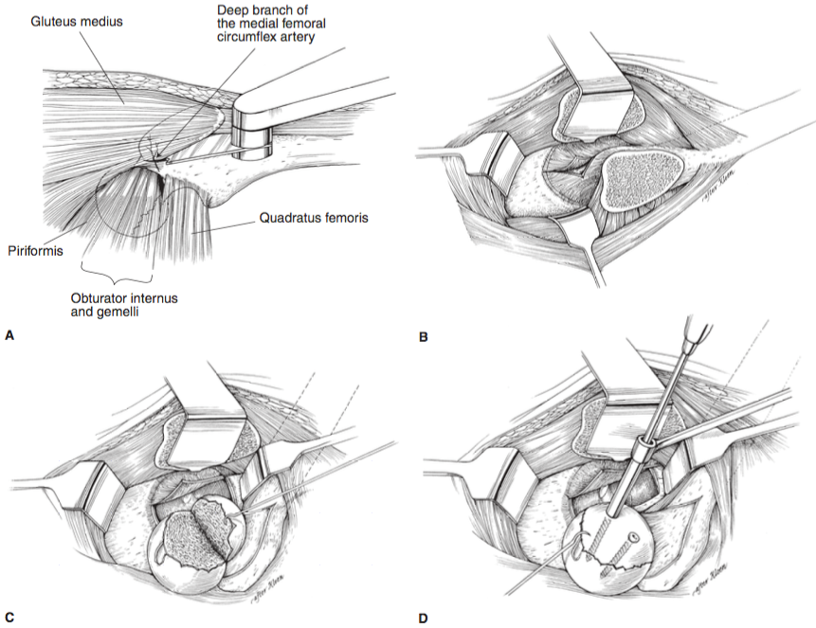
Trochanteric Flip Osteotomy

Slide 36
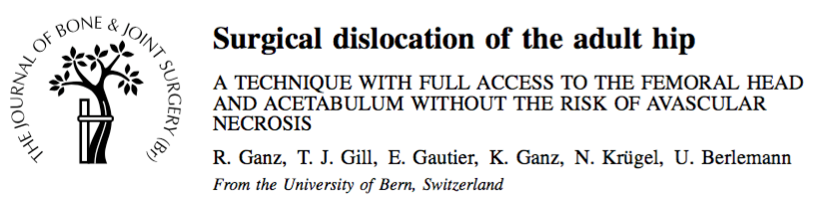
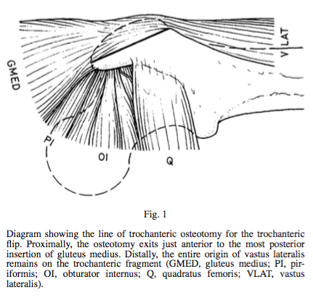
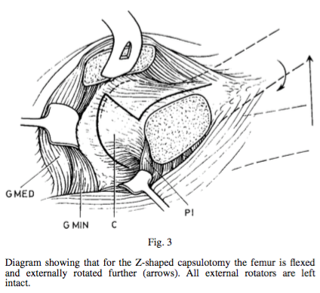

Slide 37
Anterior approach has less visibility of the acetabulum.
Bleeding from drill holes in femoral head has a high correlation with preserved blood supply.
Ligamentum teres has nerve endings like an ACL, so potential loss of proprioception with excision.

Slide 38
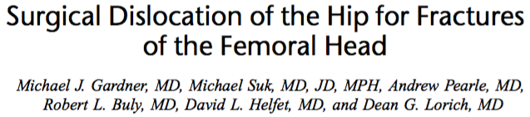
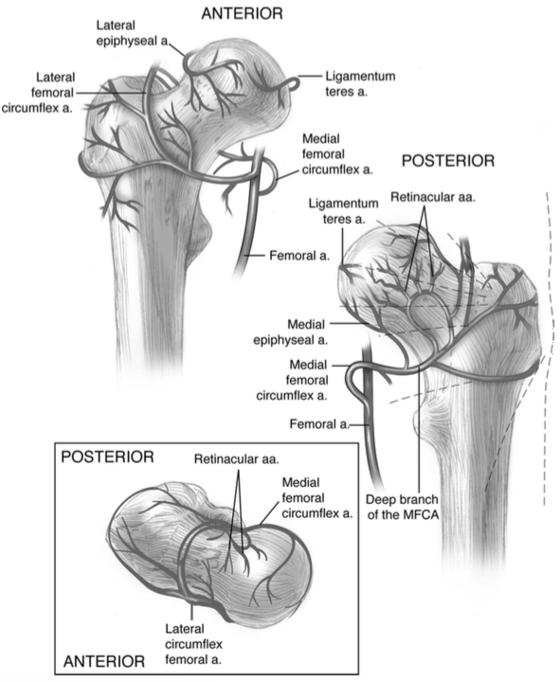

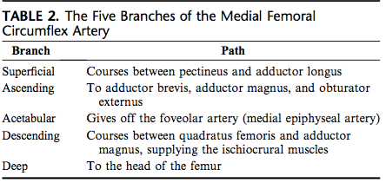

Slide 39
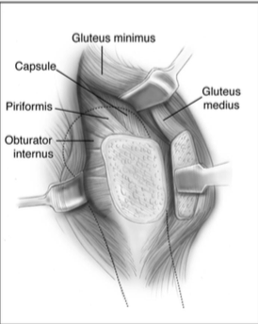
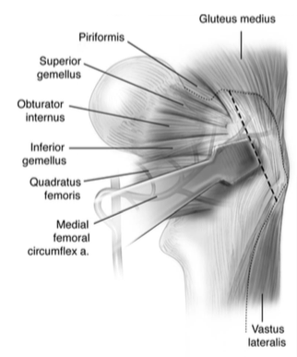

Slide 40
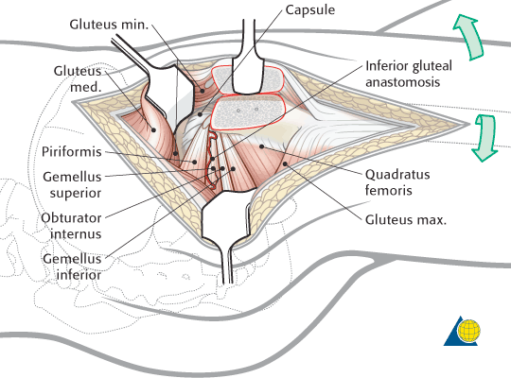

Slide 41
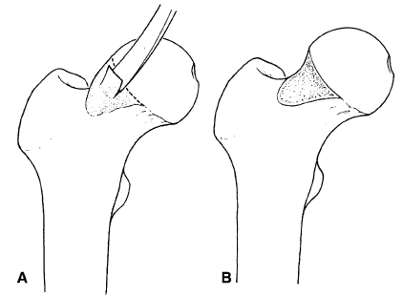
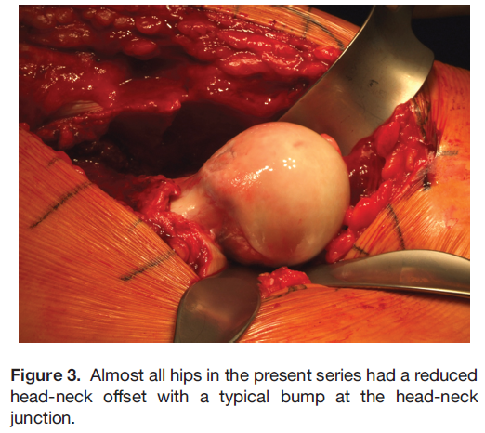
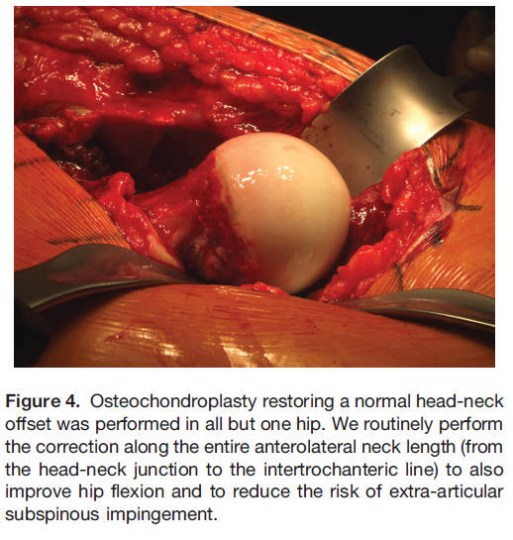
Femoral Resection Osteoplasty

Slide 42
Anteversion Periacetabular Osteotomy
Performed for pincer type rim impingement due to global acetabular retroversion and posterior wall insufficiency
Complications
  Inadequate correction of deformity, intra-articular osteotomy, nonunion of superior pubic ramus, loss of fixation and correction, symptomatic implants, neurovascular injury

Slide 43
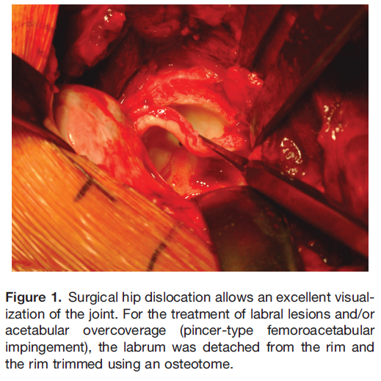
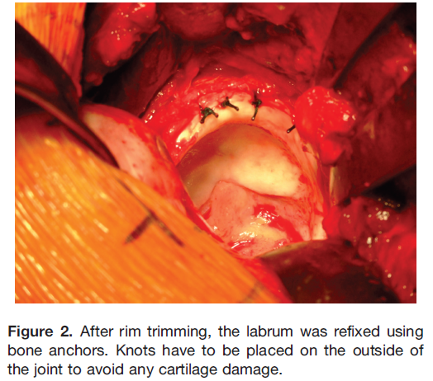
Acetabular Rim Trimming Resection Arthroplasty

Slide 44
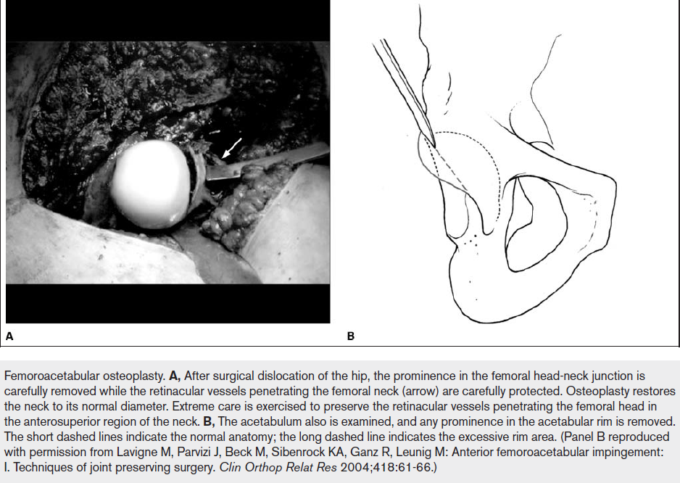

Slide 45
Hip Arthroscopy

Slide 46
Common Indications
Symptomatic labral tears
FAI
Chondral/OCD lesions
Loose bodies
Ligamentum teres injuries
Snapping hip syndrome

Slide 47
Hip Arthroscopy
Minimally invasive technique for diagnostic and therapeutic management of FAI
Downsides
  Depth of resection in the removal of CAM lesions, especially on posterior neck region, is difficult to assess
  Difficult to master

Slide 48
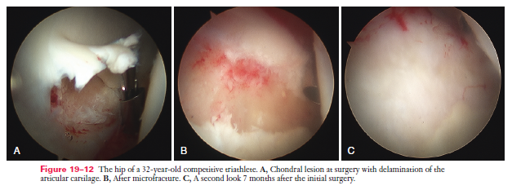



Slide 49

Hip Scope Technique
Portals - Critical to the success of the case
  Anterolateral, anterior, posterolateral
Positioning
  Operative hip is placed in extension, with 25 deg of abduction and neutral rotation
  Traction should be placed to distract the femoral head outwards instead of downwards
Image from Smith and Nephew

Slide 50


Slide 51


Slide 52
Open or Scope?
Bedi et al AJSM 2011 compared 30 patients open dislocation vs 30 patients hip scope for cam impingement
  Found no significant differences in deformity corrections
  Open technique may allow greater correction of posterosuperior regions
Botser et al Arthroscopy 2011 found higher rate of return to sport for arthroscopy in professional athletes than for open surgical dislocations
Wilkin et al JBJS 2014 found little benefit for arthroscopic labral debridement in patients older than 45

Slide 53


36 female patients prospectively randomized to labral repair versus debridement
Hip Outcome Score to determine function
Found HOS was significantly improved (91.2 vs 80.9) in repair compared to debridement

Slide 54

https://www.vumedi.com/video/arthroscopic-repair-of-hip-labral-tears-utilizing-the-iberian-suture-technique/

Slide 55

243 patients who underwent hip arthroscopy for FAI
  Mean age 29.2 years with postop f/u of 21 months
Outcome measures: modified Harris hip score, Hip Outcome Score, Activities of Daily Living, and Sports subclass, and International Hip Outcome Tool
Results: Patients with relative retroversion (<5 deg of anteversion) had significantly less clinical improvement when compared with normal or increased version

Slide 56

Focus of paper is on surgical technique
Key Points
  CAM resection should be less than 1cm deep, 8mm from proximal to distal, and 15mm medial to lateral beginning 1 cm from the labral margin
  Over 30% resection of femoral neck width increases risk of fracture
  CAM lesions are almost exclusively anterior, anterolateral or lateral
Post Op Care
  Touch Down Weight Bearing to 20lbs of force for 2 weeks after
  Early ROM with CPM and passive circumduction exercises

Slide 57




Slide 58



Slide 59



Slide 60


Case Example
39 yo F with groin pain, worse with flexion, adduction, internal rotation.

Slide 61


Case Example #2
29 yo F with history of congenital hip dysplasia as an infant treated with a Palvik harness. She complains of pain with daily activities, and has been gradually worsening over the last year.

Slide 62



MRI

Slide 63
OITE

Slide 64

OITE
A 35 year old man reports a 2 year history of right groin pain. The pain is made worse with hip flexion, prolonged sitting, and cycling. A radiograph and MRI scan are shown in Figures 16a and 16b. Nonsurgical management has failed to provide relief. What is the best surgical option?
1) Arthroscopic labral debridement
2) Reverse periacetabular osteotomy
3) Resurfacing hip arthroplasty
4) Femoral neck osteochondroplasty and resection of the detached labrum
5) Femoral neck osteochondroplasty and reattachment of the labrum

Slide 65

5 - Femoral neck osteochondroplasty and reattachment of the labrum

