Slide 1
Cartilage Injury & Surgical Treament: Microfracture, Cartilage repair/transplant
Ian Rice md

Slide 2
Outline
Cartilage Structure
Causes of Cartilage Defects
Surgical treatments with Level III & IV Evidence
Microfracture
OAT
ACI
Comparative Outcomes
Level I & II Studies

Slide 3
Articular Cartilage
Decrease friction and distribute load
Extracellular matrix
Water – 65-80% cartilage mass
Larger percentage superficially than deep
Decreases with normal aging
Increases with arthritis
Increased permeability, decreased strength, decreased Young modulus of elasticity

Slide 4
Articular Cartilage
Extracellular matrix
Collagen – 10-20% cartilage mass
Type II 90-95%
Framework and tensile strength
Proteoglycans
10-15% of cartilage
Compressive strength
Attracts water
Produced by chondrocytes
Composed of GAGs (chondroitin sulfate and keratin sulfate)

Slide 5
Articular Cartilage
Superficial laceration healing: chondrocyte proliferation, but no healing which may be related to avascularity
Deep laceration healing (deep to tidemark): fibrocartilage healing
Occurs when penetrates into subchondral bone
Hematoma → stem cell migration → vascular ingrowth
Fibrocartilage produced by undifferentiated marrow mesenchymal stem cells
Type I cartilage
Decreased resiliency, stiffness, wear characteristics, resistance to arthritis

Slide 6
Cartilage Lesions
Traumatic Injury
Osteochondritis Dissecans

Slide 7
Osteoarthritis
Management (AAOS recommendation)
NSAIDs (strong)
Weight loss (moderate)
Exercise/physical therapy (strong)
Bracing (equivocal)
Corticosteroid injections (inconclusive)
Viscoelastic injections (cannot recommend)
Arthroscopic debridement (strongly against without mechanical Sx)
High tibial osteotomy (limited strength recommendation)
Unicompartmental arthroplasty
Total joint arthroplasty

Slide 8
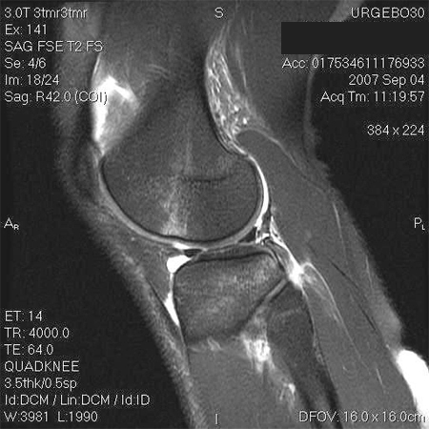
Occult Fractures & Bone Bruises
Subchondral and trabecular bone often injured w/ knee trauma
Greater recognition using MRI
Often encountered with ligamentous injuries - ACL
Seen with 70-80% of tears (COR)
Found on anterior aspect of lateral femoral condyle, near sulcus terminalis, and on posterior tibial plateau.

Slide 9
Occult Fractures & Bone Bruises
Bone bruises
Bleeding and edema from microscopic compression fractures of cancellous bone
Thought to result from traumatic impaction between the femoral and tibial condyles
Sequelae of bone bruised unclear
May lead to subsequent cartilage degeneration

Slide 10
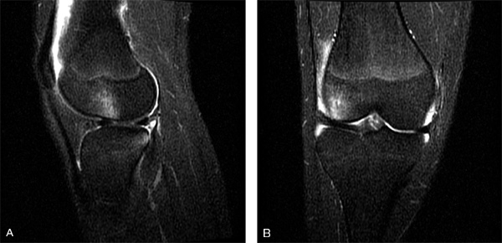
Occult Fractures & Bone Bruises
Evaluation
Pts typically present after trauma to knee
Joint effusion
Key to evaluate for ligamentous injury
Imaging
Plain films often negative
MRI
Best on T-2 fat suppressed
Short T-1 inversion recovery images

Slide 11
Occult Fractures & Bone Bruises
Treatment
Non-op
Protected WB until pain/swelling resolve
Repair of concomitant injuries as needed
Typically return to sports in 3 mos. (COR)
Surgical Indications
Impaction injury results in > 2mm displacement of articular surface of the weight bearing surface
Osteochondral fractures resulting in full focal thickness loss of cartilage
Rehab
~6 weeks of NWB
Strengthening & ROM exercises begin immediately
Return to impact & sport activities in 4-6 months

Slide 12
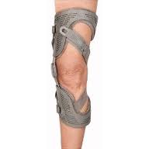
Blunt Injuries to Articular Cartilage
Treatment
Non-op
Protected WB until symptoms resolve
Unloader bracing with prolonged symptoms
Surgical:
Indications:
Prolonged symptoms or overt damage to the articular surface found on imaging
Arthroscopy
Chondroplasty: unstable flaps, loose chondral fragments
Full thickness chondral defects
Discussed later

Slide 13
Classification of Cartilage Damage

Slide 14
Classification of Cartilage Damage
Paunipagar, et al. (2014) Ind J Rad and Imaging, 24.3: 237-48

Slide 15
Osteochondritis Dissecans
Etiology still remains unclear
Repetitive microtrauma
Secondary effects of vascular insufficiency
Inherited factors
Compounded by including traumatic lesions
Classification based on location, fragmentation, displacement and status of growth plate
Skeletal age at onset of symptoms is most important prognostic factor
Influences timing and nature of treatment
Incidence: 0.02-0.03% by radiographs, 1.2% by knee arthroscopy
Highest rates age 10-15 years
Male to female 2:1
Bilateral in 15-30%
Crawford, et al. (2006) J Am Acad Orthop Surg 14: 90-100

Slide 16
Sites of lesions of osteochondritis dissecans of knee according to Heffi et al (A) and Aichroth (B).

Slide 17
Osteochondritis Dissecans
Evaluation
Pain w/o history of trauma
Typically present with poorly localized pain
Exam often yields TTP localized to anteriomedial aspect of knee
Persistent swelling/effusion
Locking & catching
Suggest loose OCD fragments
Wilson’s test – pain with internal rotatin of tibia during extension between 90-30deg relieved with external rotation
Imaging:
AP/lat/sunrise/notch views
MRI
Size of lesion
Cartilage & subchondral bone status
Signal intensity below lesion
Tc99m bone scans
Notes:
Add images of xrays

Slide 18
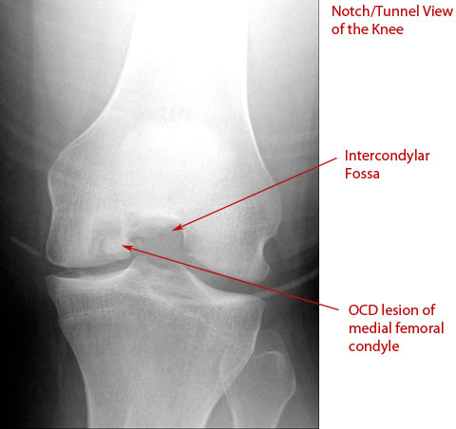
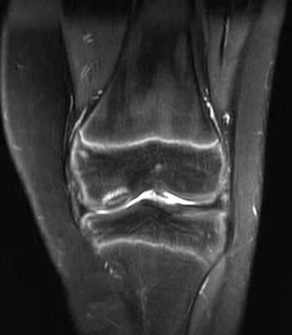

Slide 19
Stage | Arthroscopy | MRI | Radiographs
I | Irregularity and softening of articular cartilage; no definable fragment | Thickening of articular cartilage; low signal changes | Compression lesion; no visible fragment
II | Articular cartilage breached; definable fragment, not displaceable | Articular cartilage breached; low signal rim behind fragment indicating fibrous attachment | Fragment attached
III | Articular cartilage breached; definable fragment, displaceable, but attached by some overlying cartilage | Articular cartilage breached; high signal changes behind fragment indicating synovial fluid between fragment and underlying subchondral bone | Nondisplaced fragment without attachment
IV | Loose body | Loose body | Displaced fragment
Table 43-7 -- Staging Systems for Osteochondritis Dissecans
From Dipaola JD, Nelson DW, Colville MR: Characterizing osteochondral lesions by magnetic resonance imaging, Arthroscopy 7:101, 1991.

Slide 20
Treatment
Non-op
Stable lesions
Esp. with open physes
Activity modification
Protected WB
Signs of healing after 3-4 months?
Progression from rehab to sports/impact activities as tolerated
50% success rate in juvenile cases
Lower success rates
Larger lesion, skeletal maturity, location other than medial femoral condyle, lesion instability

Slide 21
Treatment
Surgical Indications
Failed non-op, unstable lesions, symptomatic in adults
Goals: maintenance/restoration of joint congruity and rigid fixation of unstable fragments when possible

Slide 22
/
Crawford & Safran 2006 JAAOS
Notes:
Add algorithm from crawford/safran review article Fig 4

Slide 23
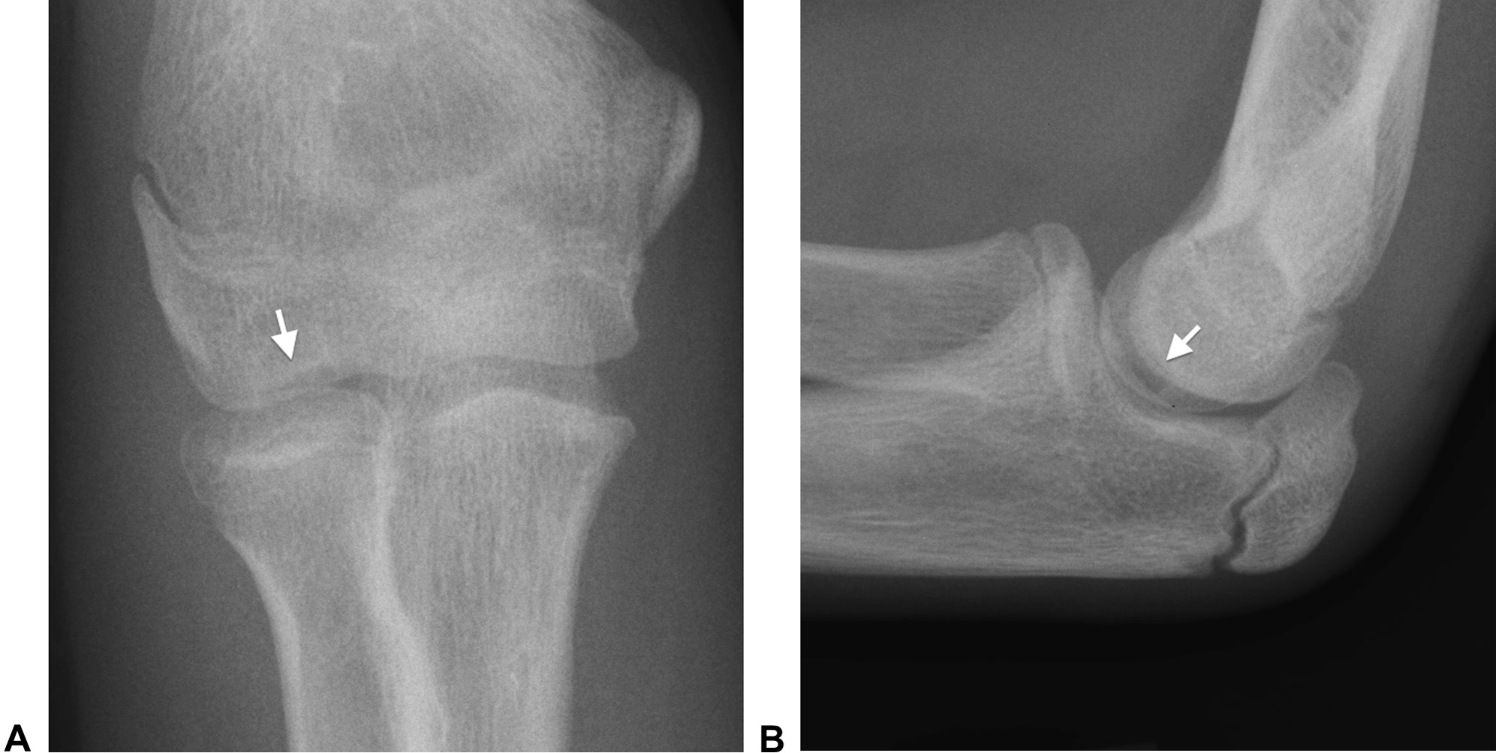
OCD Capitellum
May be confused with Panner disease
Not associated with trauma
Overhead athletes, gymnasts
Ruchelsman, et al. (2010) J Am Acad Orthop Surg 18: 557-67
Zlotolow, et al. (2014) JHS

Slide 24
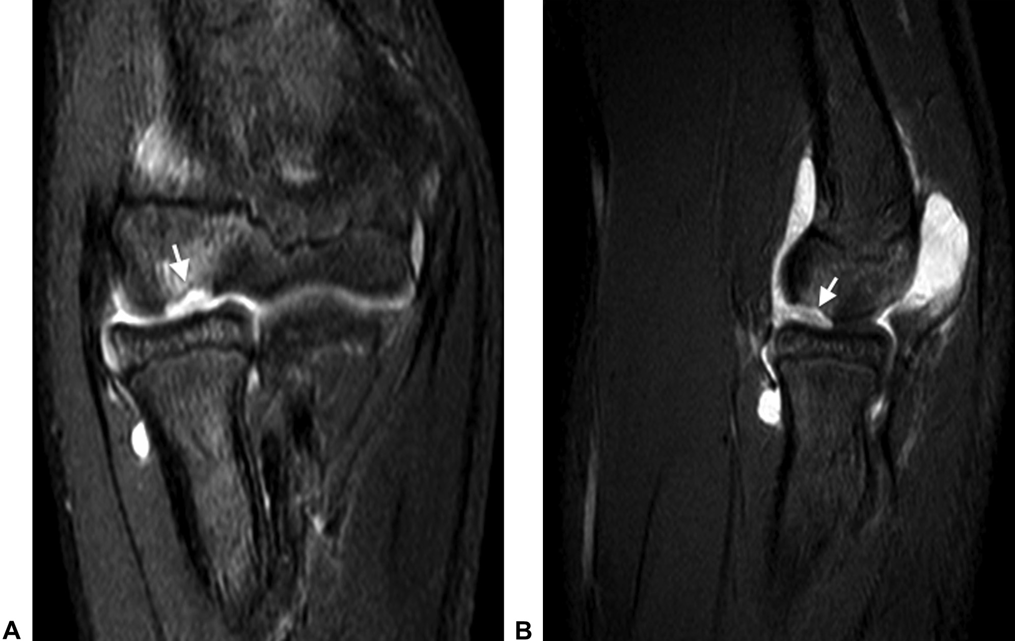
OCD Capitellum
Zlotolow, et al. (2014) JHS

Slide 25
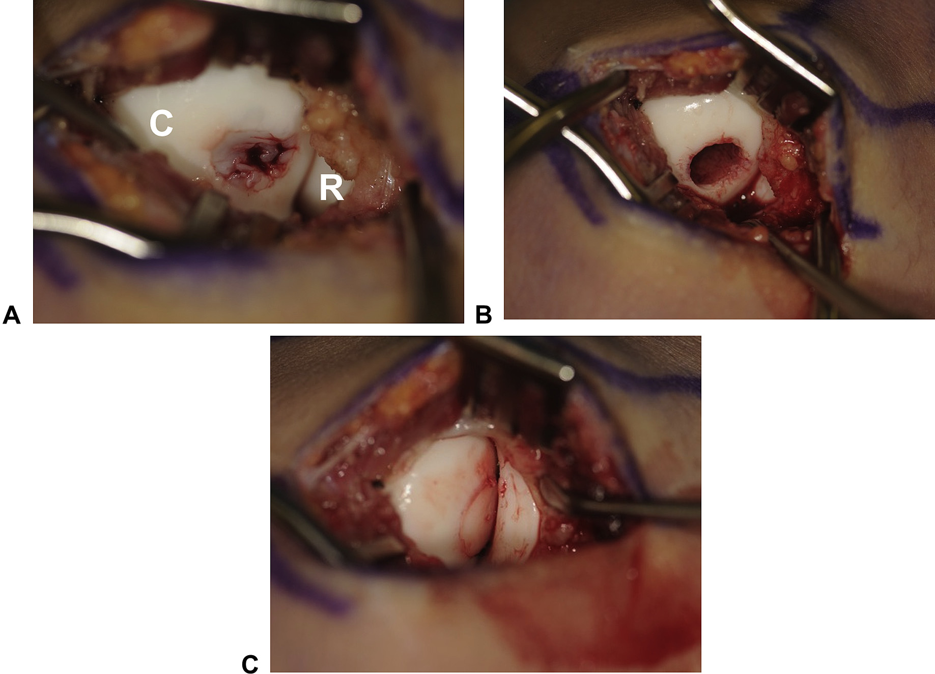
OCD Capitellum
Zlotolow, et al. (2014) JHS

Slide 26
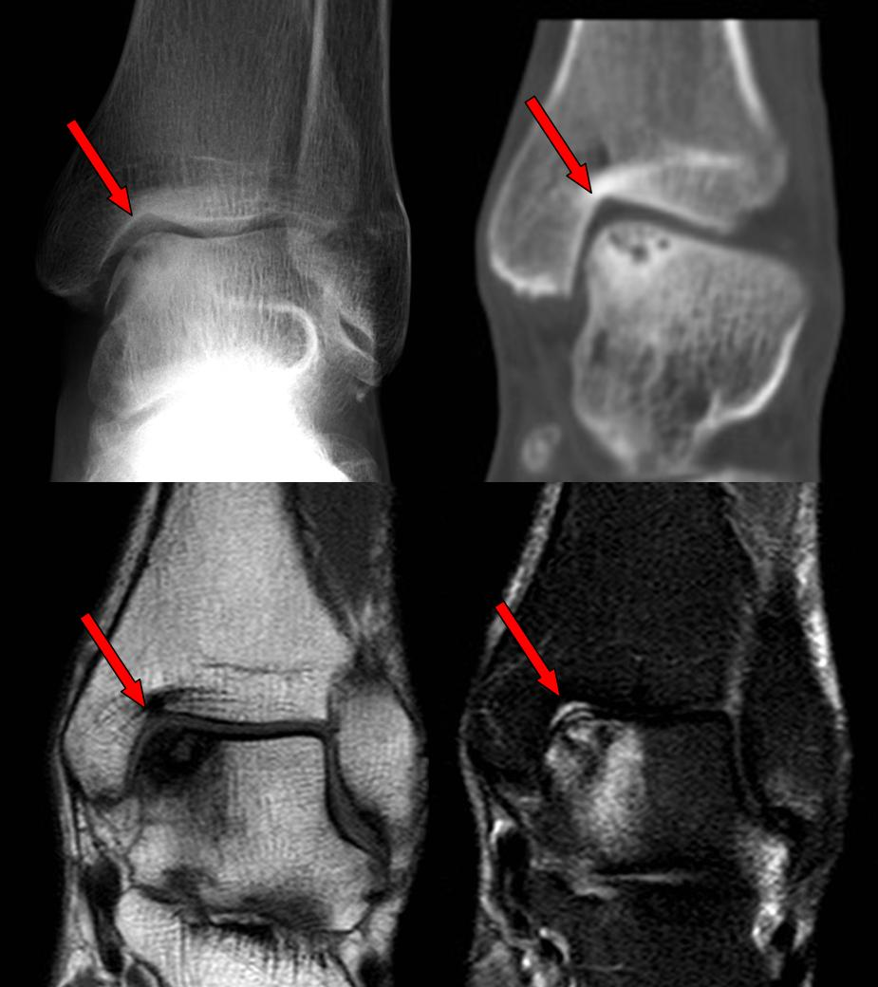
OCD Talus

Slide 27
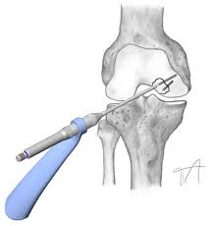
Treatment
Surgical procedures
Arthroscopic drilling for symptomatic stable lesions
Symptomatic stable lesions in juveniles
In unstable OCD lesions, any fibrous tissue found at the base of the lesions should be débrided
Options for fixation of unstable fragments (still relatively intact and congruous include):
Herbert screws
Cannulated screws
Bioabsorbable pins/screws
Options for OCD fragments <2 cm² in diameter deemed irreparable
Marrow stimulation techniques
Microfracture
Drilling arthroplasty
Abrasion arthroplasty
Other options
OATS
Osteochondral allograft reconstruction
ACI
Crawford, et al. (2006) J Am Acad Orthop Surg 14: 90-100

Slide 28
Microfracture
Considered first line treatment of full thickness cartilage defects
Minimally invasive
Technical ease
Low cost
Limited surgical morbidity

Slide 29
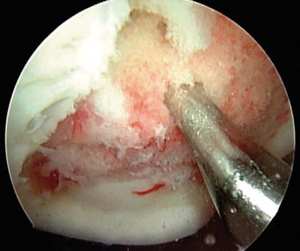
Microfracture
Lesion debrided to stable, squared off edges
Zone of calcified cartilage is removed
Not subchondral bone though
Cortical penetration
Medullary bleeding/ clot formation
Leave 1-2 mm bone bridges
Avoid confluence of holes
Surgical awl perpendicular to subchondral plate
Defect fills with fibrin clot
Vertical walls are key: reduces shear and compression

Slide 30
Microfracture
Healing Response
Clot formation
Undifferentiated (pluripotent) mesenchymal cells in clot mature to yield fibrocartilage repair tissue.
Vascular ingrowth
Tissue is mainly type I collagen
Compared to native hyaline cartilage (type II):
Inferior stiffness, poorer wear characteristics than normal hyaline cartilage

Slide 31
Microfracture
Post op
Up to 6 weeks of NWB
Use of CPM for 6 hours / day
Lesion in patellofemoral joint:
Wear a brace with flexion stop at 30º to limit patellofemoral contact
Weight bearing permitted

Slide 32
Microfracture
Outcomes
Steadman et al (Arthroscopy 2003):
80% of 71 knees in patients <45 yrs w/ isolated post-traumatic full thickness chondral defects improved at an average follow up of 7 yrs
Literature review of 28 studies with 3122 pts:
Clear improvement of knee function at 24 months but inconclusive durability at greater than 24 mos
McAdams et al 2009 Am J Sports Med

Slide 33
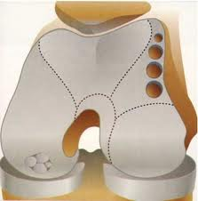
Osteochondral Autograft Transplantation (OAT)
Harvests viable, structurally intact cartilage and bone plugs from a less valuable portion of the joint, and transplanting to site of symptomatic cartilage injury.
Place donor plug flush with articular surface to achieve normal contact pressures over the healed graft
Articular gaps fill with fibrous tissue

Slide 34
OAT
Technique
Harvest from intercondylar notch or margins of condyles above sulcus terminalis
May use a small lateral arthrotomy
Patella can interfere w/ arthroscopic harvest
Depth of donor site
12-15mm
Recipient socket
2mm shorter than donor
Donor plug: can match size of defect (<10mm)
Donor plug flush with site
Centrally direct graft on insertion, via scope

Slide 35
OAT
Postop
NWB for 6 weeks
CPM for 6 hours per day
Progressive WB

Slide 36
OAT
Outcomes
Best results for < 2cm² lesions
Good results shown for < 4cm² lesions
Hangody and Fules (JBJS 2003):
831 pts over 10 yrs
92% had good to excellent results for femoral condylar mosaicplasty
79% patellar and/or trochlear mosaicplasty
87% tibial mosaicplasty
94% talar mosaiplasty

Slide 37
Osteochondral Allograft Transplantation
Useful for larger lesions (2-3.5+ cm²)
Typically 2nd line tx
Tissue matching/immunosuppression
Usually not necessary as chondrocytes are isolated by the cartilage matrix
Disadvantage: pts must be “on-call” when fresh (<28 days) allograft becomes available
Frozen can also be used

Slide 38
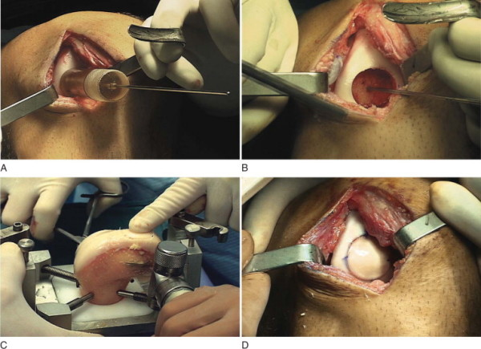
Osteochondral Allograft
Technique
Similar to autograft
Reamer converts defect to a circular recipient socket w/ uniform depth of 6-8mm
Pulse lavage before insertion
Reduce risk of graft immunogenicity
Press fit graft
Fixation can be augmented by metal compression screws

Slide 39
Osteochondral Allograft
Post op
TTWB first 6 weeks
Patellofemoral graft: limited to 45º flexion
CPM immediately after surgery

Slide 40
Autologous Chondrocyte Implantation
Ideal for symptomatic, unipolar, well contained defects from 3.5-10 cm²
Two-stage procedure

Slide 41
ACI
Stage 1:
Arthroscopic or parapatellar miniarthrotomy
Harvest 200-300mg of chondrocytes from nonessential portion of knee (stage I)
Specimen sent to Lab
Undergoes enzymatic removal of ECM, then culture expansion of chondrocytes
Placement in agarose gel

Slide 42
ACI
Stage 2:
At least 6 wks after biopsy
After preparation of recipient site(s), release tourniquet and achieve complete hemostasis
Periosteal patch sewn over defect
Cultured cells injected under patch
Sealed with fibrin glue

Slide 43
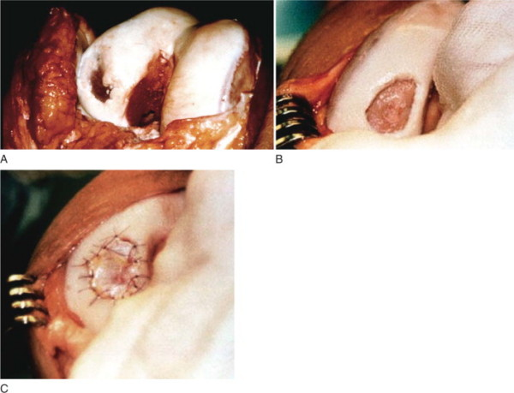
ACI

Slide 44
ACI
Periosteum:
Readily available from proximal medial tibia, distal to pes anserinus insertion
At least 2mm larger than defect
Contains pluripotent mesenchymal cells
Produces chondrogenic growth factors
Some porcine substitutes can be used
Neocartilage: superficial layer is fibrocartilaginous in nature (“hyaline-like”)

Slide 45
ACI
Post op
Restricted WB
CPM: 6-8 hours/ day
Patellofemoral lesions: full weight bearing in full extension

Slide 46
ACI
Outcomes
Good to excellent results in 51 of 61 patients at mean f/u of 7.4 yrs
Peterson et al. (Am J Sports Med 2002)
Fu et al: (Am J Sports Med 2005):
Retrospective cohort comparison of ACI vs arthroscopic debridement for lesions of femoral condyle or trochlea (58 pts) with min 3 yr f/u.
Better outcomes with ACI than debridement independent of lesion size
Median overall condition
Pain
Swelling

Slide 47
Surgical Alternatives for Treatment of Articular Cartilage Lesions - JAAOS 2000

Slide 48
Comparative Studies
Level I & II

Slide 49
ACI vs OAT
Level I prospective randomized clinical trial
58 ACI vs 42 mosaicplasty. Mean 19 mos f/u
Good to excellent outcome: 88% ACI, 69% OAT. (p = .277)
Subgroups:
-Medial femoral condyle: 88% ACI vs 74% OAT (p = .032)
-Lateral femoral condyle: 92% ACI vs 40% OAT (p = .182)
Key features
-Proud placement of OAT plugs, immediate WB for all pts,
-no CPM, cylinder cast placement immediately post-op.
Arthroscopy @ 1yr (comparing ICRS grade)
-82% good to excellent repair tissue in ACI
-34% good to excellent repair tissue in OAT
Limitations: variety of lesions and anatomic locations, small population, short f/u period, non standard postop protocol

Slide 50
ACI vs OAT
Horas et al. (JBJS 2003)
Level II prospective randomized trial
20 pts with ACI & 20 pts with OAT
Avg lesion 3.75 cm²
Tighter inclusion criteria
Both groups showed improvement
Recovery slower in ACI @ 6, 12, 24 months (Lysholm score)
Equal Meyers and Tegner activity scores
Limitations
Insufficient power, inadequate follow-up (less than 80% at 2 yrs), absence of control group

Slide 51
ACI vs Microfracture
Level 1 randomized controlled study.
40 ACI vs 40 microfracture, 12, 24 mos f/u
Significant improvement in both groups:
ACI (p=.003), microfracture(p=.0001)
At 2 yr f/u, no sig difference btw groups based on Tegner, Lysholm, visual analog scores
Microfracture improved more based on SF-36 physical component
2nd look arthroscopy (76% of patients):
No difference btw groups based on ICRS grading system
No significant differences in biopsy
Author’s conclusions: ACI and microfracture provided equal results over 2 yrs
Younger & more active pts had better outcomes in both groups

Slide 52
ACI vs Microfracture
Knutsen et al. (JBJS 2007)
5 yr Follow-Up of previous study
No significant differences between groups
9 failures in each group
1/3 of each group had radiographic OA at 5 yrs post-op

Slide 53
CCI vs Microfracture
Saris et al. (Am J Sports Med 2008)
CCI = characterized chondrocyte implantation
Designed to select for chondrocytes that express a marker profile more predictive of capacity to form hyaline-like cartilage
57 CCI vs 61 Microfracture pts
Both groups had clinically similar results at 6, 12, & 18 months
Biopsy at 1 year
Superior structural regeneration in CCI vs Microfracture
Improved longer-term outcomes?

Slide 54
OAT vs Microfracture
Level I prospective randomized study. 28 OAT vs 29 microfracture
All were regional/national athletes in Lithuania – avg age 24.3 yrs
Avg 4.3 plugs in Microfracture
Avg f/u 37 mos
Both groups showed improvement of HSS score
-OAT: from 77.99 to 91.08 (p<.0001)
-Microfracture: from 77.22 to 80.60 (p<.05)
Good to excellent results in 96% OAT and 52% microfrx
OAT: sig better results than microfrx at 1,2,3 yrs postop.
9 failures in microfrx group vs 1 failure in OAT group.
Worse Outcomes
Age > 30 yrs
Microfracture for lesions > 2 cm²

Slide 55
102 randomized to OAT, microfracture or debridement + ACL
Matched control group with intact cartilage + ACL
All 4 groups significantly improved
OAT significantly better than microfracture and debridement
Intact cartilage significantly greater than OAT

Slide 56
Conclusions
Comparative studies have not demonstrated superiority of ACI vs OAT
Microfracture may be as good as ACI
Arthroscopic OAT seems to provide better outcome than microfracture specifically for initial treatment of young athletes
Microfracture considered best first line tx overall, for full thickness articular cartilage lesions. Can be performed without a 2nd procedure and without an arthrotomy
No level I studies using a true natural history control group.

Slide 57
Comprehension Quiz

Slide 58
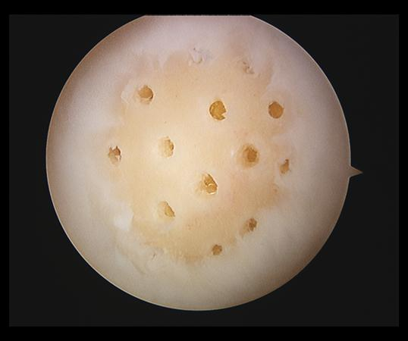
(SBQ07-32) A patient with a symptomatic chondral defect undergoes the arthroscopic procedure seen in Figure A. The reparative tissue would best be described as which of the following?
FIGURES: A
1. Fibrocartilage 2. Fibrous tissue 3. Elastofibroma 4. Hyaline cartilage 5. Chondromalacia

Slide 59
PREFERRED RESPONSE ▼ 1
The figure is an arthroscopic photo of a microfracture procedure, which creates a reparative tissue best described as fibrocartilage. Microfracture is a marrow stimulation technique where stem cells from the medullary canal are given access to the base of the lesion by making small perforations in the subchondral bone. The rationale for this technique is based on these stem cells differentiating into cells that will produce an articular cartilage repair. However, biopsy findings in animals and humans have demonstrated primarily a fibrocartilagenous repair tissue and not true articular cartilage regeneration. The collagen type found in hyaline or articular cartilage is of the type II variety. Fibrocartilage possesses some type II, but is mostly type I and III cartilage. Both the Intructional Course Lecture and the textbook by Buckwalter provide an in-depth review of articular cartilage biology and the background for chondral resurfacing techniques. Incrorrect Responses: 2. Fibrous tissue is created by fibrocytes and lacks type II collagen. 3. Elastofibroma is a distractor (elastofibroma dorsi is a fibrous tumor with a predeliction for the scapulothoracic joint). 4. Hyaline cartilage is true articular cartilage with predominantly type II collagen. It also has columnar organization and a lamina splendens (which differentiates it from what has been called hyaline-like tissue). 5. Chondromalacia refers abnormal softening of the cartilage and is a common pathologic condition of the the knee.
References:
2) Buckwalter JA, Mankin HJ: Articular cartilage: Degeneration and osteoarthritis, repair, regeneration, and transplantation. Instr Course Lect 1998;47:487-504
3) Buckwalter JA, Einhorn TA, Simon SR (eds): Orthopaedic Basic Science: Biology and Biomechanics of the Musculoskeletal System, ed 2. Rosemont, IL, American Academy of Orthopaedic Surgeons, 2000, pp 471-488

Slide 60
(OBQ10-257) Following a medial femoral condyle osteochondral autograft mosaicplasty, which of the following statements best describes the fixation of the graft?
1. Graft fixation strength increases linearly with time until subchondral union at 3 months 2. Graft fixation strength initially decreases during the early healing phase, and then increases with subchondral bone healing 3. Graft fixation strength does not change during the first 3 months following surgery 4. Graft fixation strength is enhanced by early weight bearing 5. Graft fixation strength initially increases over the first 6 weeks, then recedes with bony remodeling

Slide 61
PREFERRED RESPONSE ▼ 2
Following mosaicplasty, appropriate post-operative rehabilitation and weight-bearing status must be based upon the fixation of the osteochondral autograft plugs. Whiteside et al performed a porcine study evaluating the fixation strength of osteochondral autograft mosaicplasty during the first week following implantation. The graft fixation was notably weaker one week following surgery due to the post-operative response and host remodeling. These results suggest that protected weight bearing should be used until the osteochondral plugs have healed into the subchondral bone, generally by 3 months. However, early non-weight bearing motion is important to prevent stiffness and protect the joint surfaces with synovial fluid.
References:
2) Tyler TF, Johnson C, Jenkins WL. Rehabilitation following osteochondral injury to the knee.nee. Orthopaedic Knowledge Update: Sports Medicine 4. Rosemont, IL: American Academy of Orthopaedic Surgeons; 2009:257-262.
3) Whiteside RA, Bryant JT, Jakob RP, Mainil-Varlet P, Wyss UP. Short-term load bearing capacity of osteochondral autografts implanted by the mosaicplasty technique: an in vitro porcine model. J Biomech. 2003 Aug;36(8):1203-8. PMID:12831747 (Link to Abstract)

Slide 62
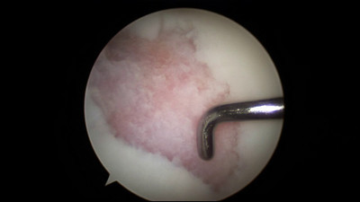
(OBQ08-94) A 32-year-old female is referred to you for definitive treatment of a symptomatic focal chondral defect on her medial femoral condyle. A photograph from a recent diagnostic arthroscopy shows the defect (Figure A), which measured 20 x 25mm after debridement. What surgical treatment would you reccomend?
FIGURES: A
1. Osteochondral autograft 2. Osteochondral allograft 3. Microfracture 4. Chondroplasty 5. Abrasion arthroplasty

Slide 63
PREFERRED RESPONSE ▼ 2
Based on the age of this patient and the size of this lesion (2 x 2.5 = approx 5cm square) an osteochondral allograft plug is the best choice. The results of microfracture are better for contained defects less than 2cm square. Autografts are generally reserved for smaller defects as well because harvesting enough plugs to fill this defect may lead to significant donor site morbidity. Chondroplasty and abrasion arthroplasty are not good solutions to this chondral defect in a young symptomatic patient. Autologous chondrocyte implantation (ACI) would also be a correct response, but it was not listed. Bert discusses the science, histology, history, and clinical results of abrasion arthroplasty for treatment of osteoarthritis of the knee. Alford et al. review the indications for treatment of chondral defects and describe the various treatment options. In addition, they discuss clinical scenarios regarding comorbid conditions including ligament instability, meniscal deficiency, and malalignment by developing a treatment algorithm (Illustration A).

